Slide 1




Notes:
Educator Note: Make sure all students have their workbooks with them.
Say: Hi again, everyone! I’m so happy to be with you again today. Before we get started on today’s lesson, I want to do a quick review of our last lesson and check to see how you did on your goals this week.

Slide 2
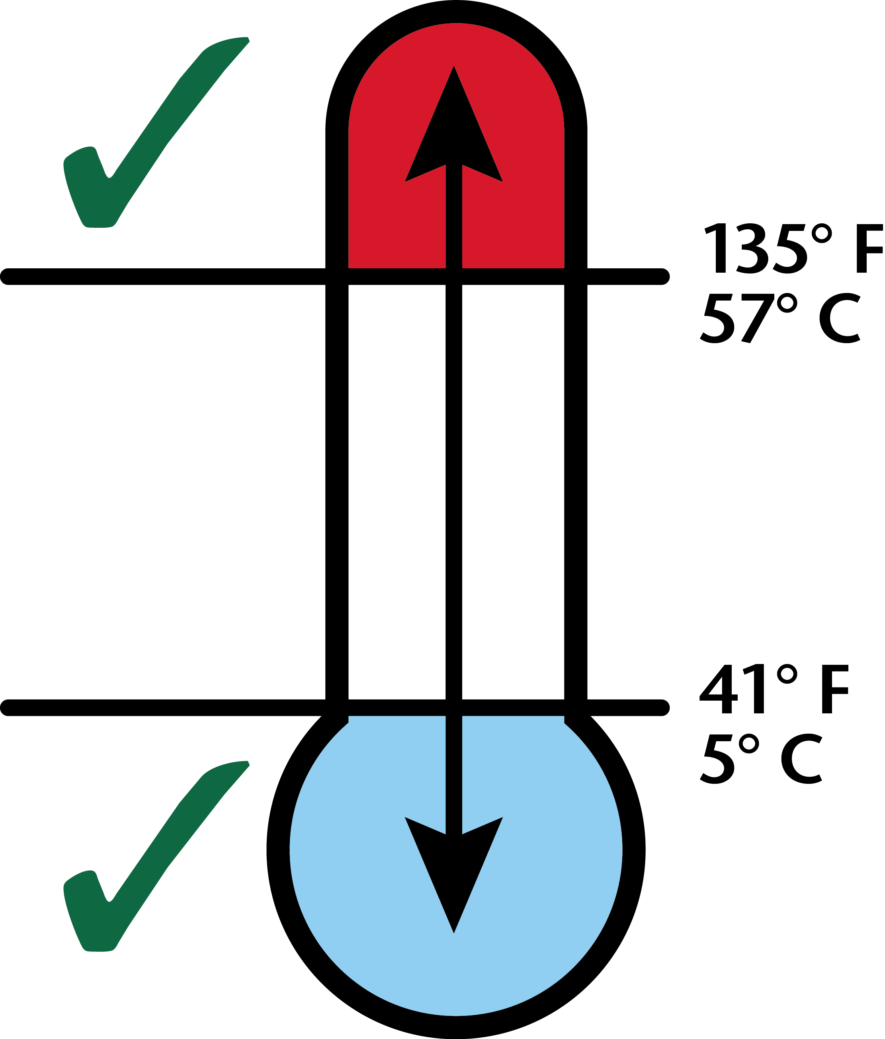


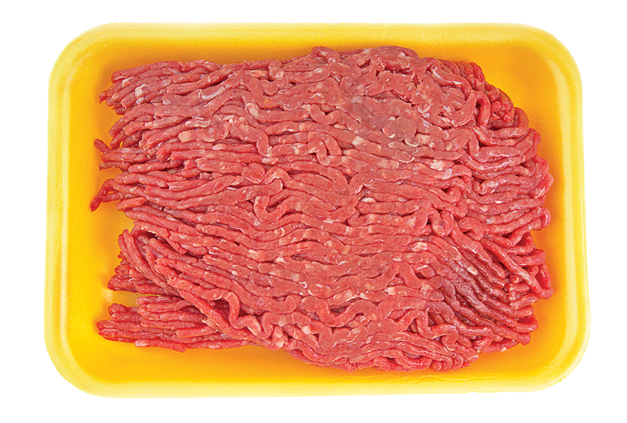
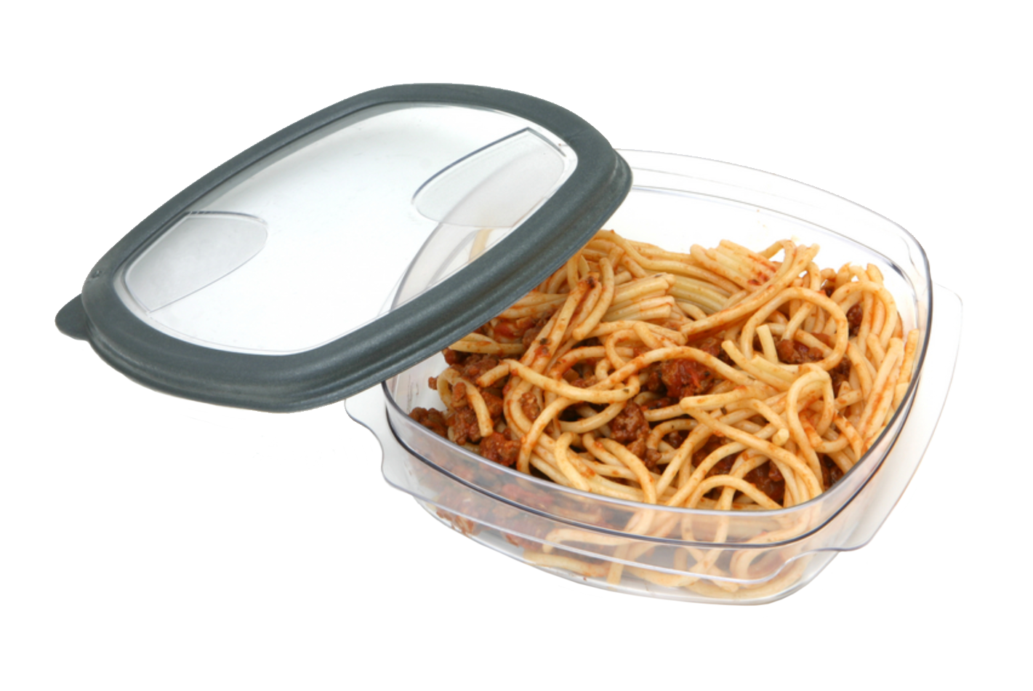
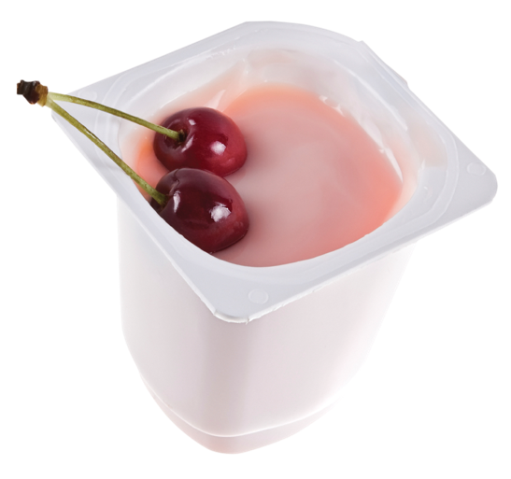

Food Safety
Notes:
[Educator Note: Your screen will be empty until you ask the first question.
ASK: Can anyone remind us what our lesson was about last week?
[Allow time for students to answer (Keeping food safe or food safety). Advance the slide to show “Food Safety” at the top after they provide the correct answer.
Say: That’s right! We learned about keeping food safe to eat.
ASK: What types of foods should you keep in a cold place like the refrigerator or freezer?
[Allow time for students to respond (milk, yogurt, meat, leftover).
ASK: What does it mean if one of those foods spoils?
[Allow time for students to respond ( the food got too warm and now it could make you sick if you eat it).
Say: Very good!
ASK: Does anyone remember what the danger zone is?
[Allow time for students to respond. May need to help students get to the answer (The danger zone is when food gets to an unsafe temperature. Foods should stay below 40 degrees or above 140 degrees). Advance the slide to show the Danger Zone thermometer.
ASK: Who remembers our Fight BAC words and motions?
[Allow time for students to respond, then advance the screen to show the Fight BAC graphic.
Say: Almost everyone raised their hand! I’m impressed!! Let’s do them together. CLEAN...SEPARATE...COOK...and CHILL!!

Slide 3
Notes:
ASK: Would someone share their progress on reaching their S.N.A.C.K. this past week? What was one of your goals and how many days did you reach it?
[Allow time for students to respond.
ASK: Did anyone try a new food? If so, what was it and did you like it?
[Allow time for students to respond.
Say: Raise your hands if you were able to reach your fitness goals at least 5 days this week.
[Allow time for students to respond.
Say: Raise your hands if you were able to reach your nutrition goals at least 5 days this week.
[Allow time for students to respond.
Say: Great job, everyone! I’m so proud of you for working towards your goals this week.
Today’s lesson is: Serve up Your Grains, Vegetables, and Fruits. Today, we will learn how:
Eating a variety of grains, vegetables, and fruits provides us with fiber, vitamins, and minerals.
Grains give you the energy to run, learn, work, and play.
Fruits and vegetables have essential vitamins and minerals to keep you from getting sick and heal cuts or bruises.

Slide 4
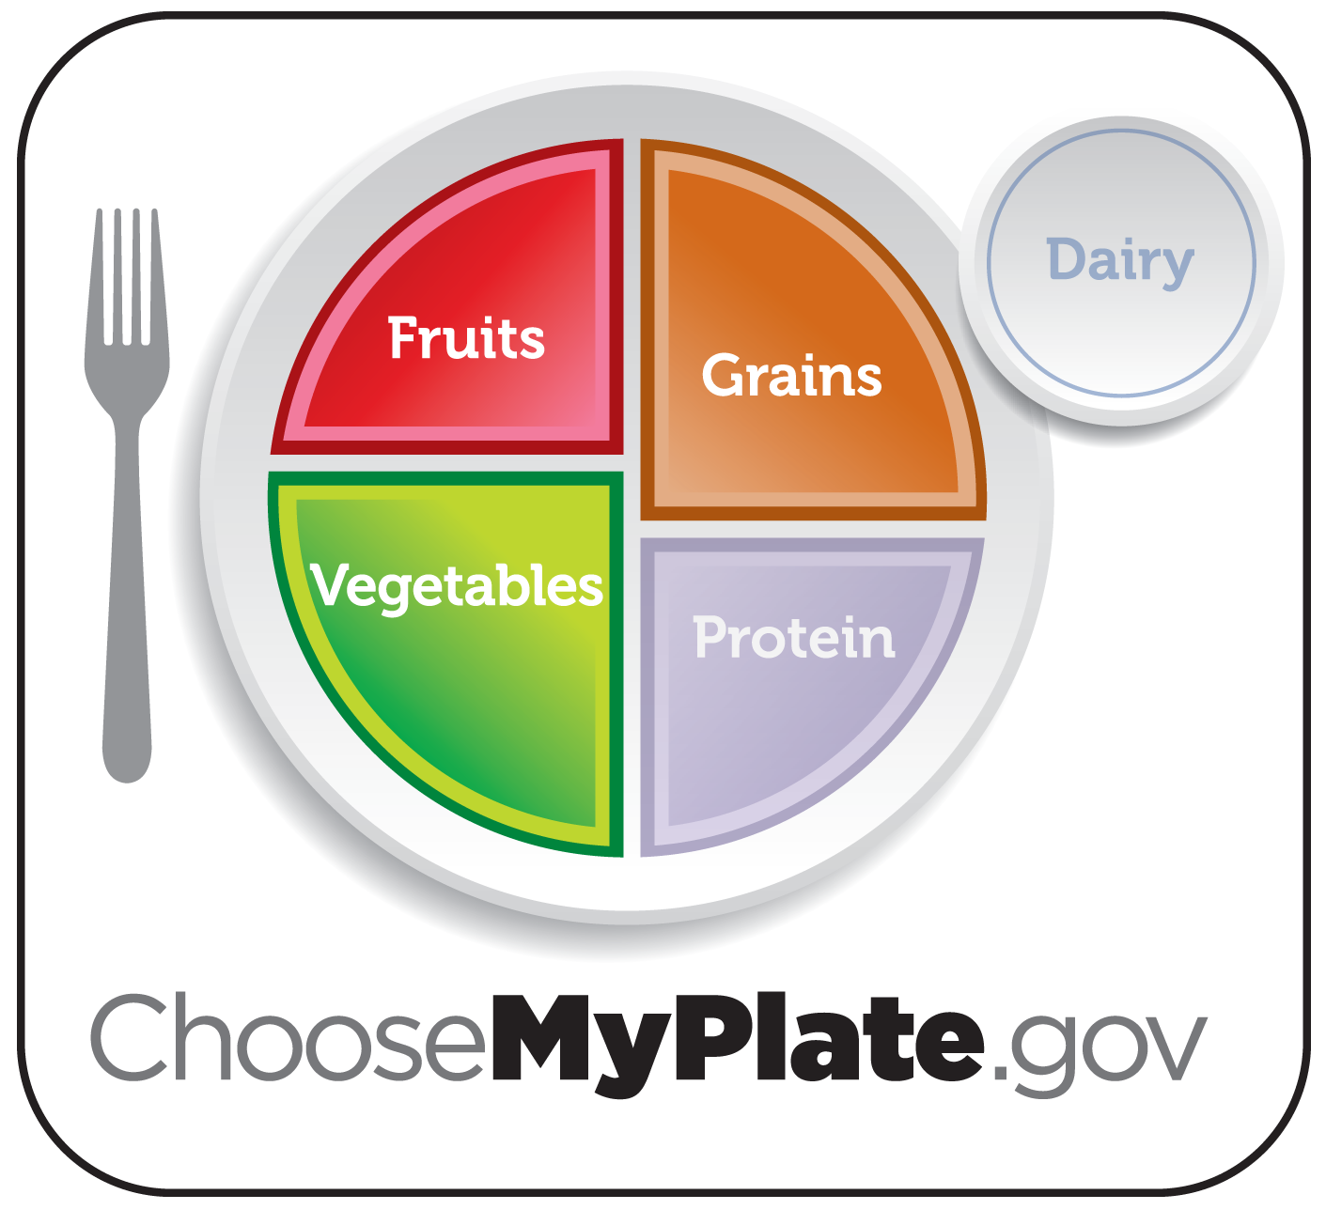
Notes:
[Educator Note: Only the left side of the screen will appear at first.
Say: Take a look at MyPlate. Today, we’re going to talk about three of the food groups: grains, vegetables, and fruits.
ASK: Can anyone tell me what colors represent these groups?
[Allow students to respond. (orange, green, red)
ASK: Can anyone tell me how much of your plate should be filled with vegetables and fruits? What about grains?
[Allow time for students to answer. (half the plate; and one quarter)
ASK: When you add those together, how much of your plate should be these foods?
[Allow students to respond. (three quarters – can demonstrate fraction math if students have trouble responding. ½ + ¼ - common denominator if 4, so multiply to change ½ to a quarter fraction ½ x2 = 2/4 2/4 + ¼ = ¾ )
Say: That’s right! When we think about our meals, think about the plate and how much of each food group should be on it. When you eat a variety of foods from each group every day you will have better health.
[Educator Note: As you discuss what these food groups give us, advance the slide to reveal each word: Fiber, Vitamins, and Minerals.
SAY: These food groups provide us with three things important to our health. Grains, vegetables, and fruits give us fiber, vitamins, and minerals. Fiber, vitamins, and minerals help our bodies to stay healthy and help prevent us from getting sick. When we eat enough grains, vegetables and fruits on a daily basis AND enough variety of these foods, our body has nutrients it needs to keep us healthy, Most of us don’t eat enough of these foods on daily basis. Today we’ll talk about how to choose more of these delicious and healthy foods.

Slide 5
Notes:
[Educator note: Be sure to have the MyPlate poster hanging up for reference.
Say: Let’s all turn to page 8 in the workbook please!
[Allow time for students to get to page 8.
Say: On page 8, we are looking at the amounts of grains, vegetables and fruits you need every day. Fill in the blanks with how many ounces of grains, cups of vegetables, and cups of fruits you need every day. We determined these amounts last week, so you can find this information on page 1 in your workbook. At the bottom of the page, write down your favorite fruit and vegetable on the blank lines.
[Allow time for students for complete the activity.
ASK: How many ounces of grains do we need every day?
[Allow time for student to answer (5 ounces).
ASK: What answer did you put for how many cups of vegetables we need each day?
[Allow time for students to give respond (2 ½ cups).
ASK: How many cups of fruit does our body need every day?
[Allow time for students to respond (1 ½ cups).
Say: Great job everyone! Choosing a variety of each of these foods everyday will help keep you healthy. Grains give you the energy to run, learn, work and play. We need the vitamins and minerals from the fruits and vegetables to prevent us from getting sick and to help heal cuts and bruises.
ASK: Who wants to share their favorite fruit and vegetable with the class?
[Allow time for a few students to respond.
Say: Fruits and vegetables come in a variety of colors: white, yellow/orange, green, blue/purple, and red.
ASK: Who can name a white fruit or vegetable? Yellow/orange? Green? Blue/purple? Red?
[Allow students to respond for each color.
SAY: Each color provides a specific set of vitamins and minerals that our bodies need. For good health, we need to include fruits and vegetables of every color in the foods we eat.
Optional activity: Ask teacher to have students track the colors of fruits and vegetables they eat for the week to see if students are able to eat fruits and vegetables from every color group.

Slide 6
Bran
Grains give us energy!
Endosperm
Germ
Notes:
[Educator Note: students will need crayons or markers to complete this activity.
[Optional Activity: You can also use the 3-part grain model provided with your Teen Cuisine Curriculum with this activity to further explain what is lost when the grain is refined.
Say: Let’s begin today by focusing on the grains group. Please turn to page 9 in your workbook. Grains are very important because they give us energy to think, grow, and play everyday! As we choose foods from the grain group, we want to make at least half of our grains whole grains. But what does that really mean? A grain has three parts. If all three parts are still present in the food, it is a whole grain. If some parts have been removed, it is a refined grain. It is important to choose whole grains because these grains contain the most fiber, vitamins, and minerals.
ASK: You need 5 ounces of whole grains a day, so how many ounces should be whole grains?
[Allow students to respond. (2 ½ ounces)
ASK: Can anyone name the 3 parts of a whole grain? Here’s a hint: there is a word bank for you to use on page 9.
[Allow time for students to answer (bran, endosperm and germ).
Say: That’s right! Now let’s identify each of the 3 parts of a whole grain and color each area a different color.
ASK: Who thinks they know what the outer shell of the whole grain is called?
[Allow time for students to answer (bran). Click to advance slide to reveal the answer.
ASK: Who can tell me what the inner shell the whole grain is called?
[Allow time for students to answer (endosperm). Click to advance slide to reveal the answer.
Say: That’s right! That leaves us with the center part of the whole grain called the germ.
[Advance slide to reveal the answer.
Say: Good job everyone. Go ahead and take a couple of minutes to color in the three sections.
[Allow time for students to complete the activity.
Say: You can remember the three parts of the whole grain by using the acronym B.E.G. for bran, endosperm and germ. When you go home, you want to BEG your parents to purchase more whole grain products
ASK: We should try to make sure that at least half of the grain products we eat each day are whole grain products. What are the benefits of making at least half your grain whole grains every day?
[Allow time for students response (grains give us energy, fiber, vitamins and minerals).
ASK: What is one food that you love to eat that has whole grains?
[Allow time for student response. (answers will vary)
Say: A great snack that is whole grain is popcorn! Air-popped popcorn is one of your best bets for a low-calorie, low-fat, high-fiber snack. Unlike many less-than-healthy snacks, popcorn is a whole grain that can help you fulfill the daily grain requirement. A 3-cup serving of air-popped popcorn is equivalent to 1 ounce of grains. Keep your popcorn low in calories by avoiding high-fat toppings like butter.
Say: It is important to eat whole grains foods everyday so your body can get more fiber, energy, vitamins and minerals.

Slide 7
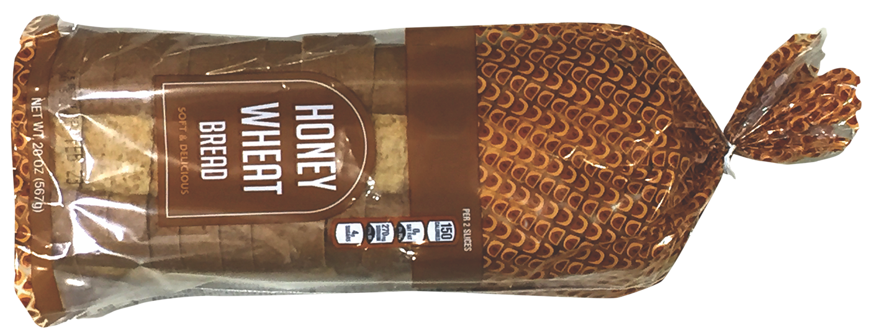
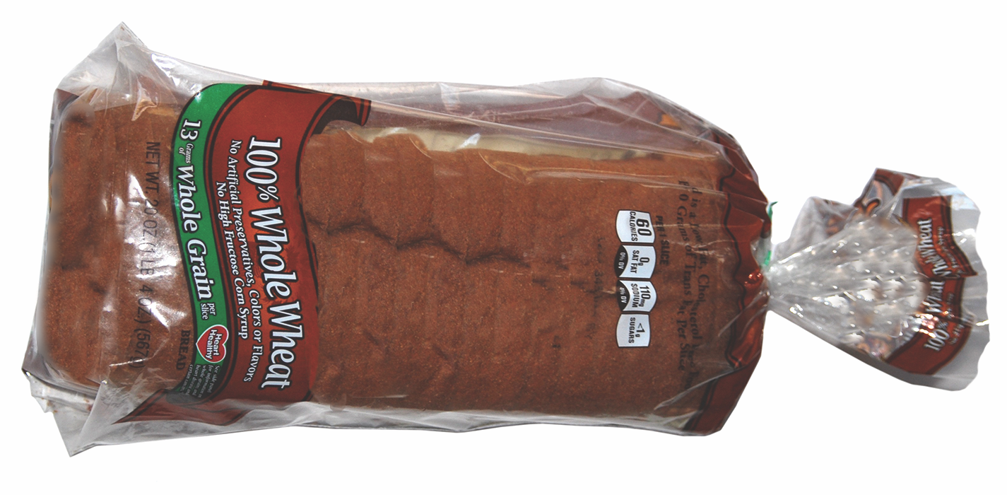
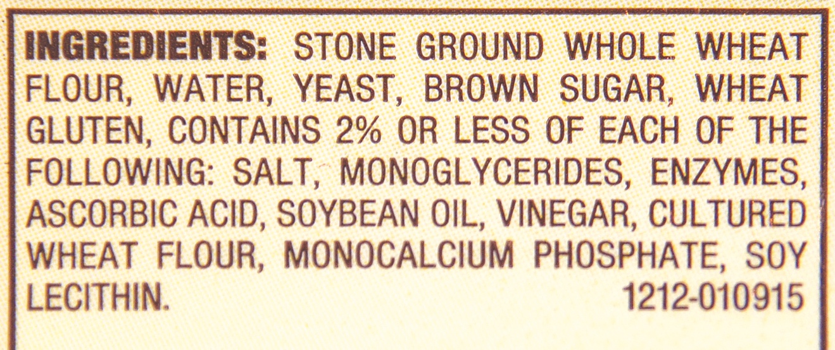
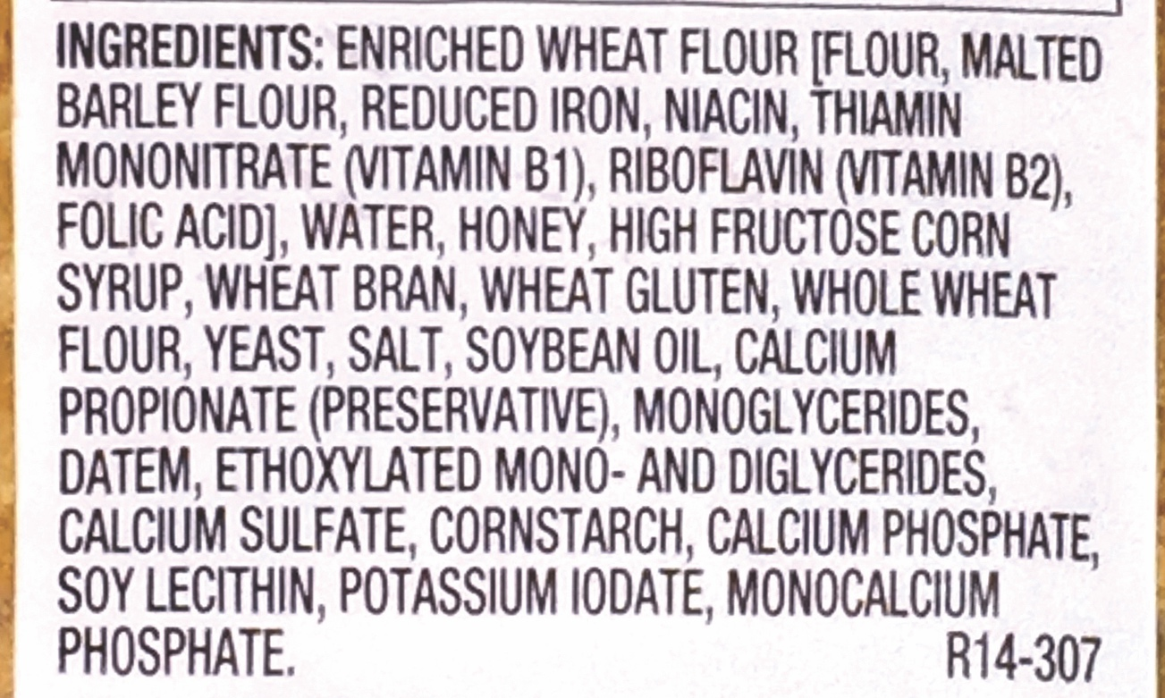
Notes:
ASK: Now that we know that whole grain includes all three parts of the grain, how do we know what foods are whole grains?
[Allow students to respond.
Say: A lot of people think that a darker food is a whole grain food, but this is not always true. Take a look at the two food labels of these breads.
ASK: Which one is the whole grain? How do we know?
[Allow students to respond. (Whole grain is listed in the ingredient list.

Slide 8
Let’s Get Active!
Notes:
Say: Who is ready to move around and do some fun physical activity? Physical activity keeps our bodies healthy and strong. Cardio activities make your heartbeat faster. This type of activity is important for heart health. Today, I am going to read a story about the food groups and every time you hear the words GRAIN, DAIRY, VEGETABLE, FRUIT, or PROTEIN you will do an action. These actions will get your heart pumping faster so they are good cardio activities.
Educator note: Demonstrate each action below.
Say: Let’s go over the motions/actions for this story. Everyone stand beside their desks so we can practice together. When you hear the word GRAINS you will do three jumping jacks. For the word VEGETABLES you will do six high knee lifts. When you hear DAIRY make five circles with your arms out to the side. For the word FRUITS you will push your arms above your head like you are “raising the roof” seven times. And when you hear the word PROTEIN, do the backpack kids dance move (shake your hips side to side, clench your fist and sway your arms in the opposite motion of your hips)
[Demonstrate the movements with them and practice them a couple times.
ASK: Who is ready to get active?
[Allow students to respond.
[Educator Note: You may want to ask teacher to read and you demonstrate or visa versa. If you have a teen volunteer, ask them to demonstrate the moves to the children. Be sure to pause when you say the food group names to give the students time to complete their actions.
Say: Okay get ready! I am going to read the story now.
I am GRAINS. GRAINS give us fiber, minerals, vitamins and most importantly, energy! Strive to eat 5 ounces of GRAINS each day. Half of our GRAINS should be whole GRAINS.
I am VEGETABLES. VEGETABLES come in many colors! VEGETABLE color groups are white, yellow/orange, green, blue/purple, and red. You should try to eat more red, dark green, and orange VEGETABLES. We should eat 2 ½ cups of VEGETABLES every day.
You can get many vitamins and minerals from FRUITS and VEGETABLES. Fresh FRUITS and VEGETABLES also contain a lot of fiber. FRUITS and VEGETABLES can be canned, frozen, or fresh. We need to eat 1 ½ cups of FRUITS each day.
DAIRY products give our bodies calcium. Calcium helps build strong teeth and bones which is why DAIRY is so important. One DAIRY food that many people like to eat is cheese. We should choose low-fat or fat-free DAIRY foods. Our bodies need about 3 cups of DAIRY every day.
PROTEIN foods help us have strong muscles. It is best to choose lean foods from the PROTEIN foods group. When we choose lean PROTEIN foods, our bodies can grow and get stronger. We need to have 5 ounces of lean PROTEIN each day.
As you can see, it is important to eat foods from all the food groups - GRAINS, VEGETABLES, FRUITS, DAIRY AND PROTEIN - in order to have a healthy diet to help us grow, play and learn every day.
ASK Did everyone have fun with our physical activity today?
[Allow time for response.
Say: Remember to do at least 60 minutes of physical activity every day to keep our bodies healthy and strong.
Educator Note: Refer teacher to website for optional Movin’ Groovin’ video assignment.

Slide 9
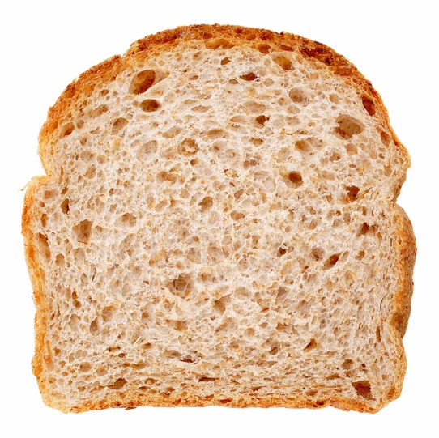
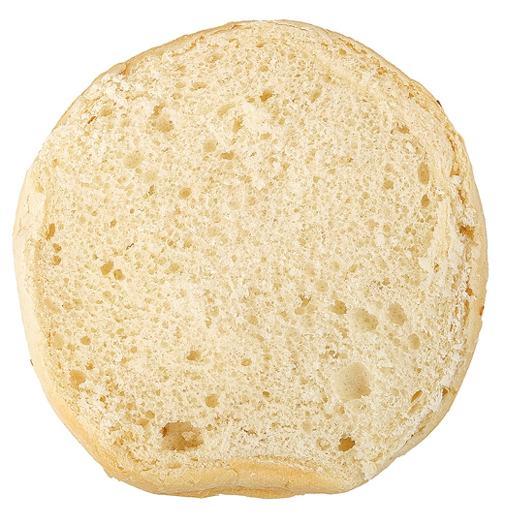
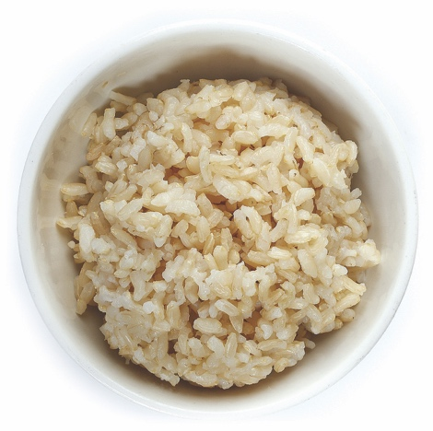
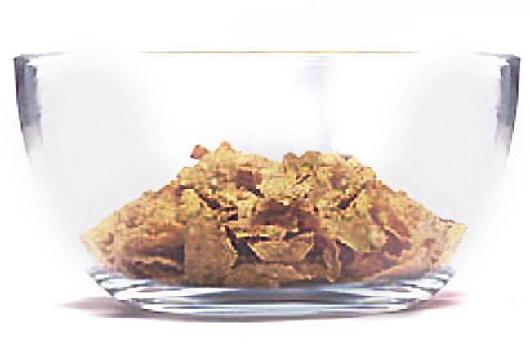
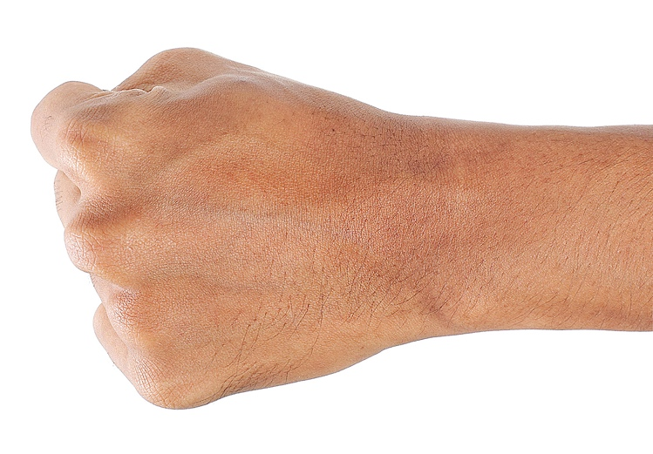
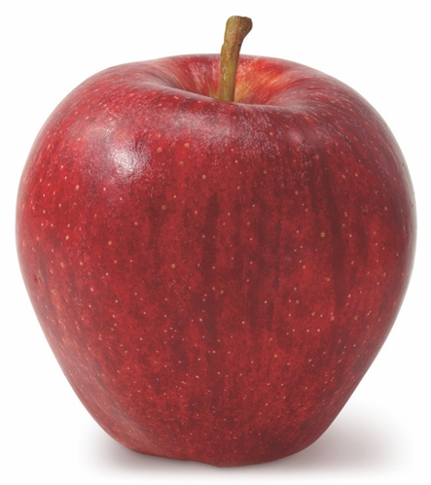
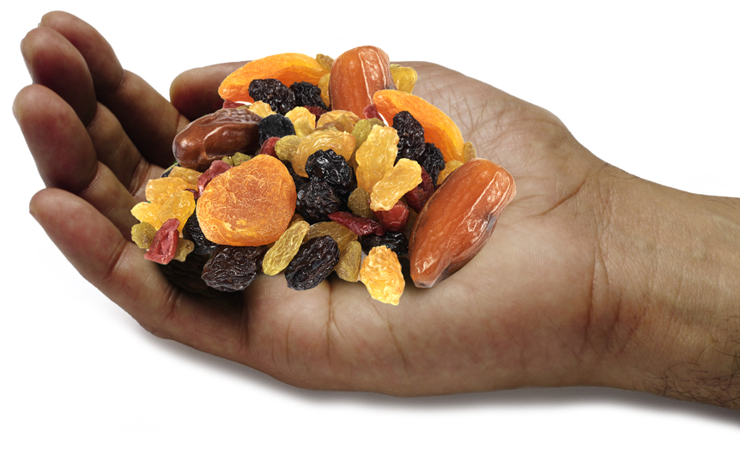
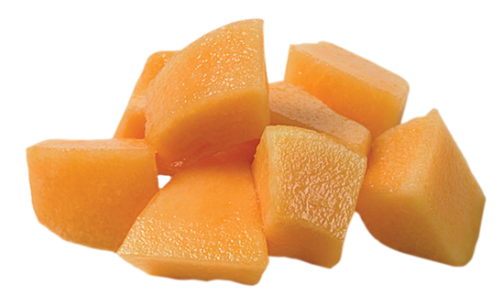
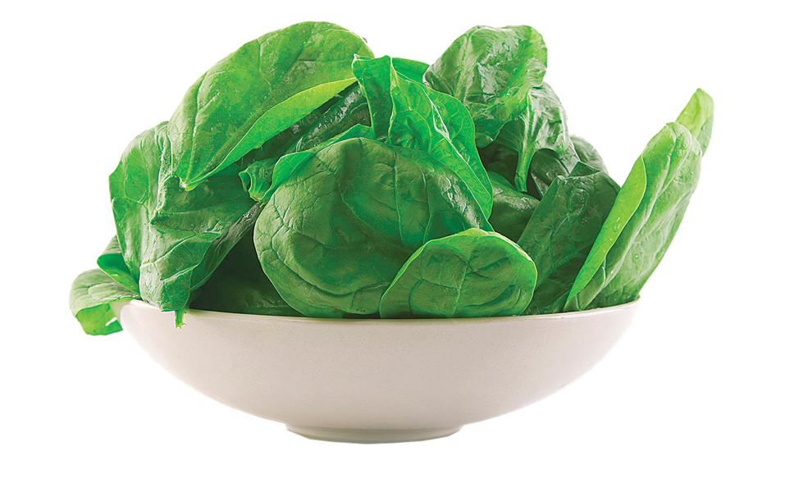
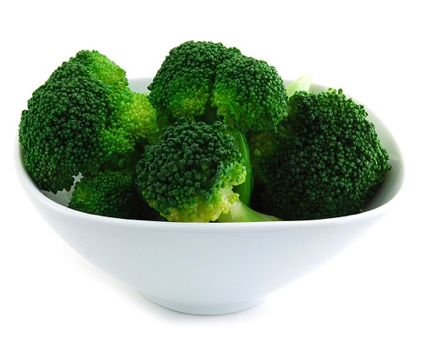
What is a serving?
1 slice
of bread
1/2 of a
hamburger bun
1/2 cup
of brown rice
3/4 cup
of cereal
Apple
1/2 cup cut fruit
1 handful dried fruit
1/2 cup cooked vegetables
2 cups of leafy greens
Notes:
Educator Note: If possible, use food models to show serving sizes.
SAY: To get the right amount of grains, fruits, and vegetables, we need to know what a serving is. A serving for grains is one ounce. But what does that look like? A one ounce serving of grains could be a slice of bread, half of a hamburger bun, ½ cup of rice, or 1 cup of dry cereal. All of these are about 1 ounce.
Fruit and vegetable servings are measured in cups. For whole fruits, a serving size is one piece of medium fruit. A serving size of cut fruit is ½ cup and a serving size of dried fruit is ¼ cup.
For vegetables, a serving size is ½ cup cooked vegetables or 2 cups of leafy greens.
ASK: Why do you think a serving is 1 cup of leafy greens? That’s a lot larger than ½ cup.
[Allow students to respond. Leafy greens have a lot of air between the leaves, so if they are compressed, 2 cups equals a serving.

Slide 10
Notes:
Say: Please turn to page 10 in the workbook. On this page you will complete the activity “Serve it Up”. Circle the correct serving size for each food shown.
[Allow time for students to complete the activity. Go over their choices when they are done. Each click will show the correct answer circled on the screen.
Educator Note: For the photo of the potato, state that they are to imagine that this potato is diced and cooked.
ASK: Is everyone finished?
[Allow time for response.
Say: The first food is bread.
ASK: How much bread do you think is one serving?
[Allow time for response (1 slice).
Say: That’s right!. The next food is carrots.
ASK: What do you think is the right amount for one serving of carrots?
[Allow time for response ( ½ cup).
Say: Correct! Now let’s look at the apple.
ASK: This one is tricky. What is one serving?
[Allow time for response (1 medium apple).
Say: Very good! The next food is rice.
ASK: Which answer equals the correct amount for one serving of rice?
[Allow time for response. (½ cup)
Say: That’s right! Now we will look at potatoes.
ASK: For one serving of potatoes how much would you put on you plate?
[Allow time for response (1/2 cup). If the potato was baked, the serving size would be ½ medium potato.
Say: Great job, that’s correct! The last food is grapes.
ASK: What is one serving of grapes equal to?
[Allow time for response (½ cup).
Say: Great job everyone!

Slide 11

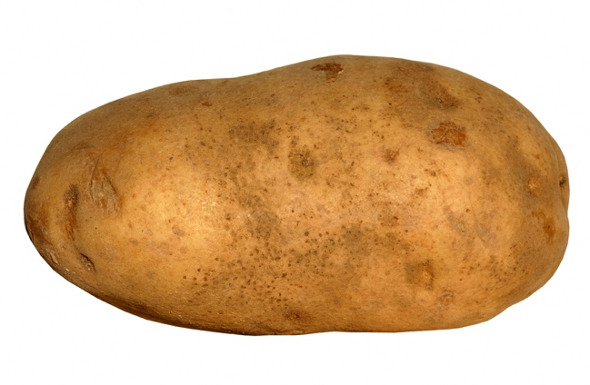
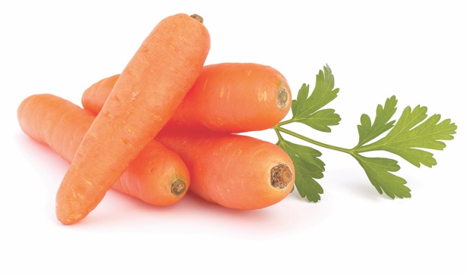
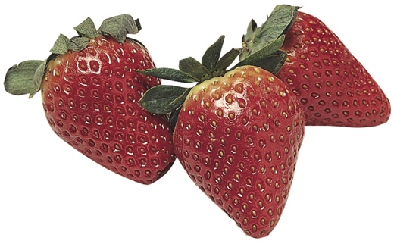
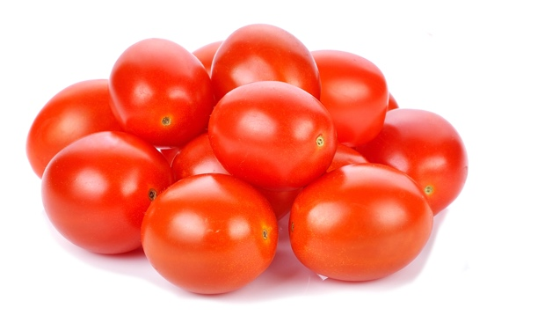
Vegetables and Fruits: Go for the Colors
2½ cups vegetables each day 1½ cups fruit each day
Breakfast | 1/2 cup sliced strawberries on cereal
Lunch | 1 cup leafy greens (equal to 1/2 cup) and 1/2 cup tomato
Dinner | 1 baked potato (equal to 1 cup)
Snacks | 1/2 cup baby carrots
Notes:
Educator Note: Divide the students into small groups.
Say: Take a look at this chart. This is a chart of the fruits and vegetables I had in my meals and snacks yesterday. With your group, decide whether or not I had 2 ½ cups of vegetables and 1 ½ cups of fruit. Once you determine whether or not I met the recommendations for the day, list the different color groups of fruits and vegetables I included.
[Allow students time to discuss.
ASK: Did I get enough vegetables for the day?
[Call on group to respond. (1 cup leafy greens, ½ cup tomato, 1 baked potato, ½ cup baby carrots = 2 ½ cups, yes)
ASK: Did I get enough fruit for the day?
[Call on a group to respond. (1/2 cup strawberries = ½ cup, no)
ASK: What could I have included to reach 1 ½ cups of fruit for the day?
[Call on group to respond. (multiple answers that add up to 1 cup will be correct).
ASK: What colors did I include?
[Allow students to respond. (red, green, white, orange)
ASK: What color group did I miss?
[Allow students to respond. (blue/purple)
Say: I could have had both blueberries and strawberries on my cereal and then I would have included every color. A vegetable we haven’t talked much about are beans and peas. Beans and peas are extra special vegetables. Not only do they provide our bodies with fiber, vitamins, and minerals, but they also provide us with protein. So, don’t forget the beans and peas!

Slide 12
Notes:
[Educator note: Students will need crayons or colored pencils for this workbook page.
[Optional: The students could write the names of the food items in the appropriate sections instead of drawing the foods.
Say: Everyone please turn to page 11 in the workbook. Using what you have learned today, your will create a lunch menu that includes all food groups shown on the plate. Write your menu at the bottom of the page. Once you have the menu, draw or write each food in the correct space on the plate. Be sure to choose a whole grain and make the plate colorful with lots of fruits and vegetables.
[Allow time for students to draw/write their meal. Once students are finished, ask the questions below.
ASK: What is one food you put on your plate and what food group does it belong to?
[Allow time for student response (Ask a few different students; answers will vary. Praise students for choosing whole grains and colorful fruits and vegetables.).
Say: Let’s ask your teacher Mr./Ms. _____ what they would put on their lunch plate.
ASK: Mr./Ms.______ what is a fruit you would put on your plate for lunch?
[Allow time for teacher response.
Say: That’s great! Everyone chose such yummy fruits, vegetables and whole grain items for their lunch plate. All your plates are colorful with the different foods you chose. Remember it is important to eat a variety of foods from each food group so you will always have a colorful plate.

Slide 13
Notes:
Say: Let’s all turn to page 12 in the workbook. On this page you will see a recipe for Cool and Radiant Raisin Salad. Yum!
ASK: When you look over the recipe for this dish what ingredient has a star next to it?
[Allow time for student response. (carrots)
Say: That’s right! Carrots are the starred ingredient. Carrots are in the vegetable group.
ASK: Does anyone remember what vegetables do for our bodies?
[Allow time for students to respond. You may have to guide them to the answer (helps heal cuts and bruises, good source of fiber,vitamins and minerals, prevent sickness).
Say: Correct! Vegetables help our bodies heal and can be a good source of fiber, vitamins, and minerals. If you look near the bottom of the Nutrition Information box, you can see that carrots are an excellent source of vitamin A and a good source of Vitamin C. Vitamin A is important for good eyesight! Vitamin A also helps our bodies fight infection and keep our hair and skin healthy.. Vitamin C helps strengthen our immune system and helps cuts to heal. Adding carrots to your daily meals is a great idea to keep your body healthy so you can continue to think, grow and play.
ASK: Where can you buy carrots for this recipe?
[Allow time for response (answers will vary, grocery, farmers market, farm stand, corner store).
Say: A good place to buy carrots is at your local farmers market or produce stand! Purchase extra to have as a healthy snack!

Slide 14
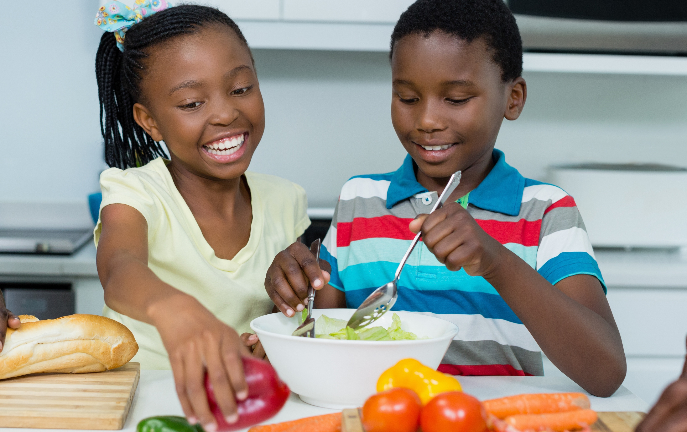
FOOD TASTING
Notes:
[Educator Note: Hide this slide if you are not doing a food tasting.
[Suggested food tasting for this lesson is Cool Carrot and Radiant Raisin Salad. Talk with teacher ahead of time to ask if this is a recipe she would like to make to demonstrate following a recipe and measuring or if it can be prepared ahead of time by food service staff. The recipe can be pre-made if the school allows it in their policies. Alternate food tasting: one whole grain, one fruit, one vegetable or pre-made quinoa salad with apples and carrots.
Say: Today we’re going to make this Cool Carrot and Radiant Raisin Salad. Before we get started, everyone will need to wash (or sanitize) their hands.
[Read the recipe. Demonstrate shredding carrots. Allow students to assemble a snack (2 T. carrots, ½ t. crushed pineapple, 2-3 raisins, ½ t. yogurt) OR allow students to taste pre-made samples. Leave out the sugar if students are assembling the snack.

Slide 15

Notes:
Say: Turn to page 13 in your workbook. It’s time for another SNACK goal this week. Remember the goals your create for yourself need to be small, needed, achievable, something that can be counted, and that you know-how to do. There are some examples at the top of the page if you need help. For your nutrition goal this week, make a goal about grains, fruits or vegetables. Don’t forget to include a fitness goal. While you think about your goals, I will come around and put the Grains, Vegetables and Fruits sticker on your page.

Slide 16

LET’S
REVIEW!
Notes:
Say: Excellent job today! Let’s review what we discussed today about grains, vegetables and fruits.
ASK: What colors on the MyPlate represent these food groups?
[Allow time for response (red, orange, green).
ASK: What do all three groups have in common?
[Allow time for response (they all have fiber, vitamins and minerals).
Ask: How do grains help our bodies?
[Allow time for students to respond (grains give our bodies energy and provide fiber).
ASK: What are the three parts of the whole grain?
[Allow time for students to respond (Bran, Endosperm and Germ).
ASK: How do fruits and vegetables help us?
[Allow time for students to respond (fruits and vegetables provide us fiber, vitamins and minerals.
SAY: In summary:
Eating a variety of grains, vegetables, and fruits provides us with fiber, vitamins, and minerals.
Grains give you the energy to run, learn, work, and play.
Fruits and vegetables have essential vitamins and minerals to keep you from getting sick and heal cuts or bruises.
Great job with today’s lesson! It’s important to eat a variety of different grains, fruits and vegetables so that you can get all the vitamins and minerals your bodies needs to think, grow and play every day.

Slide 17
Notes:
Say: Great job everyone! I’ve really enjoyed my time with you today and I hope that you have enjoyed it as well.
When I come back next week, we will talk about dairy and protein foods!

