Slide 1




Notes:
PA: Good morning/afternoon boys and girls.
Who remembers my name? (Allow students to respond.)
And who do I work for? (Allow students to respond.)
During our time together, we’ve been learning how you can stay on track with your food groups and fitness. Let’s keep riding the rails on the Food Group Express

Slide 2
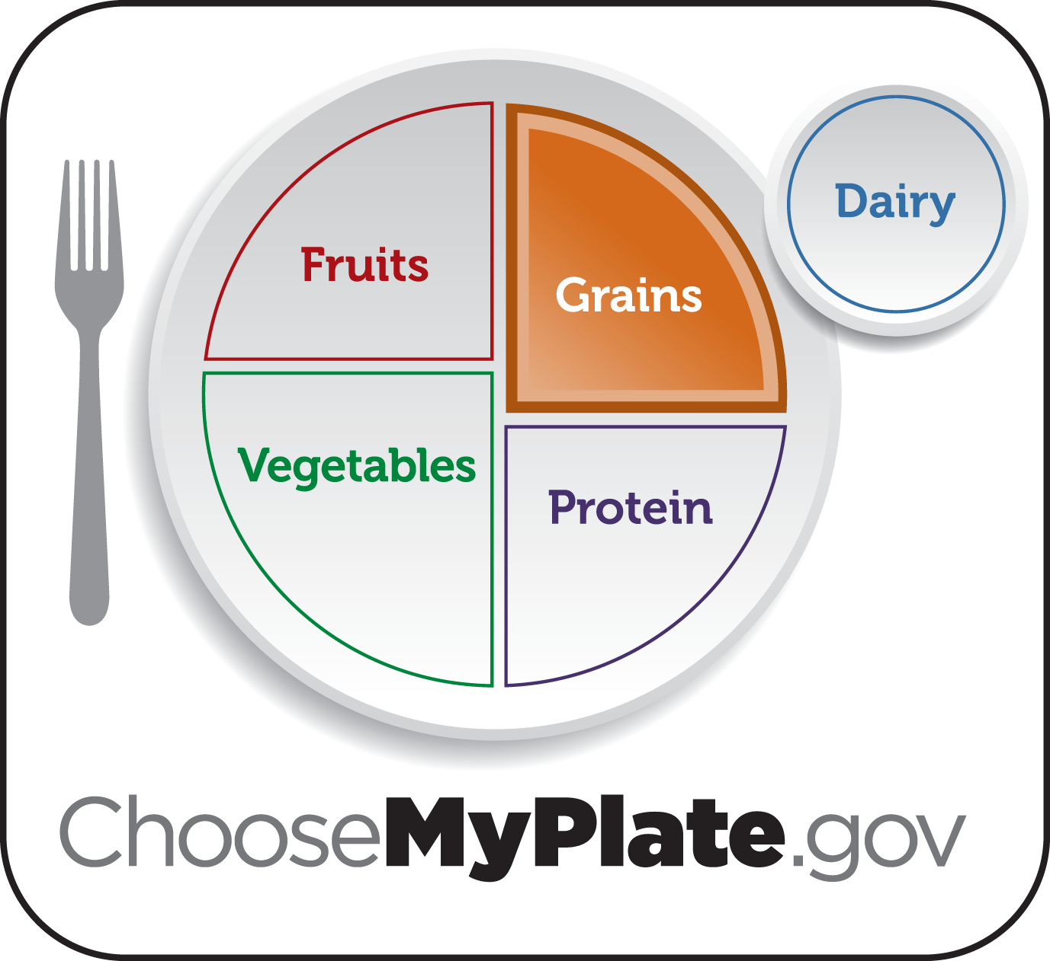

Notes:
Ask:Can anyone remind me what station our train took us to last week and what the lesson was about?
[Allow students to raise hands. (Grains)
Say: That’s right we went to Grain Station and learned about grains, the orange food group and we had a blast being physically active and learning about germs.
Ask: Who can give me examples of a few grains?
[Allow time for response. (breads, pasta, rice, popcorn, oatmeal, etc.)
Ask: Why are grains so important to our bodies? What do grains do for our bodies?
[ Allow students to respond. (Grains give us energy to play, grow, work, learn)
Ask: Did anyone try a new grain last week?
[Allow time for students to raise hands and respond. Give praise: That’s great!
Ask:Does anyone remember where our Food Group Express will be taking us today?
Say: I will give you a few clues-- This food group has foods that are crunchy, have a lot of color, and are very delicious.

Slide 3

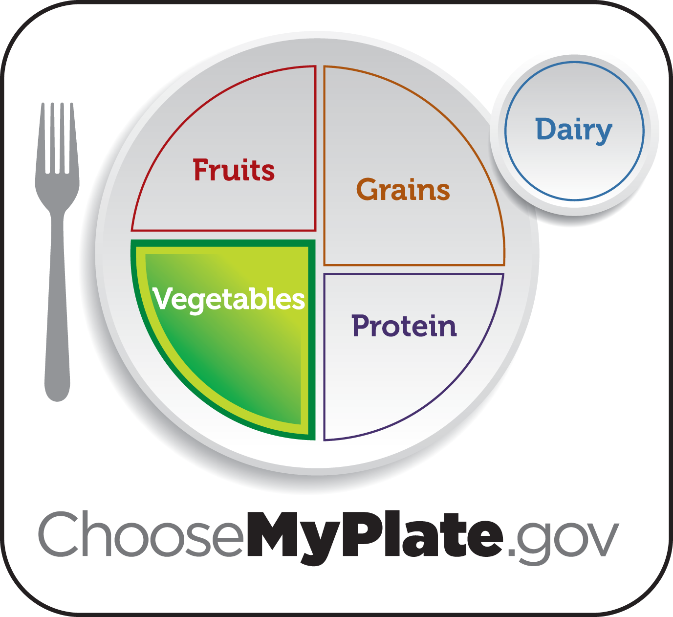
Notes:
Say: Today we are headed down the train tracks to the Veggie Terminal. All aboard! Next stop Veggie Terminal!!
Ask: What do vegetables help our bodies do?
[Allow time for response.
Say: Vegetables help our bodies to heal when we get cuts or bruises.They help our bodies fight germs, help us see in the dark and give us shiny hair and healthy skin.
We want to eat a many different kinds of veggies and we want to try as many different kinds as possible.
Ask: What should we do with fresh vegetables before we eat them?
[Allow time for response. (wash them)
Ask: Why would we wash them?
[Allow time for response. ( To wash off any dirt and germs)

Slide 4
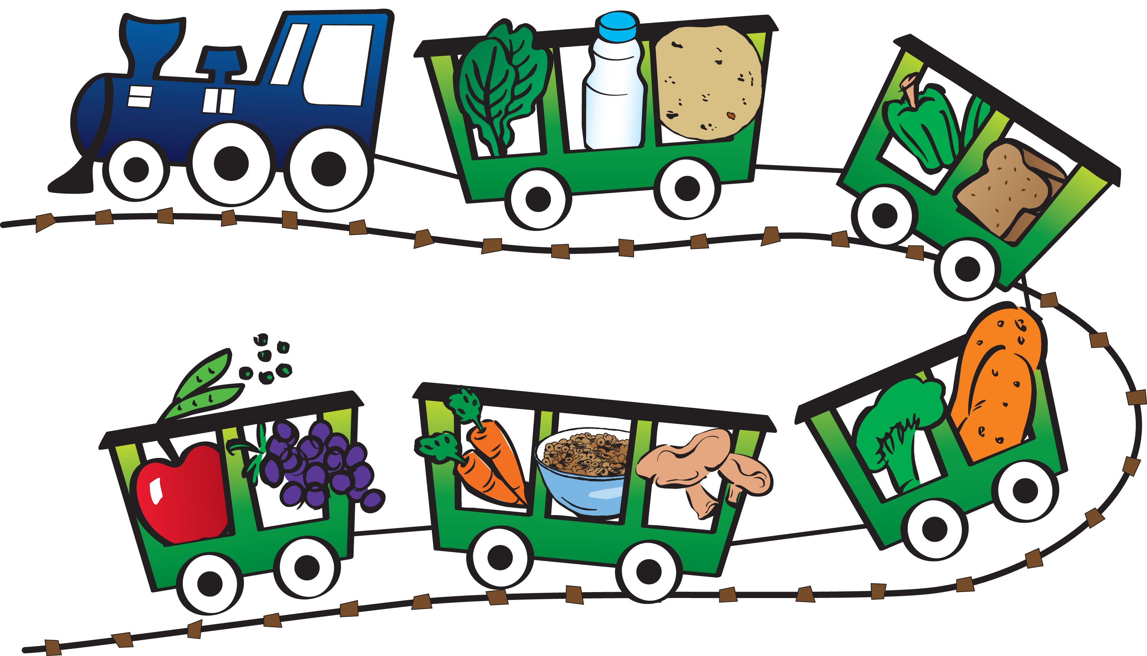
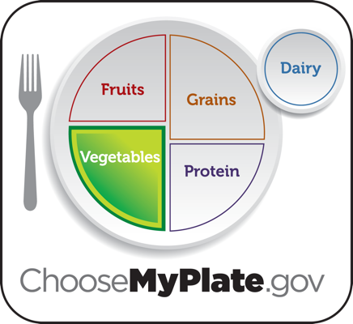
Notes:
Say: Let’s all turn to page 12 in our workbooks. On page 12, circle any foods that you think are vegetables.
[Give students time to do activity.
OK did everyone circle the vegetables on their trains?
[Allow students to respond.
Would anyone like to share what they circled?
[ Call on a few students to tell the class what they circled.
Very good!
ASK: Does anyone know what your teacher’s favorite vegetable is; let’s ask him/her. Mr./Ms. _______, can you share what your favorite vegetable is with the class?
[Allow teacher to respond

Slide 5
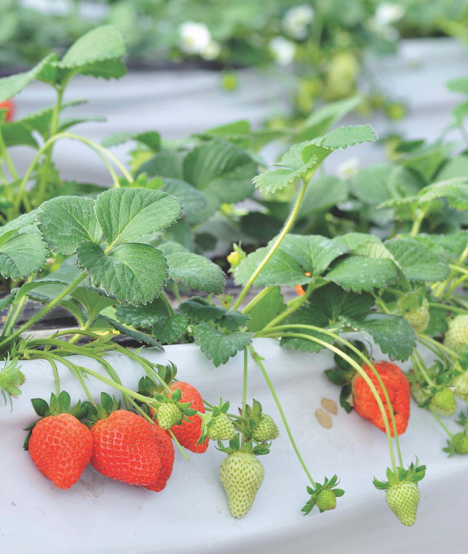
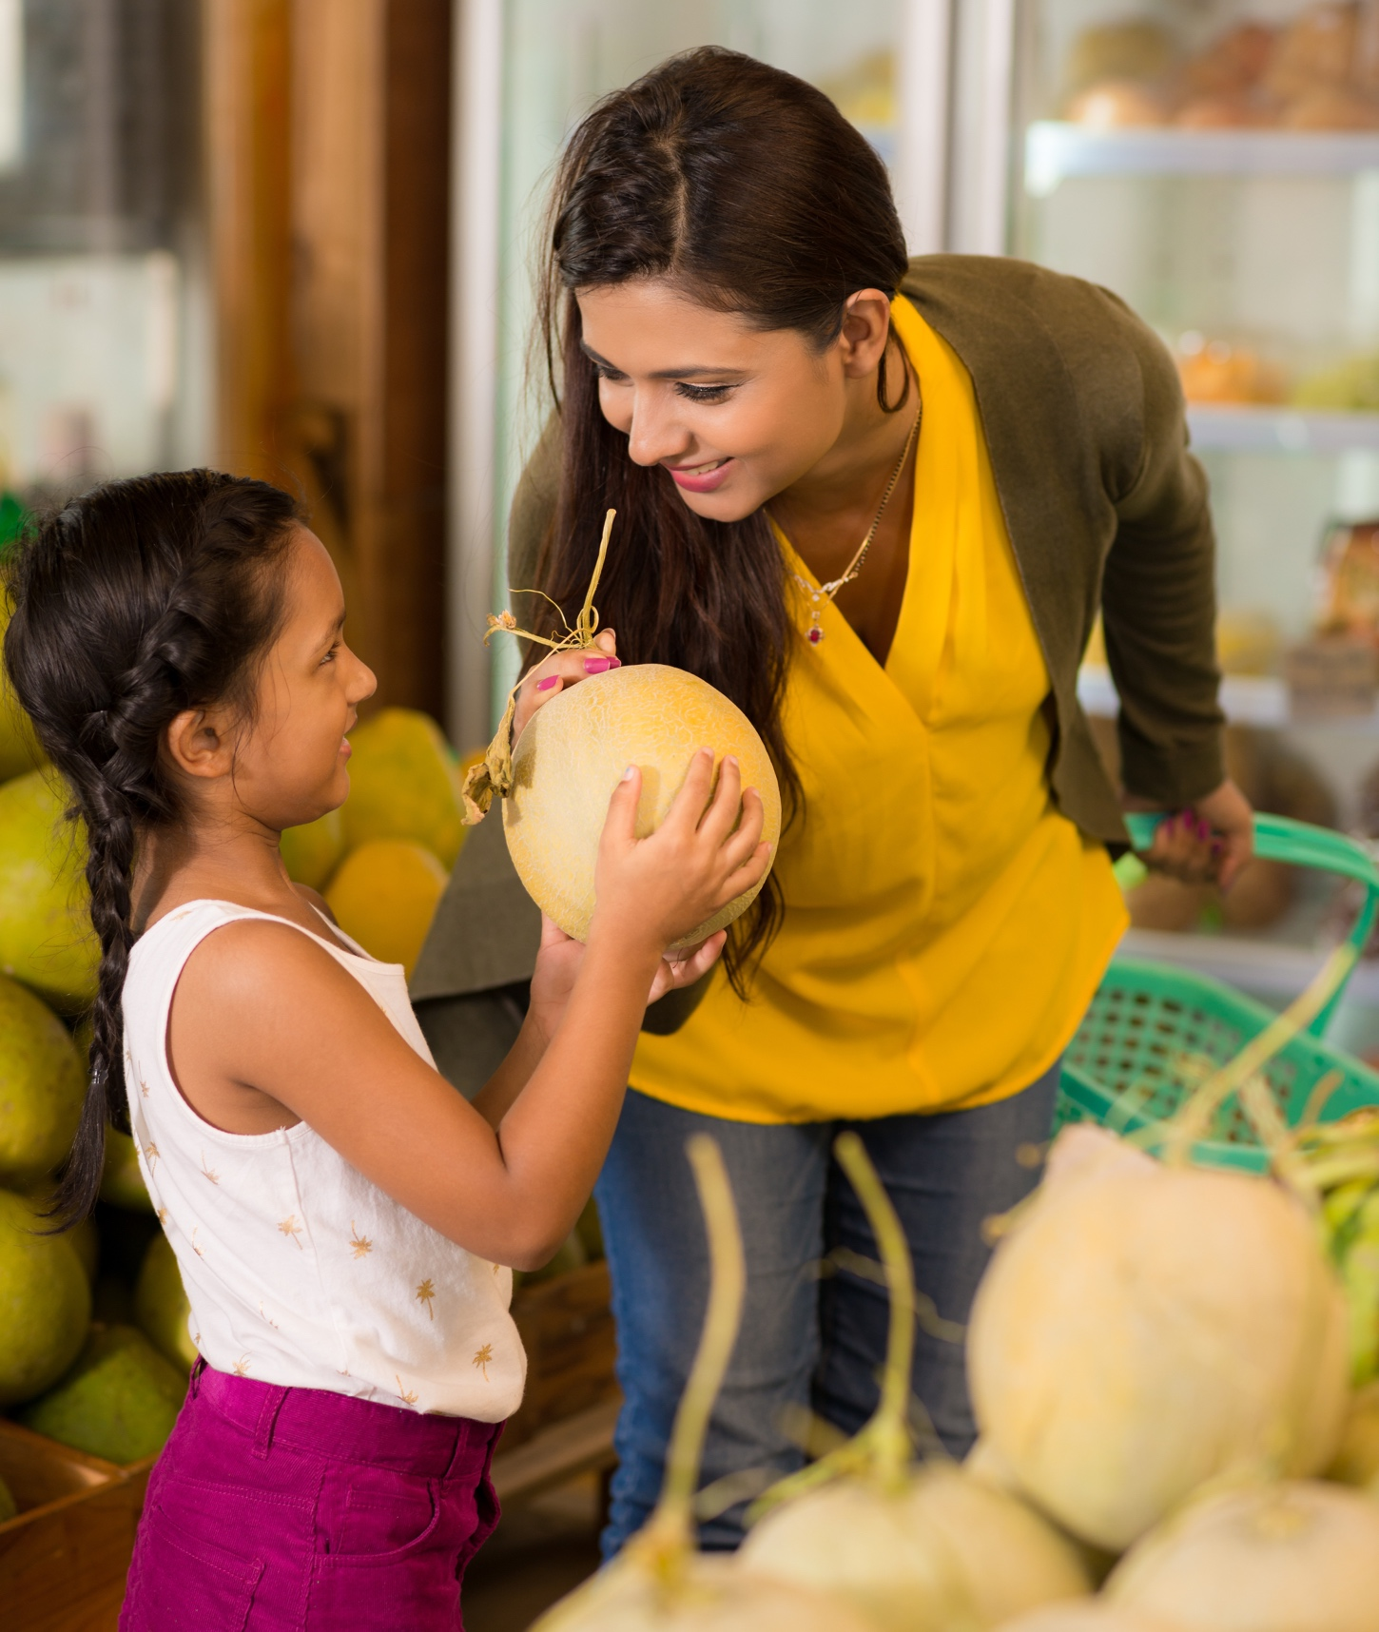
Notes:
ASK: Has anyone been to a local farm or farmer’s market to pick your own vegetables?
[Allow students to respond. Also mention experience of your own if this is something you have done before...if you pick fresh strawberries every spring, mention that and how much fun it was.
Say: You can go to local farms and pick fresh fruits and vegetables or you can visit a local farmer's market to buy fresh fruits and veggies from local farmers. When you buy fruits and veggies from local farmers you are supporting the farmers and the community. It is not only a fun activity for you and your family but it can be healthier for you. You don’t have to wait for the fruits and vegetables to be shipped or driven long distances. That can help the environment too, because it doesn’t use lots of oil and gas etc.

Slide 6
Notes:
Say: Vegetables come in many different colors and varieties. We want to make sure we eat many different vegetables on a daily basis so that we can be healthy and strong.
Say: Please open your workbooks and turn to page 14, and we’ll complete the “What color am I?” activity.
[Explain the activity. There are different color categories and we want to circle which vegetables match the color at the top of the column. Allow students to do this on their own or with a partner next to them. Go over the activity with them when they are finished.
(Onion and potato are white. Squash and corn are yellow. Carrots and sweet potato are orange. Tomato and beets are red. Purple carrots and eggplant are purple. Celery and spinach are green.)
Say: Good work class!

Slide 7
Notes:
Say: We know what colors vegetables can be and we know what your teacher’s favorite vegetable is. Now it’s time to find out what your classmate’s favorite vegetable is!
Turn to page 15 in your workbooks. With a partner I want you to complete the “My Favorite Vegetable” activity. You will interview a classmate about their favorite vegetable. Once you have answered all the questions draw a picture of your classmate’s favorite vegetable on the MyPlate diagram at the bottom of the page.
[Allow time for students to complete the activity.
ASK: Does anyone want to share their classmates answers?
[Allow time for a few students to share
Say: Very good! Those are all very delicious vegetables.

Slide 8
Notes:
Say: Now let’s turn to page 13 in your workbook. We need to wash our fruits and veggies! Does anyone know what order should we do that in?
[ Go through page with students. What is step one? What is step 2? Step 3? Step 4?
1.Wash your own hands for about 20 seconds with warm water and soap.
2. Clean all fruits and vegetables under cold water before eating or cutting up.
3. Dry fruits and vegetables after you’ve washed them. Use a dry paper towel to get rid of any lingering dirt or germs.
4. Enjoy eating your fruits and veggies.
Say: We have learned how to wash all the germs and dirt off of our vegetables!
ASK: Who wants to make a pot of vegetable soup and do some fun physical activity while we cook?
[allow students to raise hands to indicate yes.

Slide 9
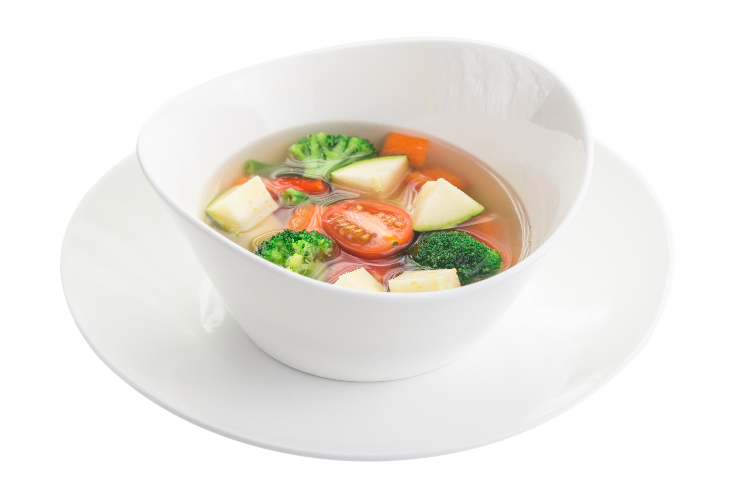
Notes:
[Pass out the vegetable soup cards to students before beginning to make the soup. There are 26 different vegetables plus the tomato soup, salt and pepper and the chef. If your class has less than 30 students, give some students two cards from the same color group. Try to have no less than two students per vegetable color so that no one has to do the motions for their group by themselves
Say: We want to make our soup with as many different vegetables in as many colors as we can.
[ Use the pot of gold from your teaching kit as the pot for the veggies.
Say: When we eat vegetables they give vitamins to our bodies and that helps us stay on the healthy TRACK. The vitamins have special jobs, like building strong bones, keeping our eyes healthy, giving us healthy skin and hair, protecting us from getting sick, and helping to heal cuts and scrapes. A good rule to remember is to always make half your plate fruits and veggies. Vegetable soup is great way to eat a lot of veggies at one time. Vegetables can come in 5 different colors just like we saw in the activity on page 14..
Ask: Can someone tell me the colors we learned about?
[Allow time to answer. ( white, yellow orange, red purple, green.)
[Choose a student to be the chef and have them come to the front of the class. Have the student stand behind the “pot”. Give them a paper chef's hat or an apron and a wooden spoon.
Ask: Are you ready to make the soup?
[Allow time to answer.
Ask: Is there anything we need to do before we prepare our soup?
[Allow students to respond. (We need to wash our hands)
[Take students through the steps of handwashing that they learned during the first week. (Wet hands, apply soap, scrub backs of hands and wrists, rinse hands, dry with paper towel, turn off water with elbow or paper towel.)
Ask: Is there anything we need to do with the vegetables before we use them in our soup?
[Allow students to respond. (We need to wash the vegetables.)
Ask: Why?
[Allow students to respond (to wash off dirt and germs)
Say: That is correct!

Slide 10
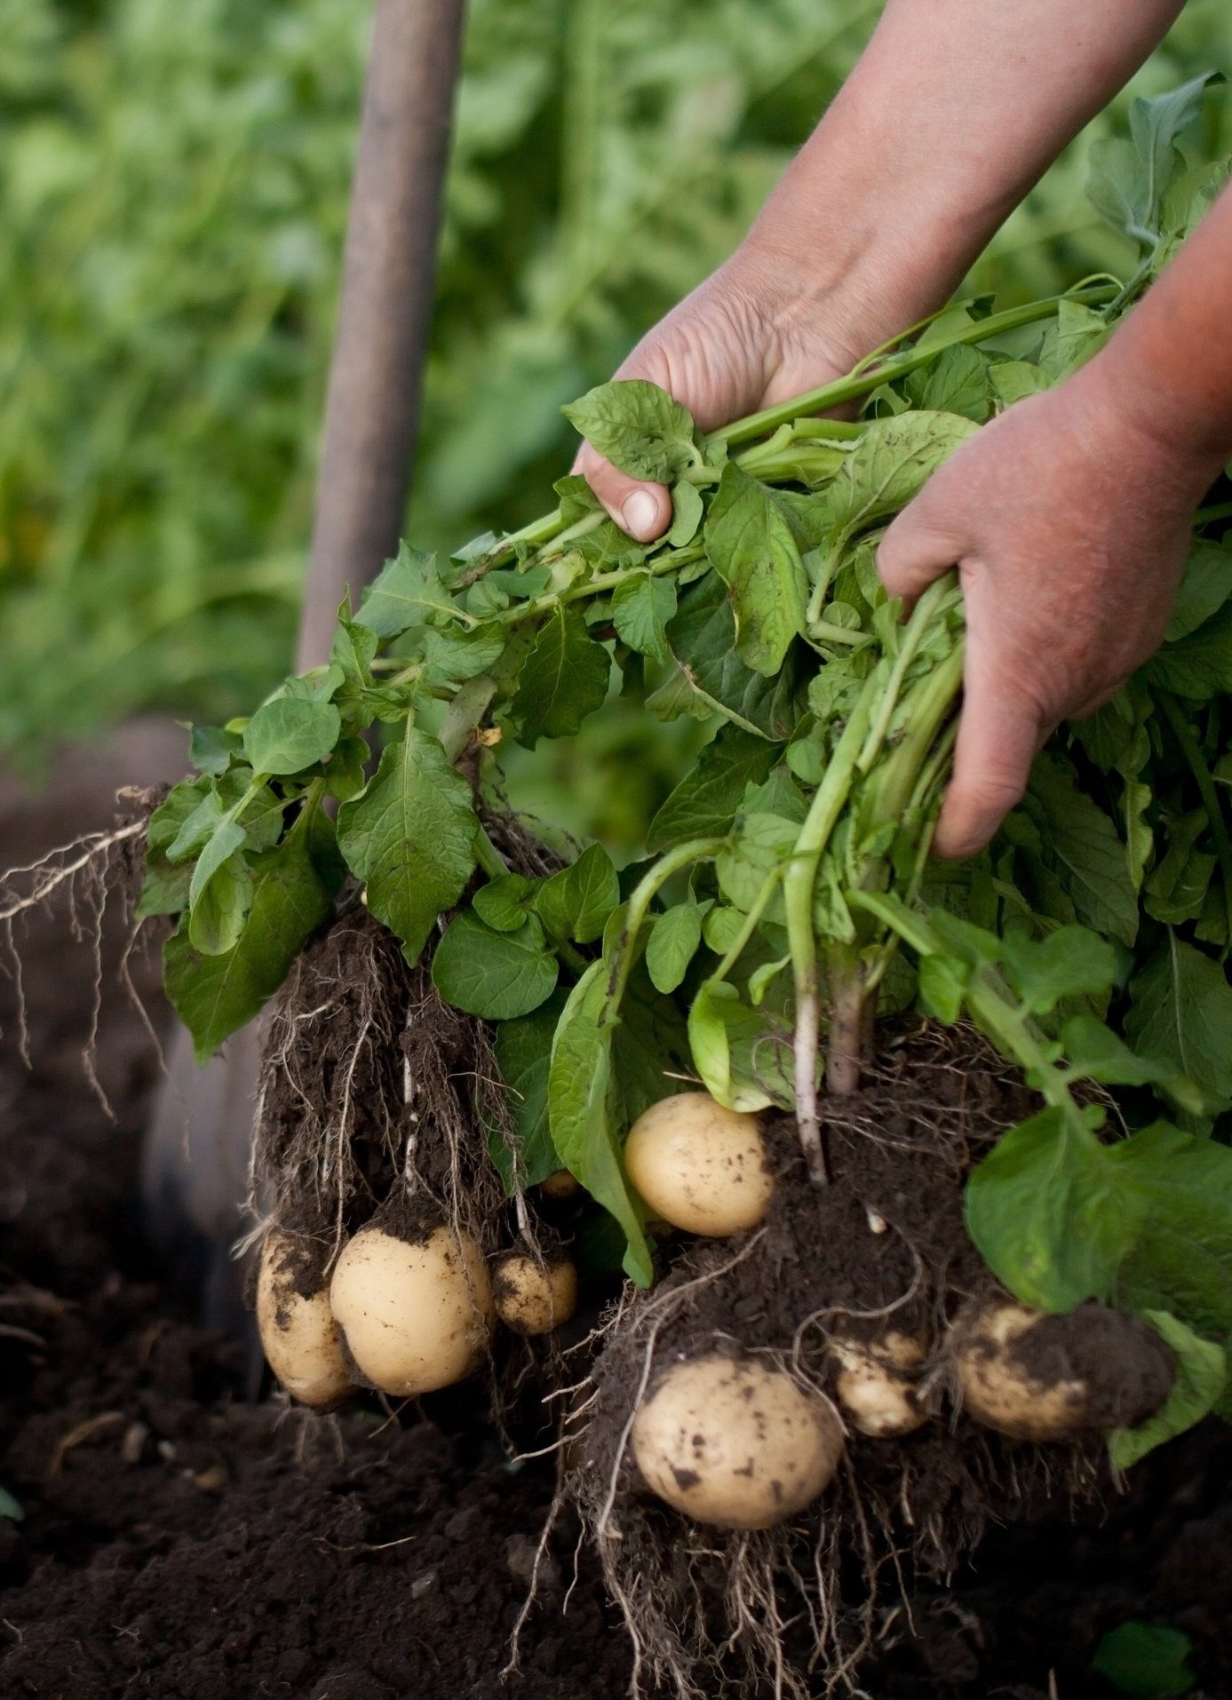
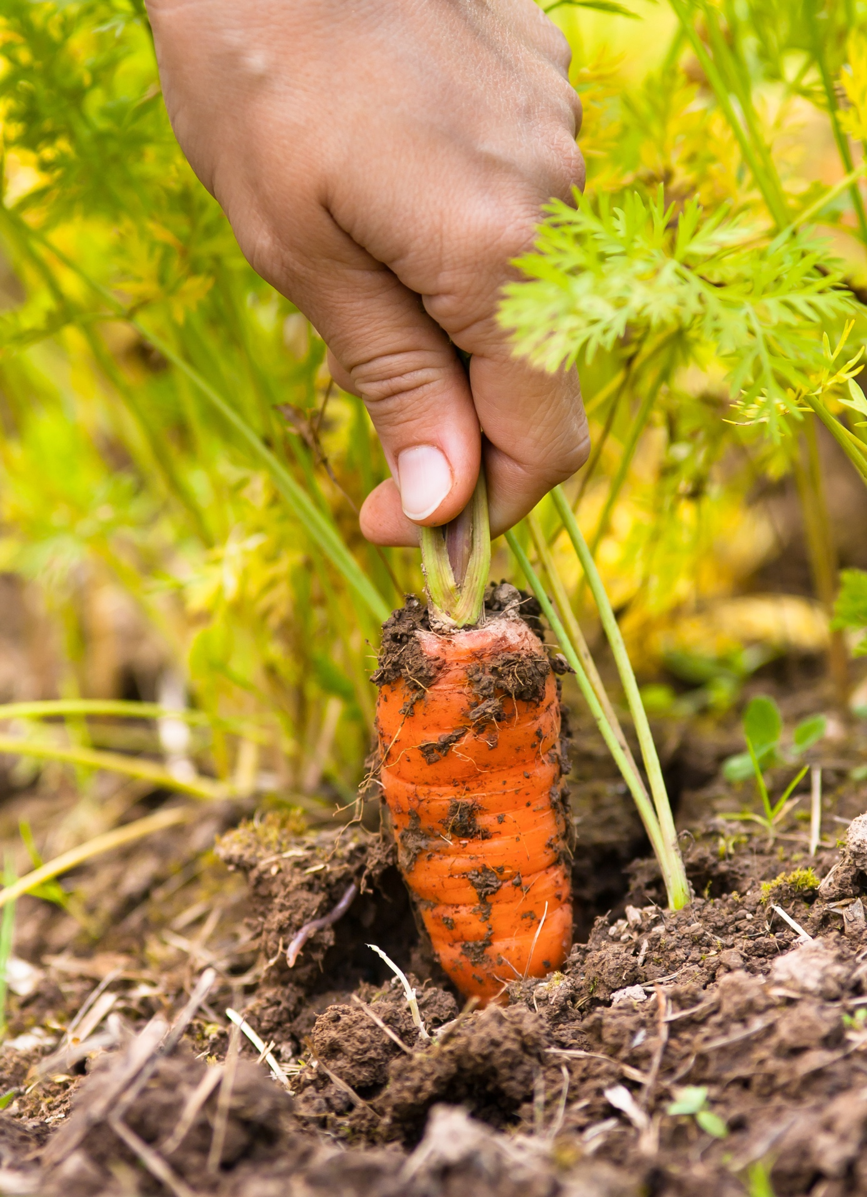
Notes:
Say: Did you know that some vegetables grown by farmers are grown under ground? Does anyone know an example of a vegetable that grows under ground?
[ allow time for response. ( Potatoes and carrots are grown under ground)
We need to pick these vegetables. Everyone stand up and pick the potatoes and carrots out of the ground.
[Demonstrate by squatting and pulling up the potatoes and carrots.
These fresh vegetables might still have some of the dirt on them from the ground so we definitely need to wash those. Dirt is not an ingredient in vegetable soup!
[Have children pretend to wash their vegetables.
Once all of our vegetables are dirt and germ free we can start cooking.

Slide 11
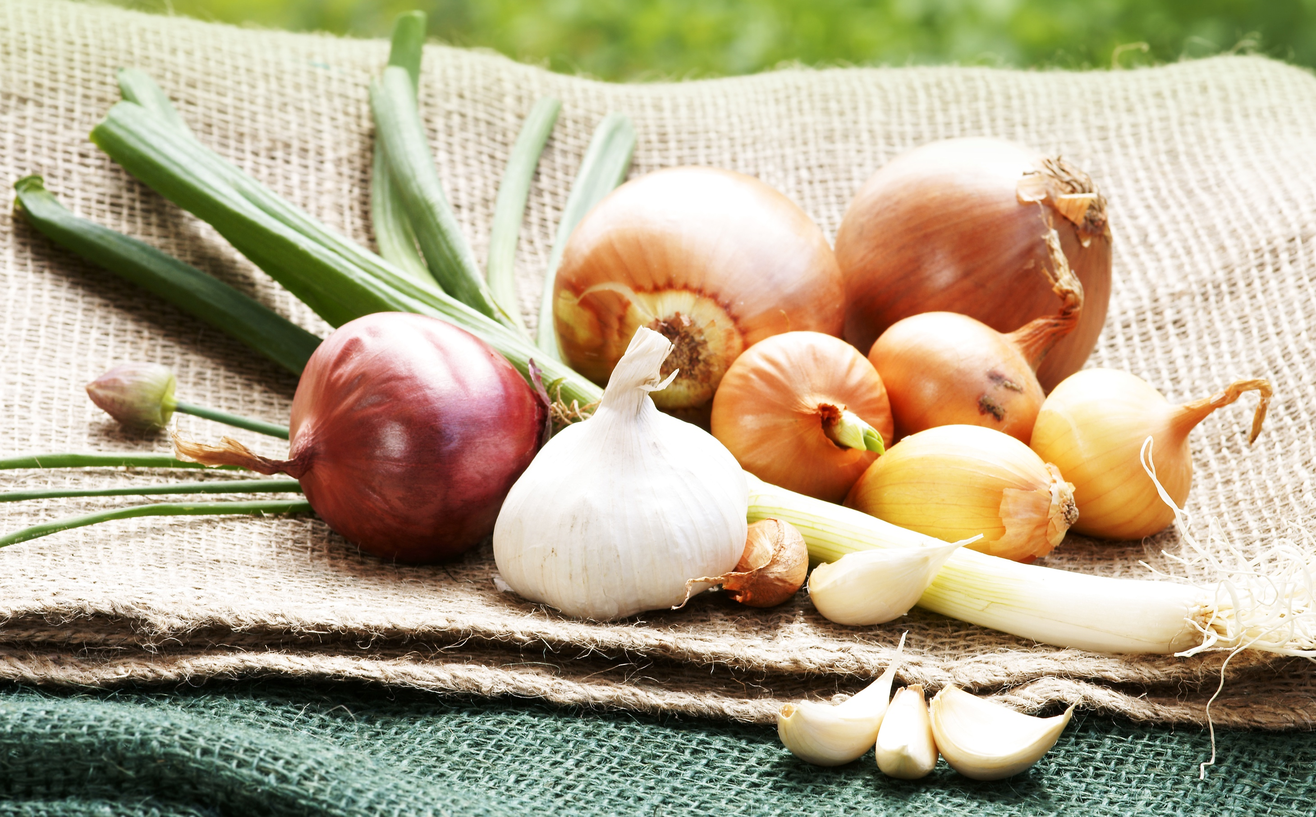
Notes:
Say: Some of our vegetables for our soup need to be sauteed. This means the vegetables need to be browned a little and it will help bring out their delicious flavors. These vegetables are green onion, onions and garlic.
[Have the students who have these vegetable cards come to the front of the room and put their ingredients into the pot. They will stay in the front of the class to the side of the pot and will do the movement as described below.
Say: Now our chefs will start to stir the vegetables.
[Have the chefs pretend to stir.
Say: Now that the onions and garlic are in the pot they are going to be sauteed and they will move around a little. We need the three of you to show us how they cook.
[Students will follow your directions. Put your right leg in front of you. Put your arms out in front of you. Cross your hands over one another while crossing your arms over each other and say “shh shh”; reverse legs and do it again. Do the motion twice.
[Students will stay at the front of the class and eventually will make a circle as more students join them.
Say: We don’t need to make out shh shh noises anymore. The vegetables have been sauteed enough. Later on, when I point to you, you will need to do the the saute motion again. Okay class, let’s all practice this motion with them.
[do the motion with everyone

Slide 12
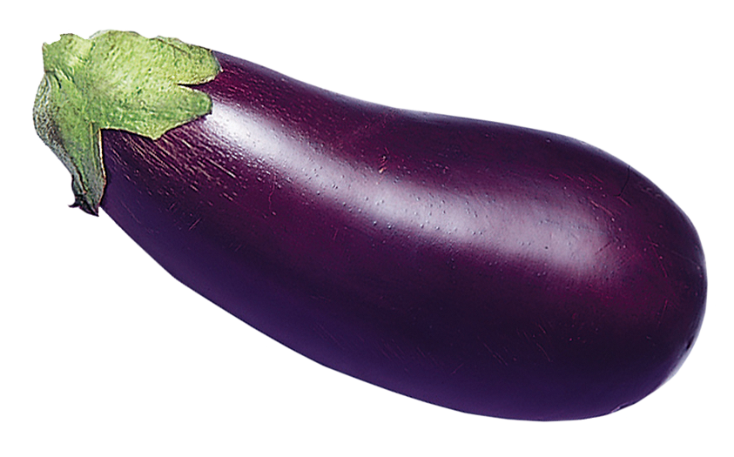
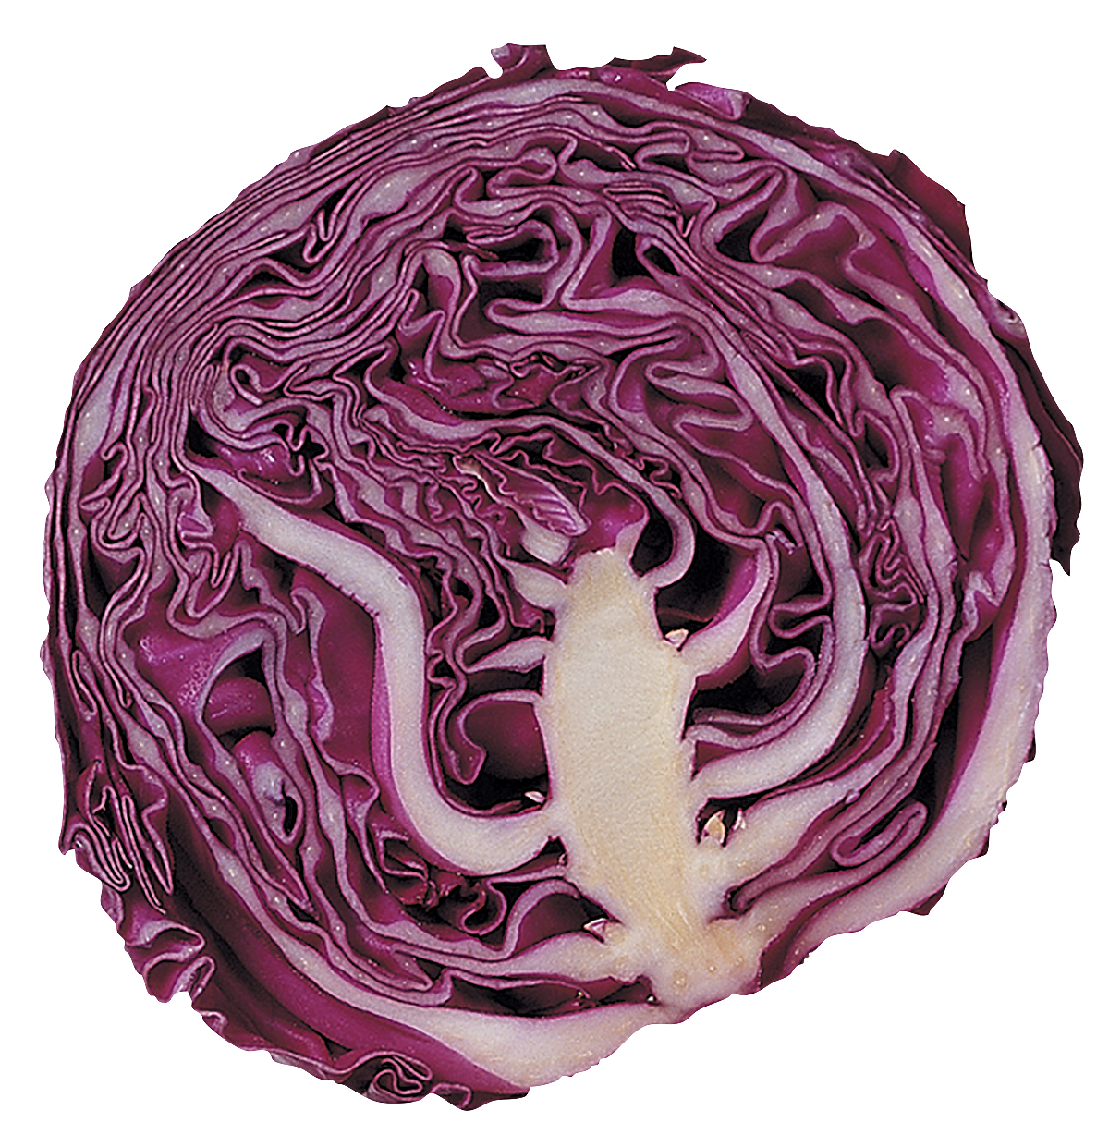
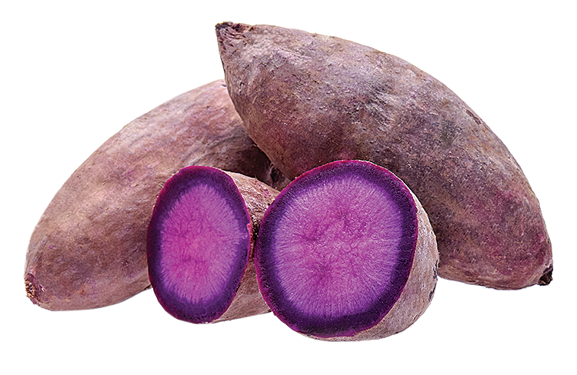
Notes:
Say: Does anyone know why we sauteed the onions and garlic for only a short time?
We don’t want to overcook the veggies because they will lose their vitamins. Cooking the vegetables just enough will allow them to get tender and crunchy and still be full of vitamins.
It’s time to add our purple/blue vegetables to the pot. We have eggplant, purple potatoes and purple cabbage.
[Have the students who have these vegetable cards come to the front of the room and put their ingredients into the pot and stand on the other side of the pot from the onion group.
Say: Purple/blue group we need to help the vegetables move and cook. Reach out your arms above your head, bring them down to your shoulders, and now do the onion and garlic saute motion.
[point so that everyone at the front of the class does the last motion - the saute motion.
Have the students practice two times and then watch the purple group. When they get ready to do the onions and garlic motion point to the onions and garlic, and have them join in doing these actions. At this time all onions, garlic, and purple vegetables should be doing the same repetitive action.

Slide 13
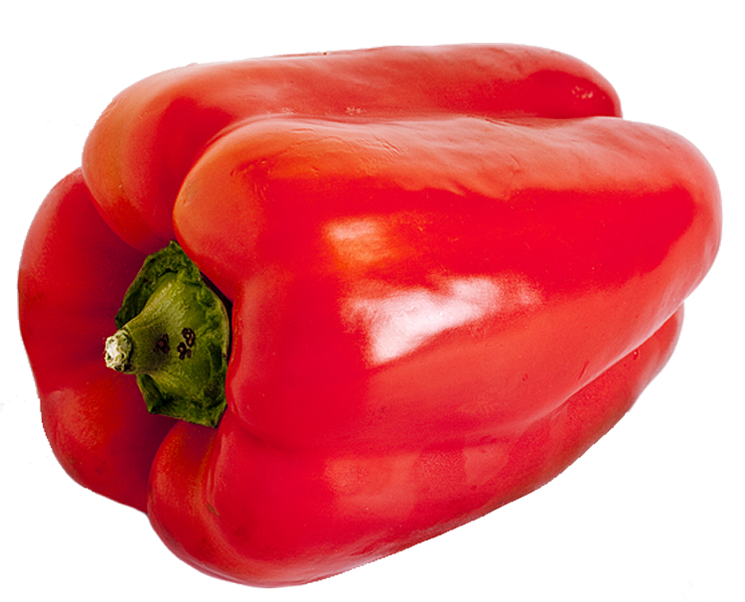
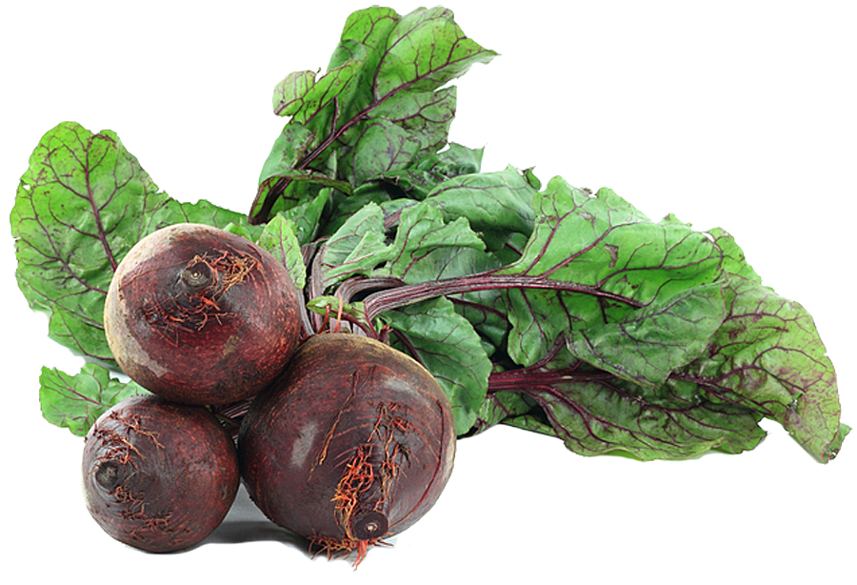
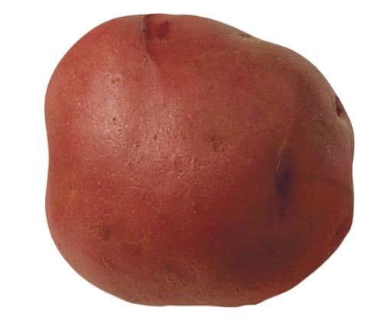
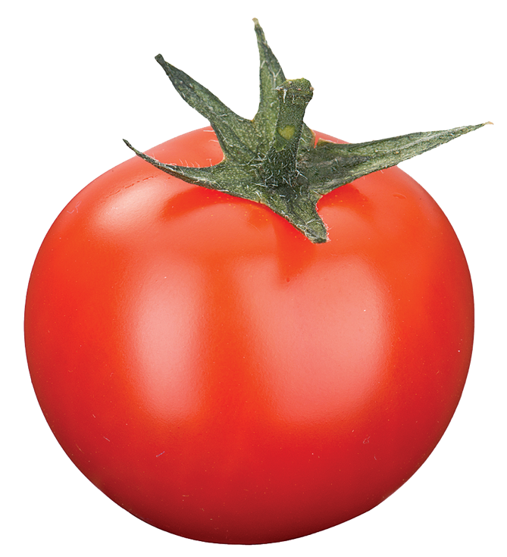
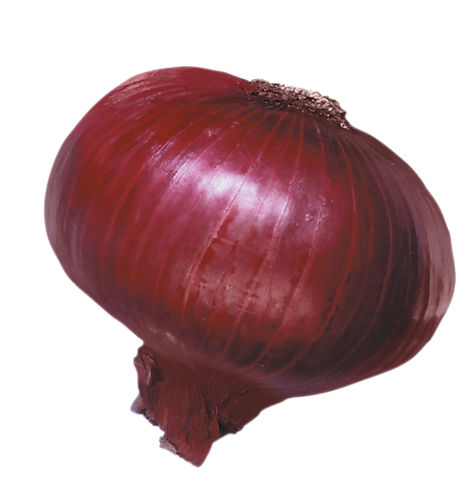
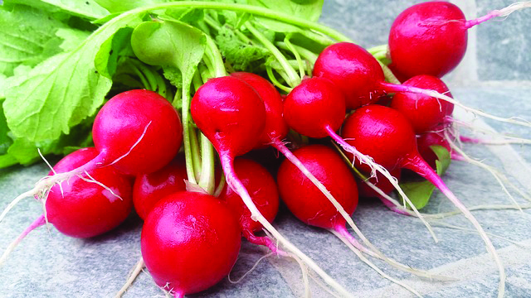
Notes:
Say: There are lots of red vegetables to go in our soup. We have beets, radishes, red peppers, red onion, red potato and tomato.
[Have the students who have these vegetable cards come to the front of the room and put their ingredients into the pot. Add these students to the circle on whichever side needs more students. Instruct the red group on their actions.
Say: Bend down and touch your toes and then your knees two times, do the onion/garlic motion. This last part of the motion is repetitive and will be done by everyone at the front of the room.
[ When the red group gets ready for the repetitive part, point to the onions, garlic and purple group so that all the groups are doing the same repetitive motion all at the same time.

Slide 14
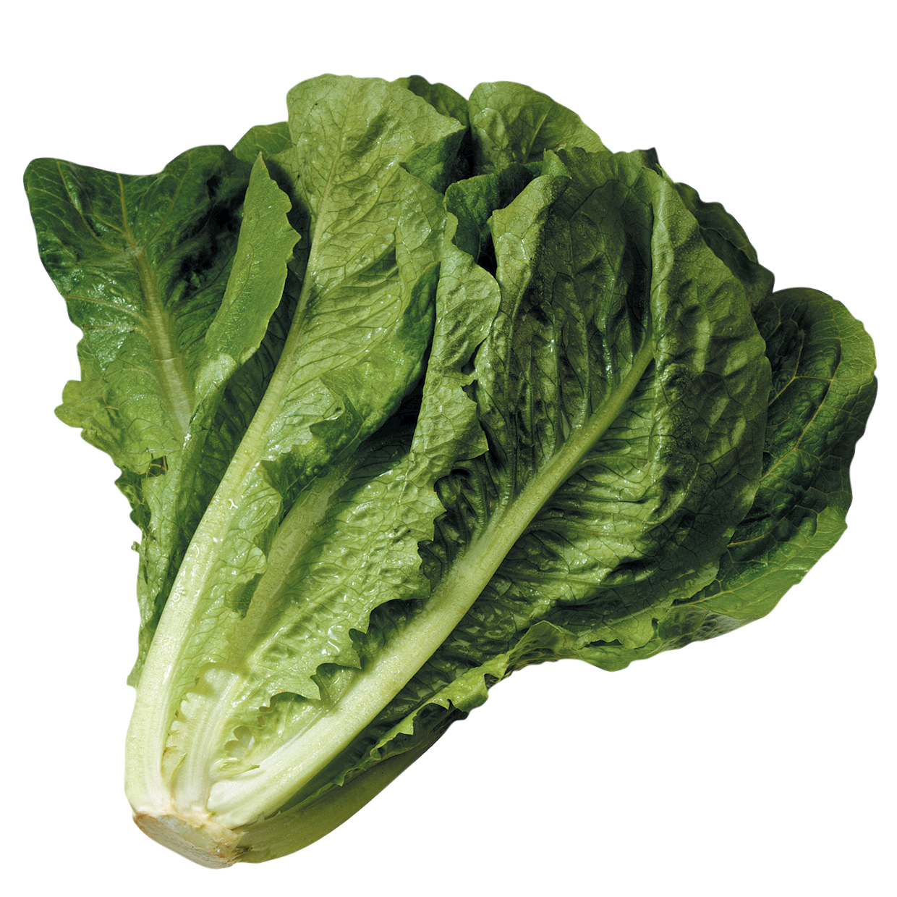
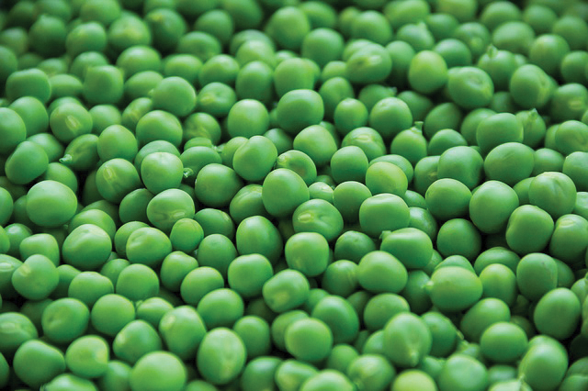
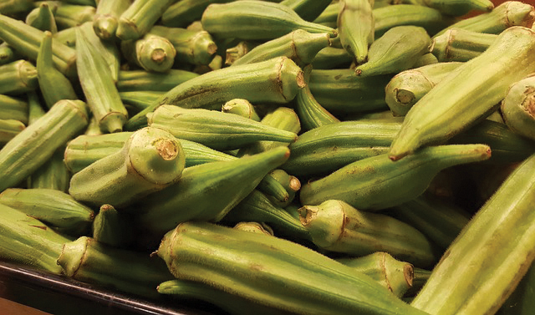
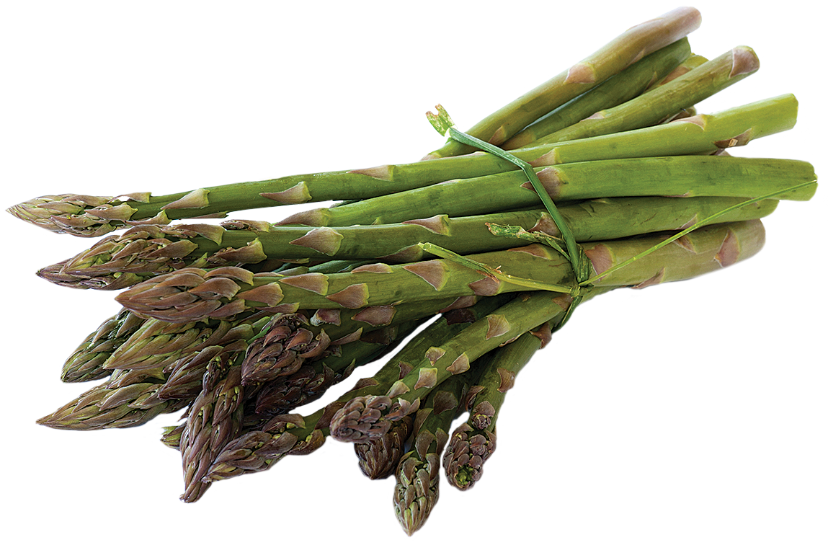
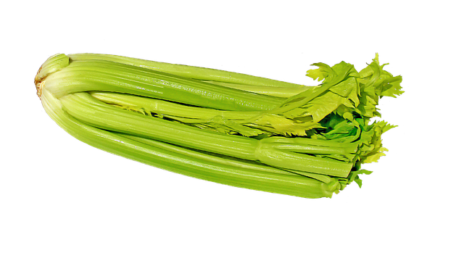
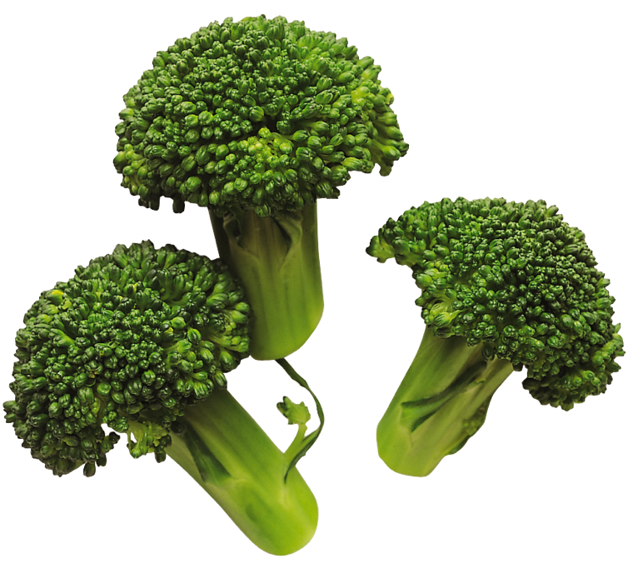
Notes:
We also have a lot of yummy, green vegetables to add to our soup. We have okra, broccoli, asparagus, lettuce, peas and celery.
[Have the students who have these vegetable cards come to the front of the room and put their ingredients into the pot. Keep adding the students to the circle alternating sides.
Say: The green vegetable action is to put your hands on your hips, bounce your hips twice to the right and then twice to the left, repeat two times twice, then do the onion/garlic motion.
[When the green group gets ready for the repetitive motion point to the onions, garlic, purple, and red groups. All the groups are doing the same thing at this point.

Slide 15
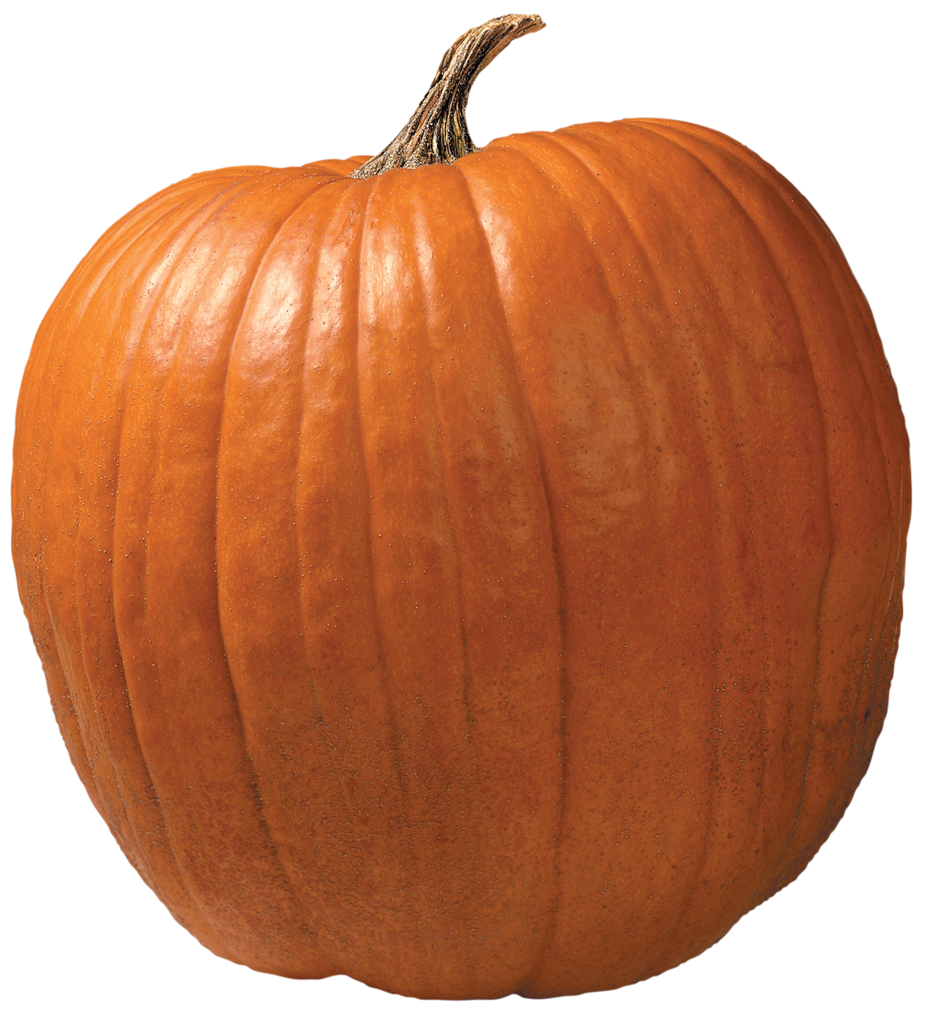
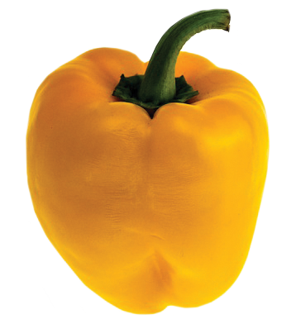
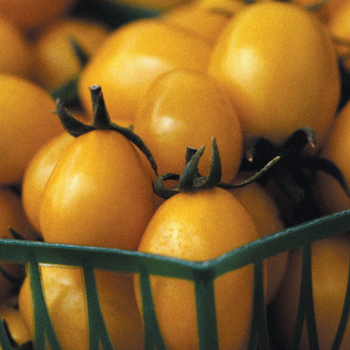
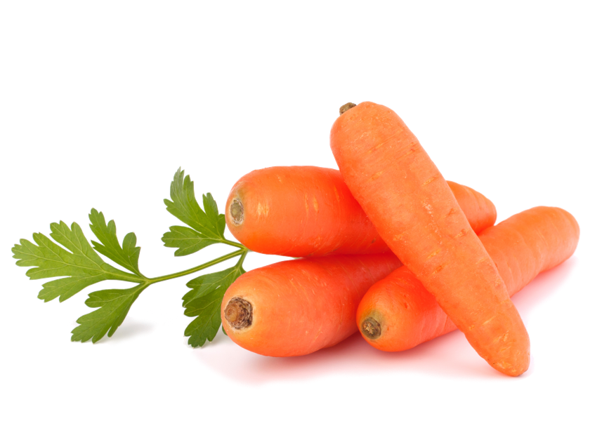
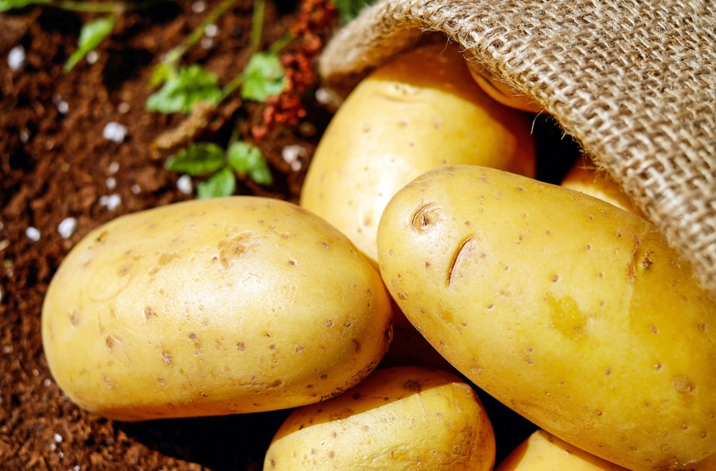
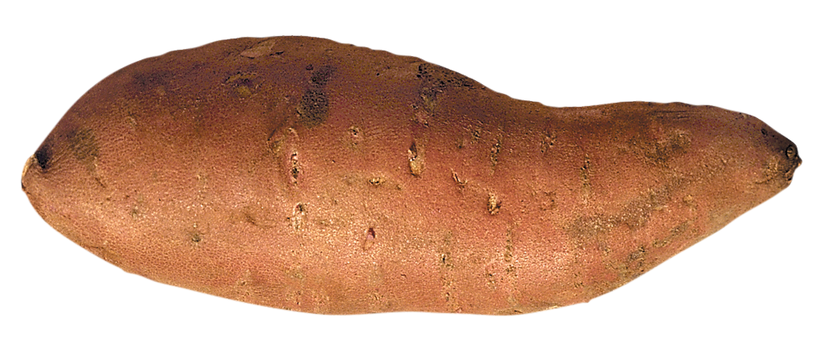
Notes:
Say: If you have a yellow or orange vegetable, come on to the pot and drop your vegetable in the pot. We have sweet potatoes, pumpkin, carrots, yellow/orange peppers, gold potatoes, yellow or orange tomato.
[Have the students who have these vegetable cards come to the front of the room and put their ingredients into the pot. Keep adding the students to the circle alternating sides.
Say: The yellow/orange action is to jump up high, jump down low, repeat twice and then everyone does the onion/garlic motion.
[Watch the yellow/orange group and when they get ready for the repetitive motion point to the onions, garlic, purple, red and green groups so that all groups are doing the same repetitive motion.
White vegetables:
After yellow/orange vegetables ask all the students with white vegetables to come to the pot and instruct them to say the name of their vegetable as they drop it in the pot. Continue adding students to your circle alternating sides. Tell the white group their actions are:
Turn around two times, do onion/garlic motion. This last part of the motion is repetitive and will be done by all the groups.
Watch the white group and when they get ready for the repetitive motion point to the onion, garlic,purple, red, green, and yellow/orange groups so that all groups are doing the same repetitive motion

Slide 16
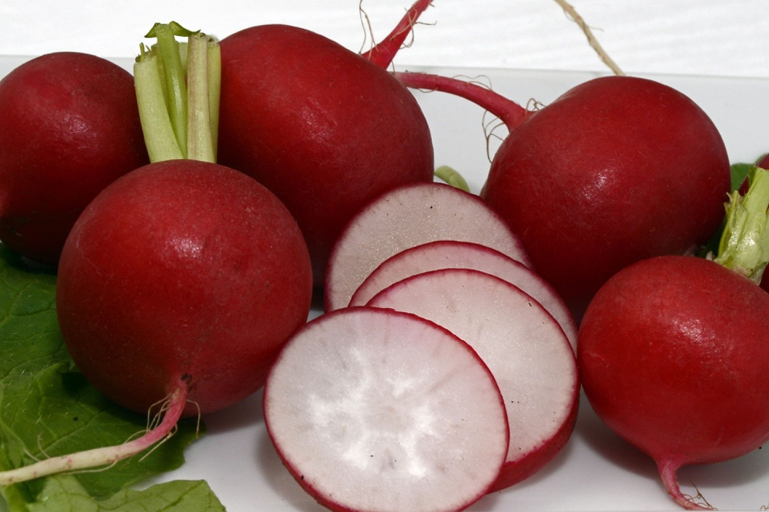
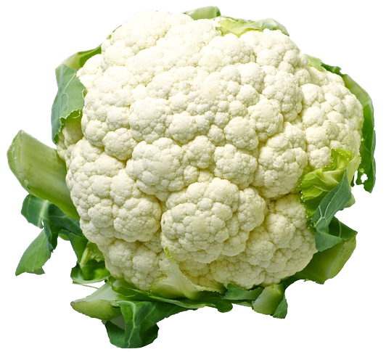
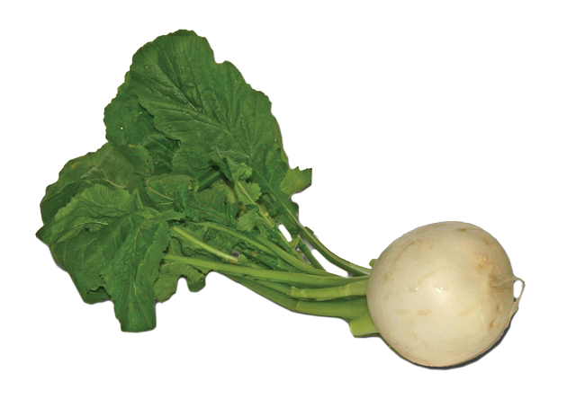
Notes:
Say: Will the students with the white vegetables come on up to the pot and drop your vegetable in the pot. The white vegetables are cauliflower, radish and turnip. We already put garlic and green onion in the pot at the beginning when we sauteed.
[Have the students who have these vegetable cards come to the front of the room and put their ingredients into the pot. Keep adding the students to the circle alternating sides.
Say: The white vegetable action is to turn around two times and then do the onion/garlic motion with everyone.
[Watch the white group and when they get ready for the repetitive motion point to the onion, garlic,purple, red, green, and yellow/orange groups so that all groups are doing the same repetitive motion

Slide 17
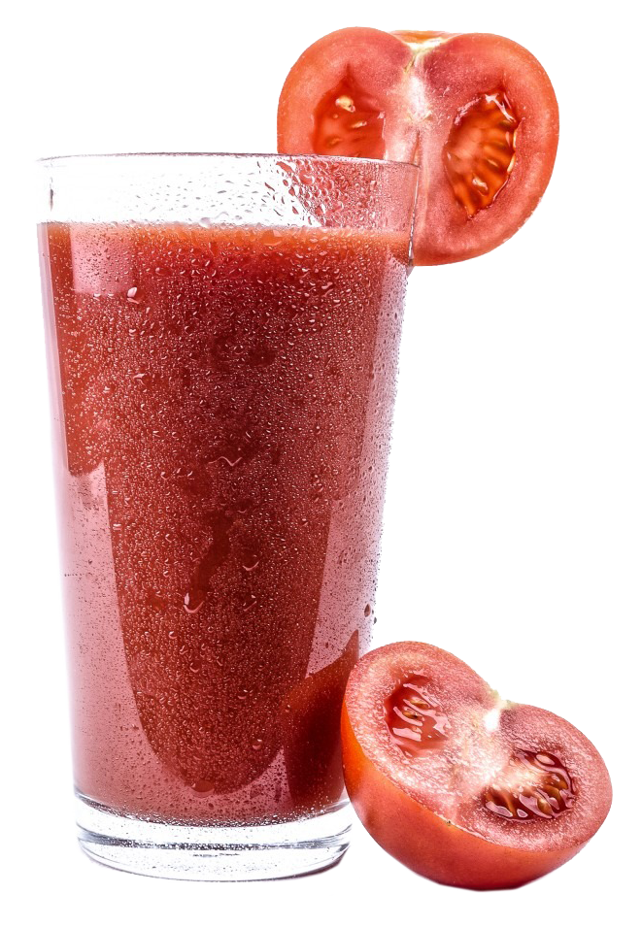
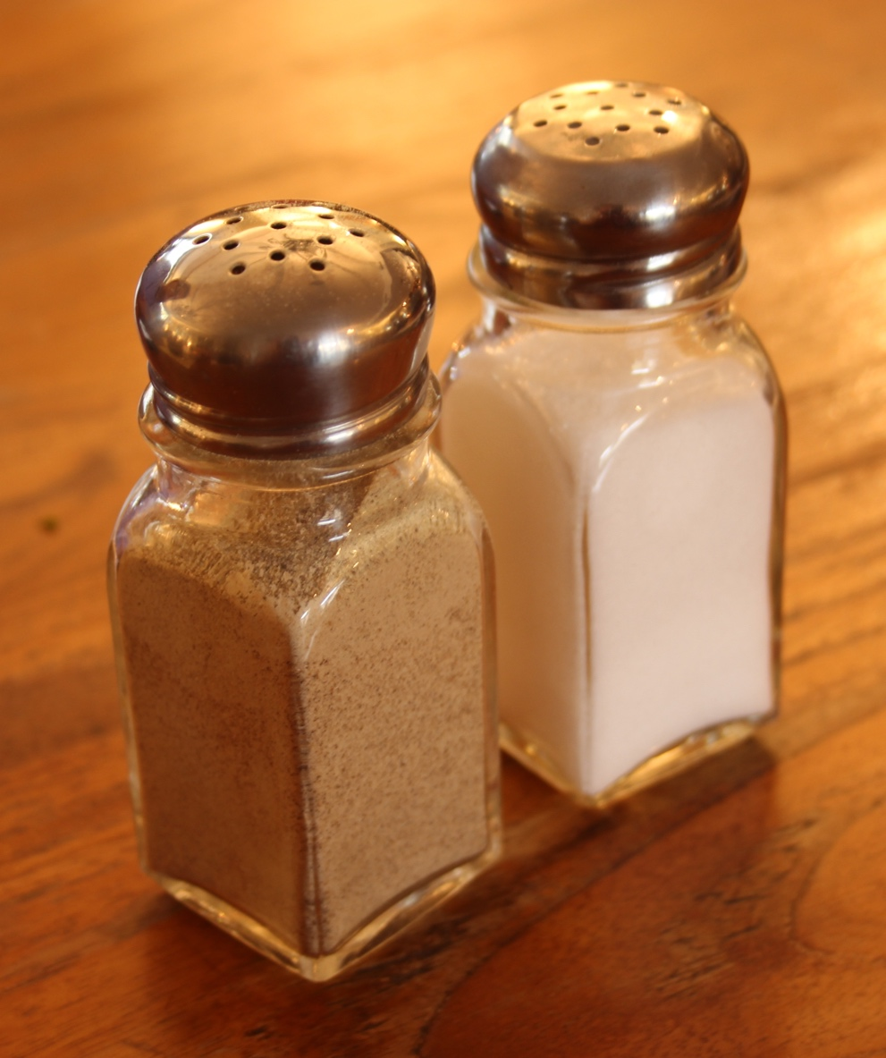
Notes:
Say: We need our students with the tomato juice, salt and pepper to come up to the front of the room. First we will add the tomato juice and that will blend all the vegetables together. Then we will add the salt and pepper to season our soup and give it a little extra flavor. Remember we only want to use just a little salt because too much would not be good for us. Please put the tomato juice into the soup pot. Now add your salt and pepper to the soup pot.
The tomato juice action is to act like a pitcher pouring. Do the motion twice and then everyone will do the onion garlic moton. The Salt and pepper action is to shake all around, then do the onion/garlic motion with everyone..
Say: We need to bring our soup to a boil, which means it needs to be a very high temperature. After it gets very hot, we will turn it down to a simmer. To bring it to a simmer it means we turn down the heat to a lower temperature just below boiling. To bring our soup to a boil we have to do all of our vegetable actions very fast! To bring it down to a simmer after the boil we will do this by slowing down our motions.
Say: You have to watch me very carefully. When i raise my hand high in the air that means you to do your actions really fast (boil) and when I put my hand down you need to simmer so you will do your motions slower.
[Raise and lower your hand several times then the students can return their seats when you are finished.

Slide 18
Notes:
Say: Raise your hand if you liked making our vegetable soup.
[Let students respond.
SAY:Thank you to our chef for helping! You did a great job keeping our pot stirred so our soup didn’t burn!!
Say: That was a great way to get active and move our bodies to stay healthy.

Slide 19
Notes:
Say: Today we learned all about vegetables and how they keep us healthy. Being physically active keeps us healthy too! Let’s all turn to page 17 in the workbook.
ASK: Can anyone tell us how long we should be active each day?
[Allow time for student response. ( 60 minutes.)
Say: That’s right we need to be active for at least 60 minutes every day. One way to get active is to do strength and flexibility activities. Flexibility can help us reach all they way to our toes. Raise your hand if you can touch your toes!
[Allow time for students to raise hands.
Say: That’s awesome! Page 17 gives us some examples of activities that are for strength and flexibility. You can stretch, climb the monkey bars, do yoga, and martial arts.
At the bottom of this page I want you to fill in the activity log with a plan of what strength and flexibility activities you will do on each day of the week and for how long. Remember, you don’t have to do only one activity for 60 minutes. You can do lots of different activities during the day. Just be sure you are getting at least 60 total minutes of physical activity each day. While you complete this I will come around with your stickers for completing todays lesson at Veggie Terminal.
[Allow students to do activity and pass out stickers.
ASK: Does anyone what to tell me a flexibility and strength activity they are going to do this week?
[Allow time for response.
Say: Very good!

Slide 20
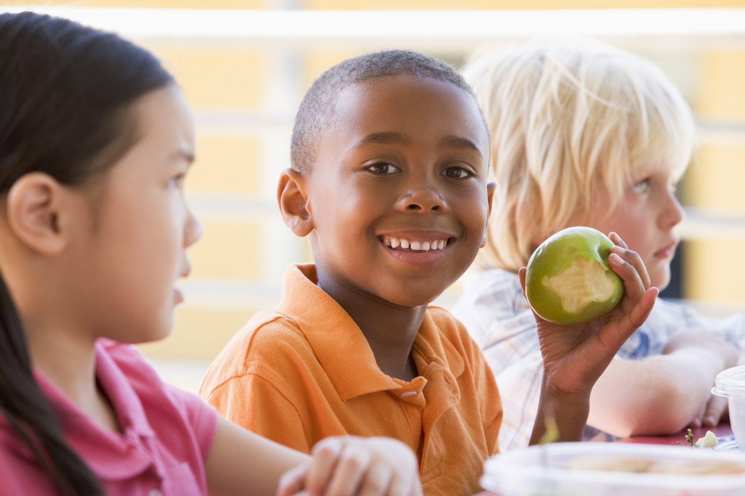
FOOD TASTING
Notes:
[PA Note: HIde this slide if you are not doing a food tasting.
[ Suggested food tasting for this lesson is Broccoli Salad-- recipe found on page 16. If not doing a food tasting, review the recipe with the students and encourage them to make it at home when they take their book home at the end of the series of lessons.

Slide 21
Notes:
Say: Before we leave veggie terminal who can tell me why we wash our fruits and vegetables?
[allow time for response (to get all the dirt and germs off)
Ask: Why don’t we want to overcook your vegetables?
[allow time to answer (because they will lose most of their vitamins.)
Say: Vegetables are very important to our bodies because they help our bodies with a lot of things. Vegetables help our bodies fight germs, help heal our cuts and bruises and they can also give us healthy skin and shiny hair. It is important that we choose to eat a variety of different vegetables everyday.
Ask: Who can help me name the different colors of vegetables? Hands in the air if you think you know the answer.
[Allow students to respond. (red, white, green, orange, yellow, purple)

Slide 22
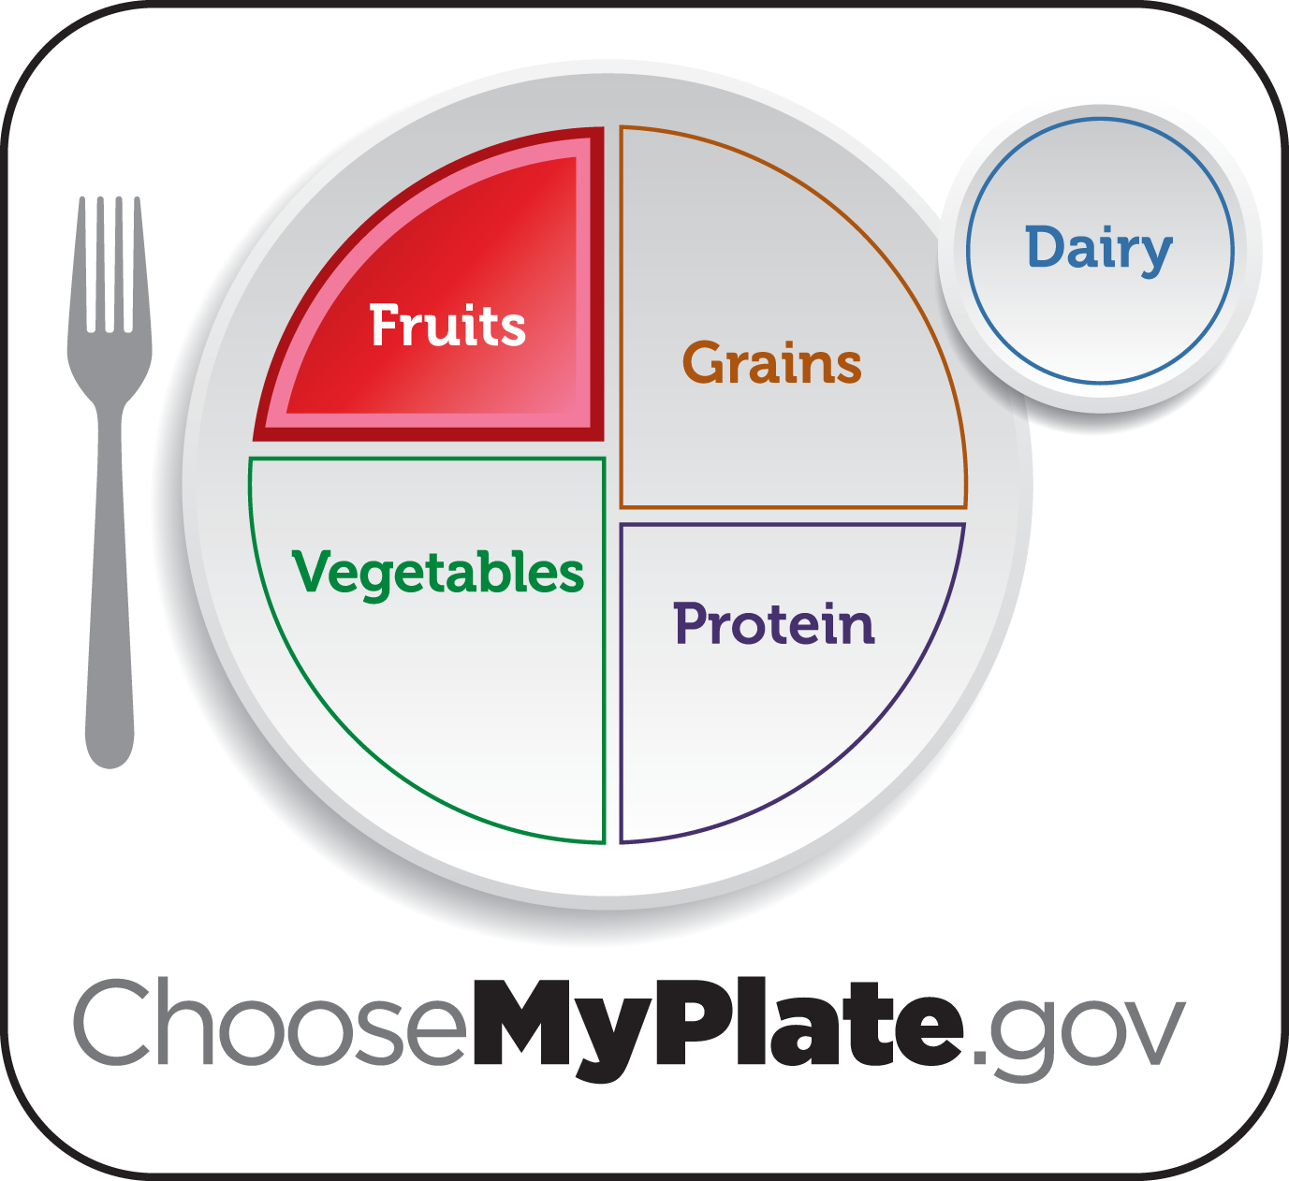
Notes:
Say: Next time I see you we will be aboard the fruit caboose learning how to keep our health on track with different fruits. Today, I want to challenge you to try a new vegetable this week. Raise your hand if you will try to do that.
Great! See you next week!

