Slide 1




Notes:
SCRIPT:
Say: Good morning/afternoon boys and girls. My name is ________________ and I work with a program called EFNEP – Expanded Food and Nutrition Education Program through Cooperative Extension. EFNEP is part of the Family and Consumer Sciences and 4-H program.
Ask: How many of you have heard of 4-H? By participating in our EFNEP nutrition classes, you are part of 4-H. If you are interested in learning about more exciting things you can learn and do through 4-H, please let me know. I will help connect you with our local 4-H Agent.
Extension is a part of NC State University in Raleigh and NC A&T University in Greensboro.
Ask: How many of you have ever been to Raleigh? How many of you have ever been to Greensboro?
Say: For the next few weeks I’ll be visiting your classroom to help you learn more about how you can be healthy and have FUN with Food and Fitness. We’ll taste some familiar foods and maybe try some new foods. We’ll also have FUN moving around and playing some games. I want to thank your teacher for inviting me to your classroom. I think we’re going to have a lot of FUN together.

Slide 2

Notes:
SCRIPT:
Say: I would like ask you to help me out. I need to know what you already know so we can really focus on what you don’t know. I am going to pass out a form with some pictures on it. Right now all I want you to do is print your first and last name in the box labeled “Name” and put today’s date in the box that says “date”. Then, put your pencils down and wait for directions.
Ask: Has everyone got their name and today’s date printed on their paper?
Say: Great! I want you to stay with me and answer the questions the best you can. It’s OK if you don’t know something. This is not a test. Remember, I want to know what YOU know, not what your neighbor knows.
Ask: Are you ready?
Say: Look at the 4 pictures for question 1. Circle the picture or as many pictures as you think show kids being active. (wait about 15 seconds).
Ask: Is everybody ready to continue? OK. Turn the page.

Slide 3
Notes:
Say: For question number 2, circle the picture or as many pictures as you think show a healthy snack. (wait for about 15 seconds)
Ask: Are you ready to go on to the next picture?

Slide 4
Notes:
Say: Look at the picture on the bottom of this page. For question 3, circle any food that you think is a vegetable. (wait about 15 seconds).
Ask: Are you ready to move on? Let’s turn to the next page.

Slide 5
Notes:
Say: For question 4, circle any food you think belongs to the dairy food group. (wait about 15 seconds)
Ask: Is everyone finished with this question?
Say: Let’s move to question 5.

Slide 6
Notes:
Say: For question 5, circle any food that you think is a fruit. (wait about 15 seconds)
Ask: Are you ready for the last question? Ok, then turn the page for question 6.

Slide 7
Notes:
Say: This is the last question. For question 6, circle any picture that shows a time that you would need to wash your hands before eating.
Ask: Is everyone done?
Say: Great, I’ll collect these from you now. I’m going to pass out your workbooks. Be sure to write your name and your teacher’s name on your book. We’ll be using these each time I come.

Slide 8

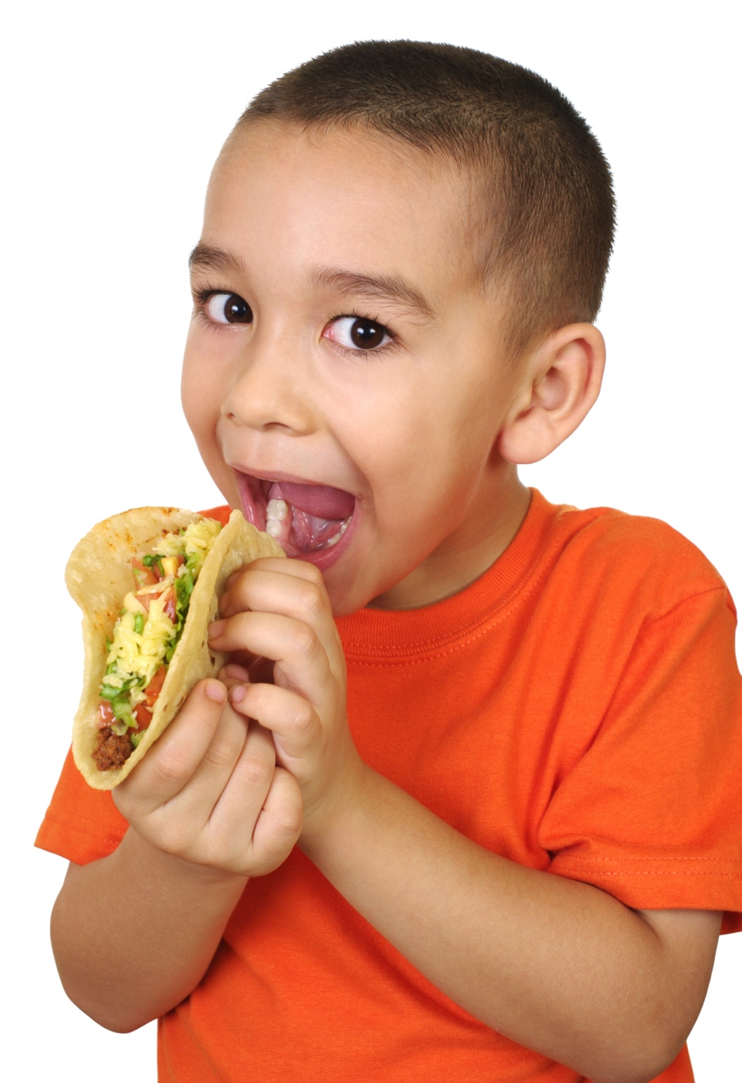
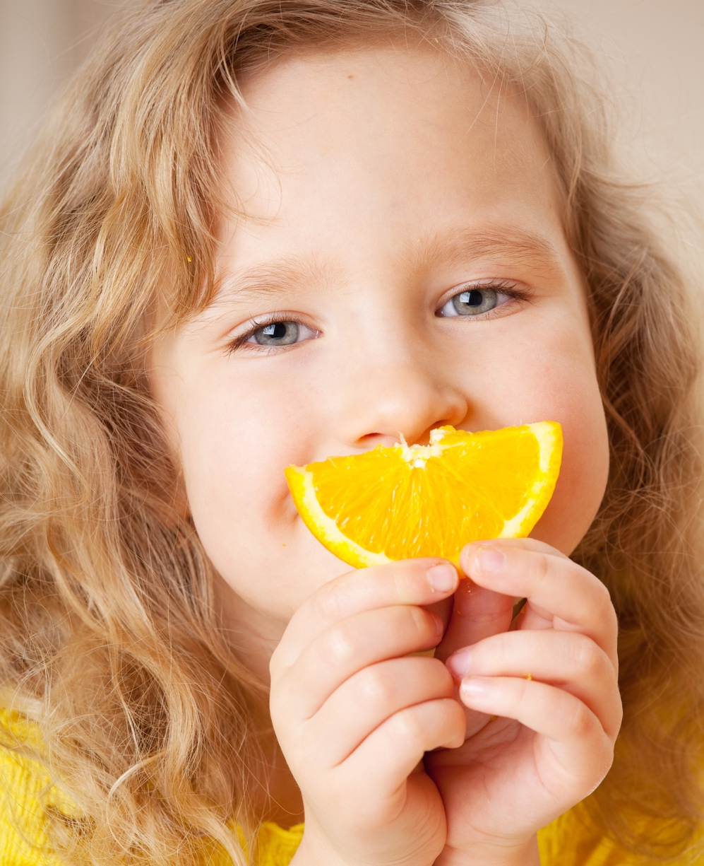
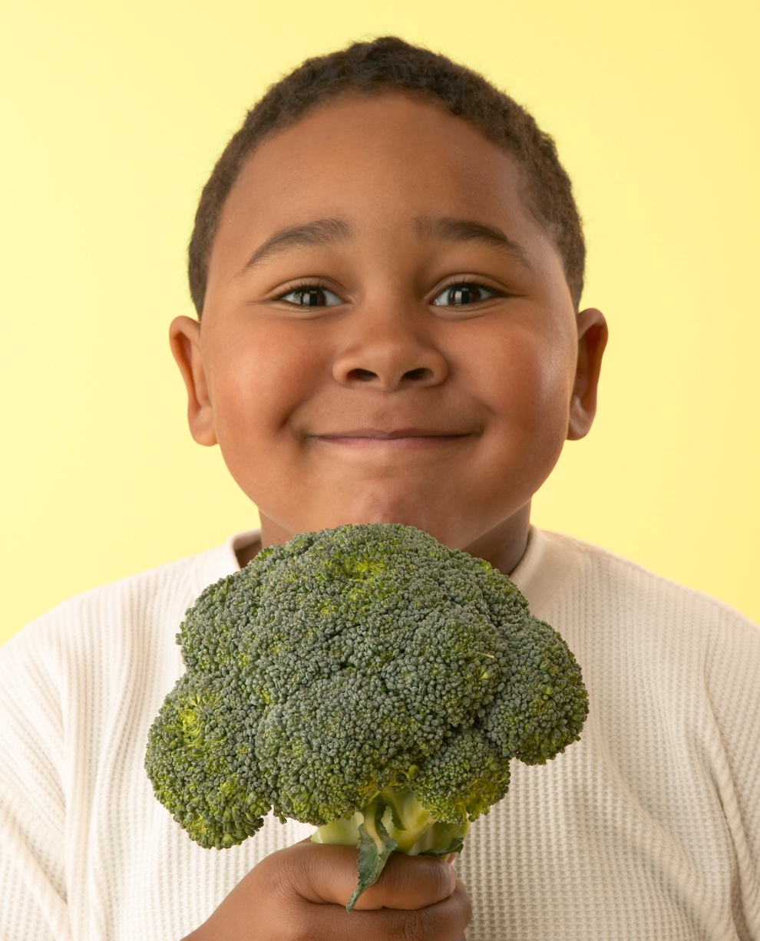
Why do we eat food?
Why do we eat food?
It smells good.
We like the flavors and textures.
We’re hungry.
Notes:
Ask: Why do you think people like to eat?
(Allow children to respond and then reinforce their comments by clicking on this slide.)
Say: We eat because something smells good. We eat because we’re hungry. We eat because we like the different flavors and textures of food like chewy, crunchy, salty and sweet.

Slide 9
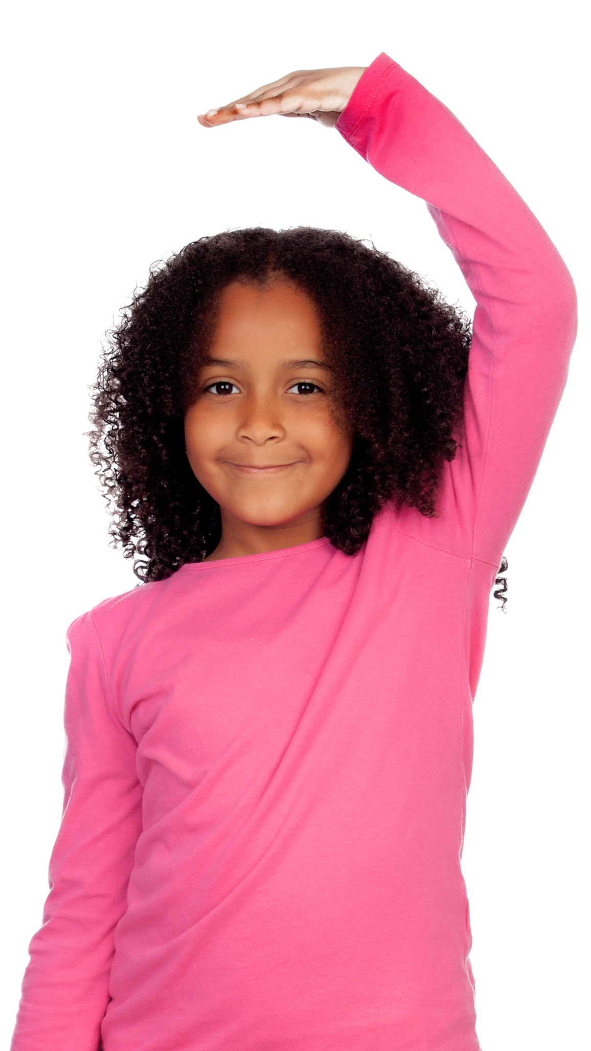
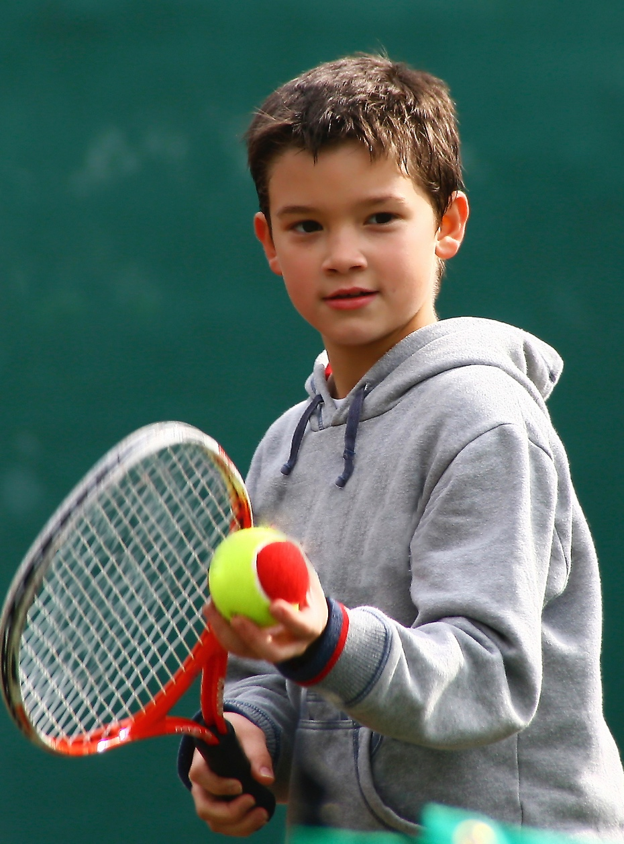
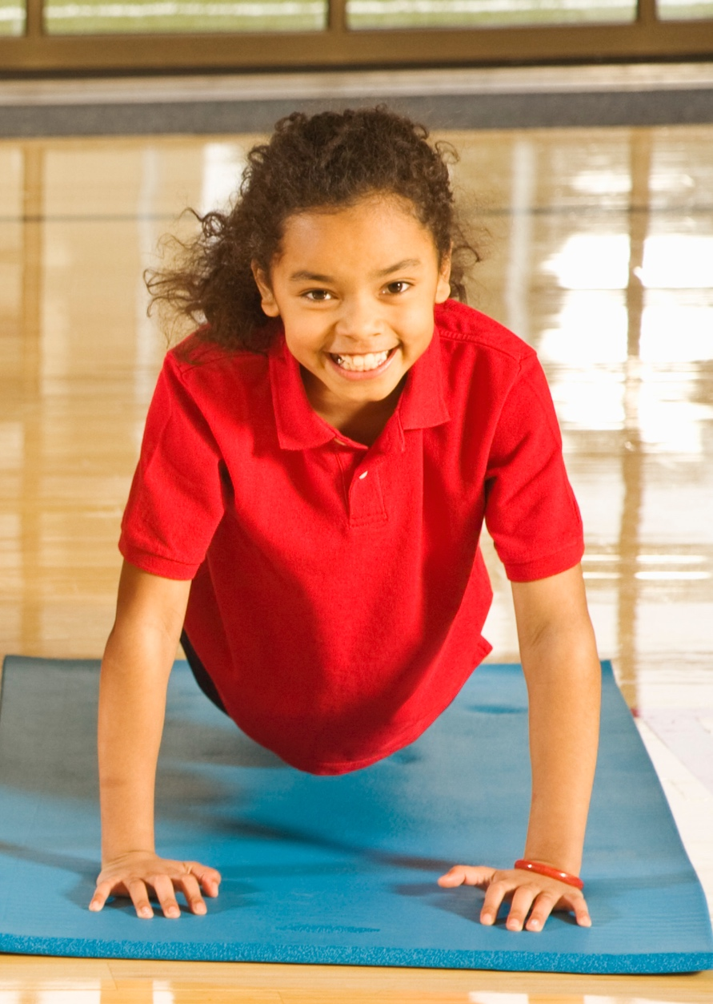
We need to eat food to…
We need to eat food to…
…grow.
…have energy
to learn and play.
…have strong bones and teeth.
Notes:
Ask: Why do we need to eat?
(Allow children to respond and then reinforce their comments by clicking on this slide.)
Say: We need to eat food to
help us grow,
to have energy to learn and play and
to have strong bones and teeth.

Slide 10


Notes:
Today, we’re going to focus on three FUN topics: foods, activity, and germs.
Say: Let’s begin by having some FUN with food. It all starts with a plate. Take a look at the plate on the slide. The plate is divided to show us the foods we should include each day to make a healthy plate. Let’s take a look at each of the food groups.
Ask: What food group is orange on the plate? (Grain) Open your workbook to the first page. Can you point to that part of the plate in your workbook? Good job.
Say: Down at the bottom find the box labeled “Grain.”
Ask: Who would like to read the names of the grains in the box? (Pick a student and allow them to read the grain names)
Say: Very good job! There are many other grains as well. (Review other grains shown on screen).
Ask: Think about all the grains we named. What is one of your favorite grains? (Choose 2-3 children to respond)
Say: Choose one grain you would like to eat for lunch and draw it or write the name in the grain section on MyPlate.

Slide 11

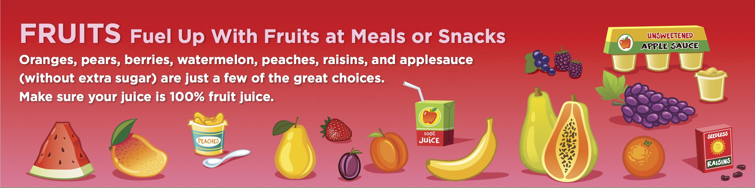
Notes:
Ask: Which food group is in red on the plate? (Fruit) Can you point to that part of the plate in your workbook? Good job.
Say: Down at the bottom find the box labeled “Fruit.”
Ask: Who would like to read the names of the fruits in the box? (Pick a student and allow them to read the fruit names)
Say: Very good job! What are some of your favorite fruits to eat? (Choose 2-3 students to respond). Great! Choose one of your favorite fruits you like to eat for lunch and draw it or write the name in the fruit section on MyPlate.

Slide 12

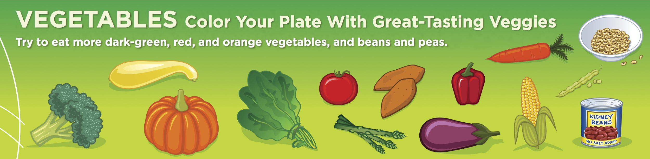
Notes:
Ask: Let’s look at the plate again. Which food group is in green on the plate? (Vegetables) Can you point to that part of the plate in your workbook? Good job.
Say: Down at the bottom find the box labeled “Vegetables.”
Ask: Who would like to read the names of the vegetables in the box? (Pick a student and allow them to read the vegetable names)
Say: Very good job! What are some of your favorite vegetables? (Choose 2-3 students to respond)
Say: Choose one of your favorite vegetables that you like to eat for lunch and draw it or write the name in the vegetable section on MyPlate.
Ask: Before we go any further, I want to ask you a question. How much of the plate is covered by the fruits and vegetables groups? (Half) What do you think that tells us about fruits and vegetables? (Important to our health) When you named your favorite fruits and vegetables how many colors were named? (Red, Yellow/Orange, Green, Purple, White)
Say: Fruits and vegetables come in many colors. Have FUN by choosing fruits and vegetables that are many different colors to eat each and every day.

Slide 13

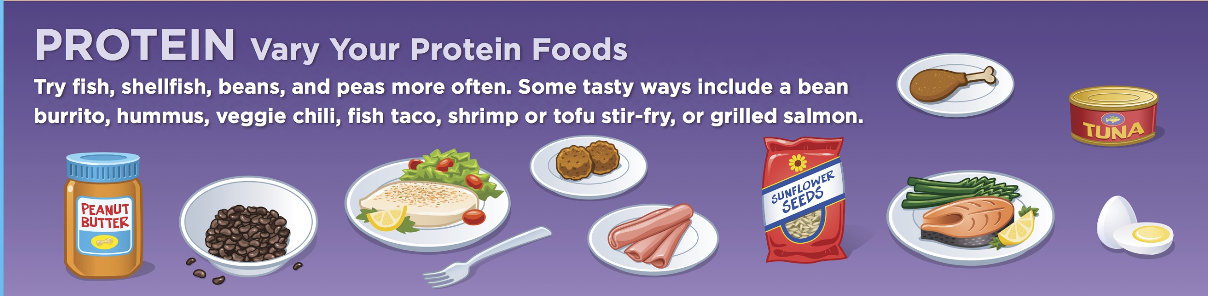
Notes:
Ask: Which food group is in purple on the plate? (Protein) Can you point to that part of the plate in your workbook? Good job.
Say: Down at the bottom find the box labeled “Protein.”
Ask: Who would like to read the names of the protein foods in the box? (Pick a student and allow them to read the protein names)
Say: Very good job! What is one of your favorite protein foods? (Choose 2-3 students to respond) Think of one of your favorite protein foods that you like to eat for lunch and draw it or write the name in the protein section on MyPlate.

Slide 14

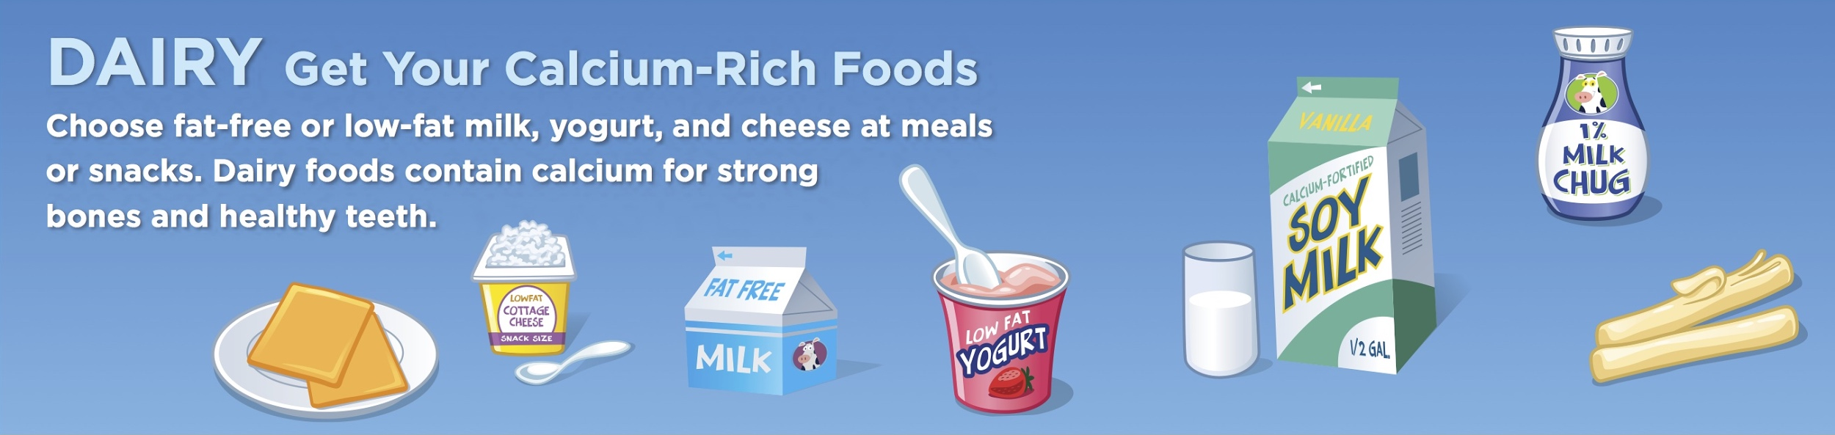
Notes:
We have filled our plate, but there is one food group that we sometimes eat, but often drink. In fact, you may even drink a food from this group at lunch.
Ask: Which food group is the blue group? (Dairy) What do you think is the food in this group that we often drink? (Milk) Can you point to that part of the plate in your workbook? Good job.
Say: Down at the bottom find the box labeled “Dairy.”
Ask: Who would like to read the names of the dairy foods in the box? (Pick a student and allow them to read the dairy names)
Say: Very good job!
Ask: What is one of your favorite dairy foods? (Choose 2-3 students to respond).
Say: Choose one of your favorite dairy foods that you like to eat OR drink for lunch and draw it or write the name in the dairy section on MyPlate.
Ask: Take a look at your plate. Would someone like to share the foods on their lunch plate? (Choose 1-2 students to share). Great job, everyone!

Slide 15

Notes:
Say: Remember how we talked about fruits and vegetables taking up half our plates and that we need to eat a variety of colors of fruits and vegetables? I want to spend the next few moments sharing one of my favorite books with you. It’s called All Our Fruits and Vegetables by Roberta L/ Duyff and Particia McKissack. The beautiful pictures in this book are illustrated by Michelle Doreenkamp.
(Read the book)
Ideas to enhance the book reading (At a minimum, ask at least 2 questions to check comprehension):
Pages 4-7 - If time allows: Have the children plant vegetable seeds in a cup
Pages 8-9 –Have students point out the vegetables that are leaves, roots, seeds, stalks and flowers.
Pages 12-13 – Have students name one vegetable they have never tried before that’s in the picture.
Page 21 – Ask where pears, grapes and apples grow – a vine, bush or tree
Page 22-23 – What fruits do you see that you’ve never tried before? What fruits are your favorite?
Page 24-25 – What would you put in your fruit salad?
Page 26-27 – Have you ever made fresh orange juice or lemonade/limeade by squeezing the juice out of the fruit?
Page 30-31 – Have the children name as many of the fruits and vegetables that they can. Be ready to supply the name for the ones they don’t know.
Okra, tomatoes, turnip, sweet potato, apple zucchini, banana, rhubarb, lettuce, potato, green and red bell peppers, plum, raspberry, cantaloupe, celery, kiwi, pineapple, orange, strawberries, pear, blueberries, carrots, cabbage, peas, starfruit, bok choy, broccoli, cherries, corn, eggplant
(Ask the teacher if she wanted to share anything else about the book.)

Slide 16
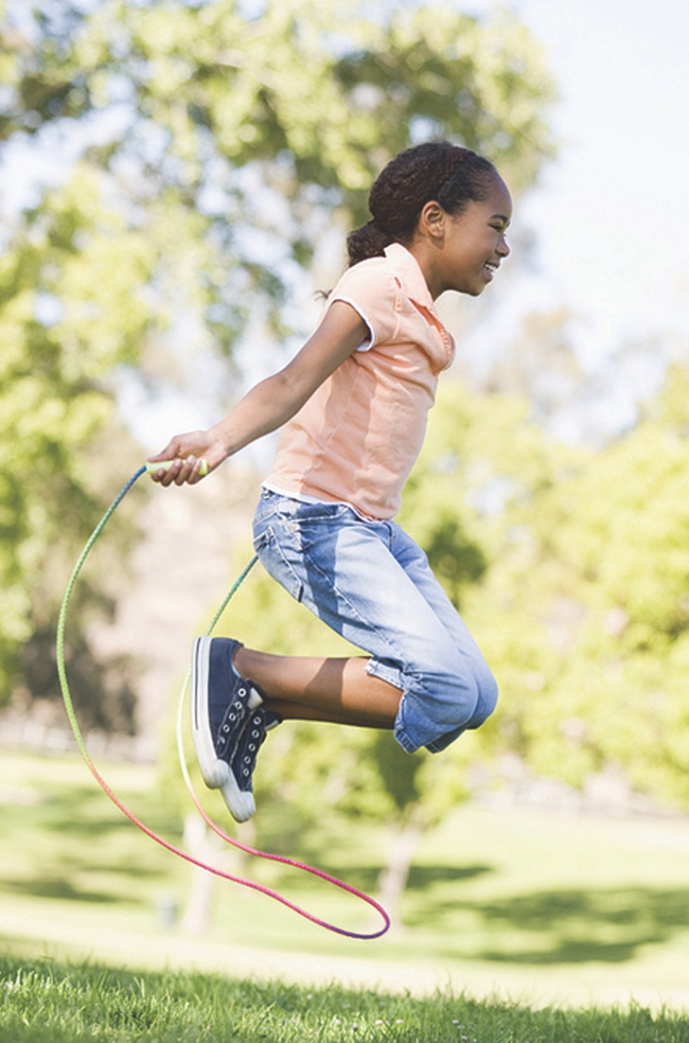
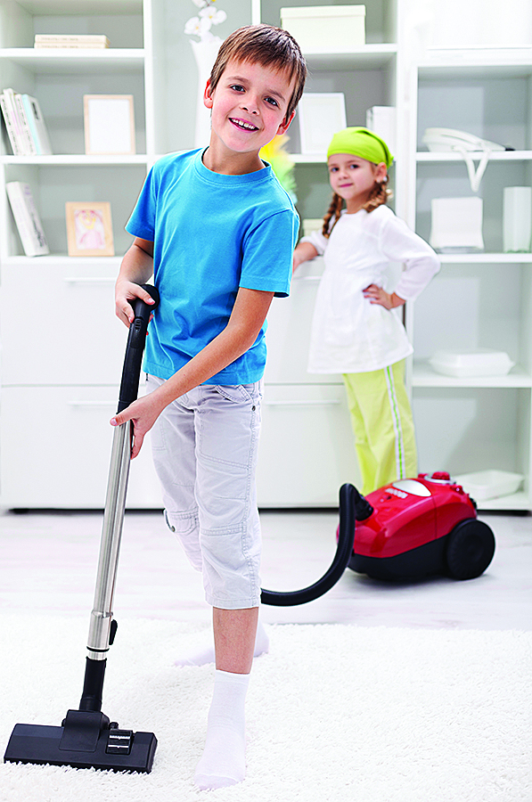
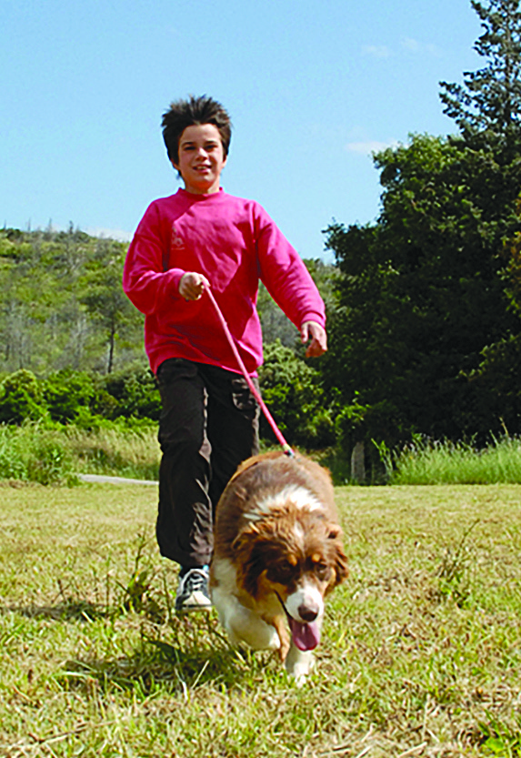
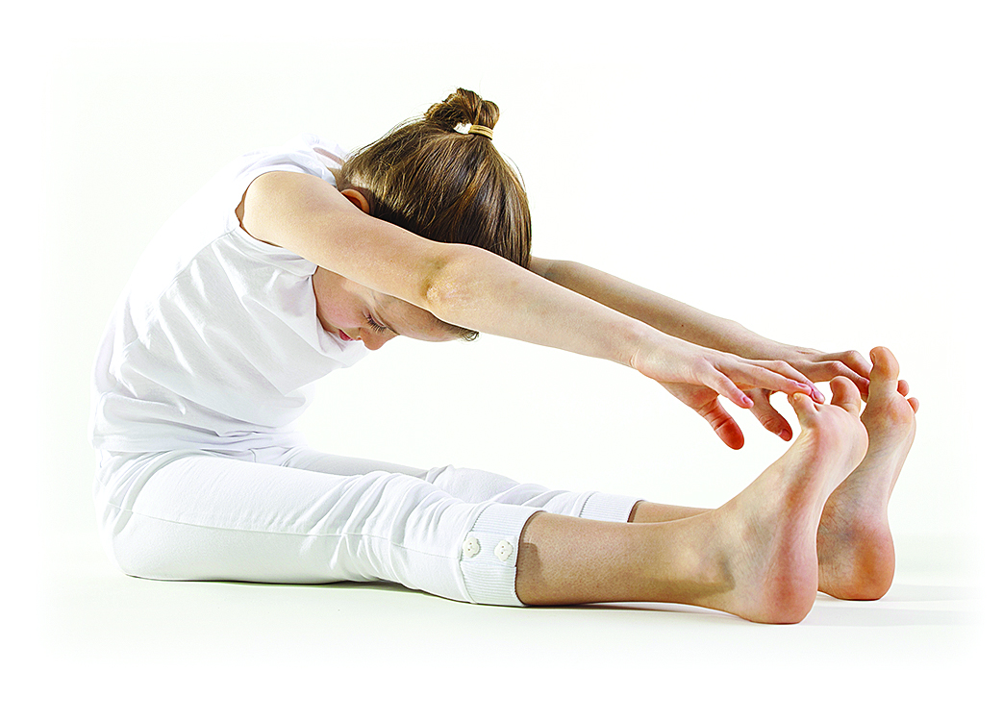
Notes:
Script:
Say: Take a look at these pictures.
Ask:
What do you see the children doing?
Say: The general name we use to describe things like stretching, yoga, jumping, running, biking and vacuuming is Activity. Activity is something that gets us up and moving. Most of the time, activity is FUN, but sometimes we do an activity like, cleaning up that may not be quite so much fun. The most important thing is to BE ACTIVE every day! And, even if the activity is only a little fun, we can make it more FUN!
Ask
What could you do to make cleaning your room more FUN? (turn on music and dance while cleaning)
What do you think these children are trying to tell us? (We need to move our bodies every day)
Say: There are three levels or types of physical activity. They are:
Stretching and strengthening – which pictures show this?
Aerobic – which pictures show this?
Everyday Activities – which pictures show this?
Say: We need 60 minutes of play each day. All activity that you do counts towards your 60 minutes.
Say: Turn to page 2 in your workbook and circle your favorite activity in each group.

Slide 17
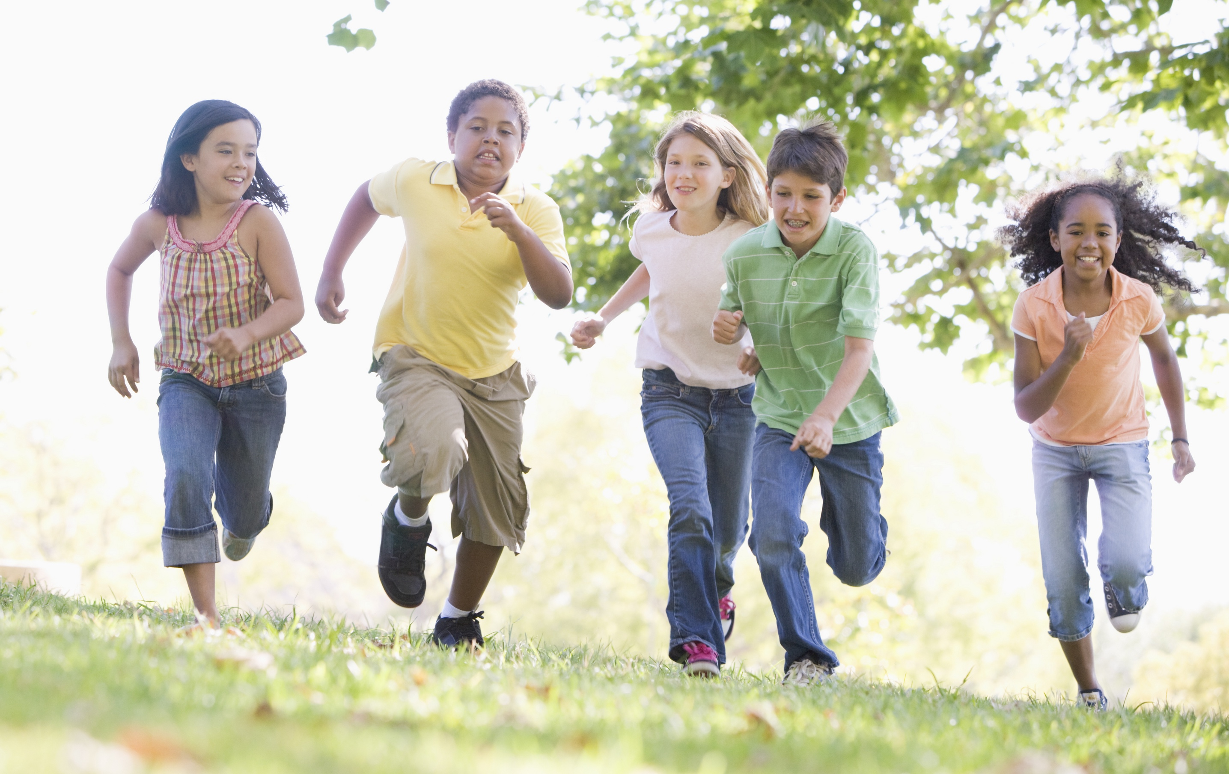
LET’S GET ACTIVE!
Notes:
Say: Let’s have some FUN being active together! Everybody stand up…we’re going to move our bodies for a few minutes.
Lead the kids through the Food Group Stretch (below) OR pick 5 Fit Food Activity cards from your kit – 1st graders should do each activity no longer than 2 minutes
Food Group Stretch:
Display the MyPlate poster in the classroom.
Lead students through the activity as follows:
Reach to the right and grab a grain for energy! Let’s grab a slice of whole wheat bread.
Now, let’s reach out in front of our bodies. Grab a vegetable with your left hand. Let’s grab some carrots. Carrots help our eyes adjust to see at night.
With our right hand, let’s grab a fruit. How about some delicious North Carolina blueberries? Blueberries help keep our brains healthy.
Now, reach way over to the left and grab some dairy. Let’s grab a cold glass of milk. Milk helps keep our bones strong.
And, reach way over to the right and grab some protein. How about a handful of North Carolina peanuts? Protein foods help keep our muscles strong.
Now, reach down to your toes and slowly all the way back up to the ceiling. You’ve just done the Food Group Stretch!

Slide 18

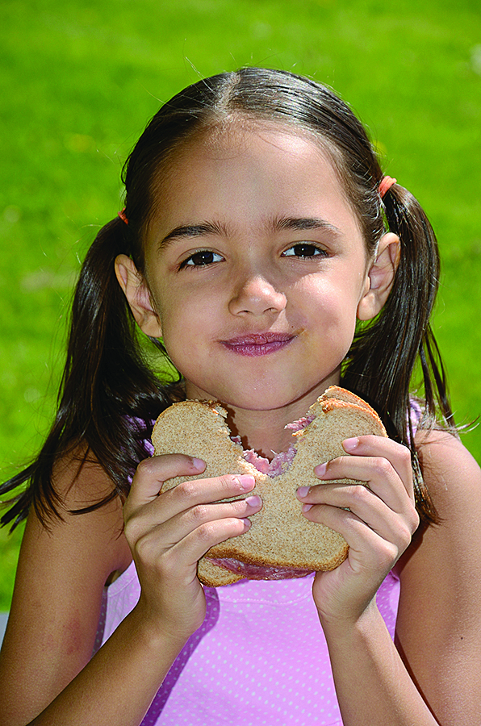
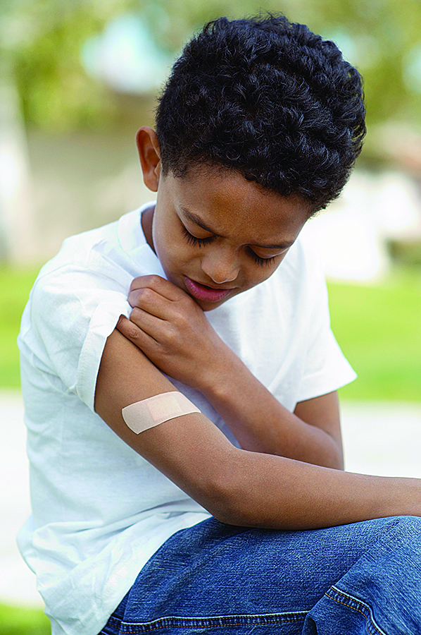
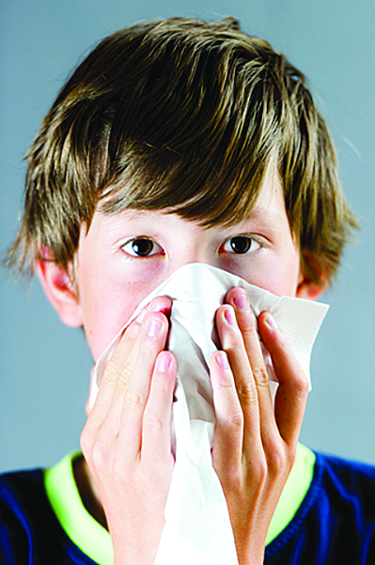
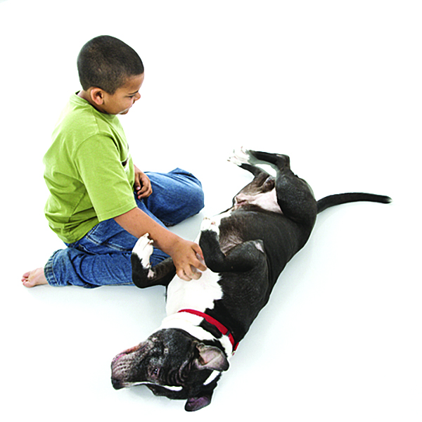
Notes:
Say: Let’s have some Fun with germs. Well, germs aren’t particularly fun because they can make you sick.
Ask: Can anyone tell us about a time when you got sick? (Choose 1 student)
Say: Being sick is NO Fun! We can prevent a lot of times we get sick by simply washing our hands properly. You know what is FUN? Fighting BAC! those germs. To help me explain how we can get rid of germs, I’d like to call on a germ friend of mine, named BAC. (Bring out puppet) BAC, say hello to the boys and girls. (Manipulate BAC puppet to nod and greet the students).
Say: BAC, short for bacteria is present on everything and these bacteria (or germs) can make us sick. This is especially true if we don’t wash our hands. Take a look at the pictures on page 3 of your workbook. When you look at each picture, think about whether you need to wash your hands Before the activity or After. (Wait for children to circle their responses.)
Say/Ask: Now, let’s go through each response together. (Call on individual students to share their responses. If the response is incorrect, have BAC shake his head yes. If the response is correct, have BAC shake his head no and hide his face. Tell the boys and girls, BAC is trying to fool us so that more of his friends can join us, but we don’t want MORE BACTERIA, do we?)
Ask: Can anyone tell me two things we use to wash our hands that BAC doesn’t like? (soap and water) That’s right, soap and water! (Say this to BAC and have puppet shake head no and act scared.)
Say: We need to wash our hands with soap and water for 20 seconds to keep BAC’s germy friends from staying with us and making us sick.
Ask: Does anyone know how long 20 seconds is? (allow 1-2 children to guess). Twenty seconds is the same amount of time that it takes you to sing your ABC song or the Happy Birthday song twice. Let’s pretend we are washing our hands and give it a try. (As the children near the end of the song, move the puppet out of sight.) Say goodbye to BAC!
Say: Good job, boys and girls! Isn’t it Fun to Fight BAC! Washing our hands with soap and water for 20 seconds before we eat or prepare food, after we use the restroom, after we cough or sneeze or blow our nose, and after we play outside or pet animals keeps BAC and his friends away and when they’re gone, we don’t get sick.
Ask: If you want a snack when you get home from school today, what should you do before making or eating your snack? (Wash your hands) If you decide to play ball with your friends this afternoon, what should you do before sitting down to eat dinner? (Wash your hands) By the way, that reminds me, we’re getting ready to try a Fun recipe so everybody needs TO: (let children say it with you) Wash our hands!
Say: Let’s try an experiment to see just how good of a job we do when washing our hands. This is a lotion that glows when you don’t wash an area as good as you should. I’m going to place a drop of the lotion in your hand and ask you to rub the lotion in on both hands and then go wash your hands. When everyone returns, we’ll check to see how much of your hands are glowing.
(Use the Glo-Germ and have the children wash their hands and see the remaining germs under the black light. Remind them how to wash their hands properly and that it should be for 20 seconds or the time it takes to sing the ABC song or the Happy Birthday song twice. Check each student’s hands using blacklight when they return to their seats)

Slide 19
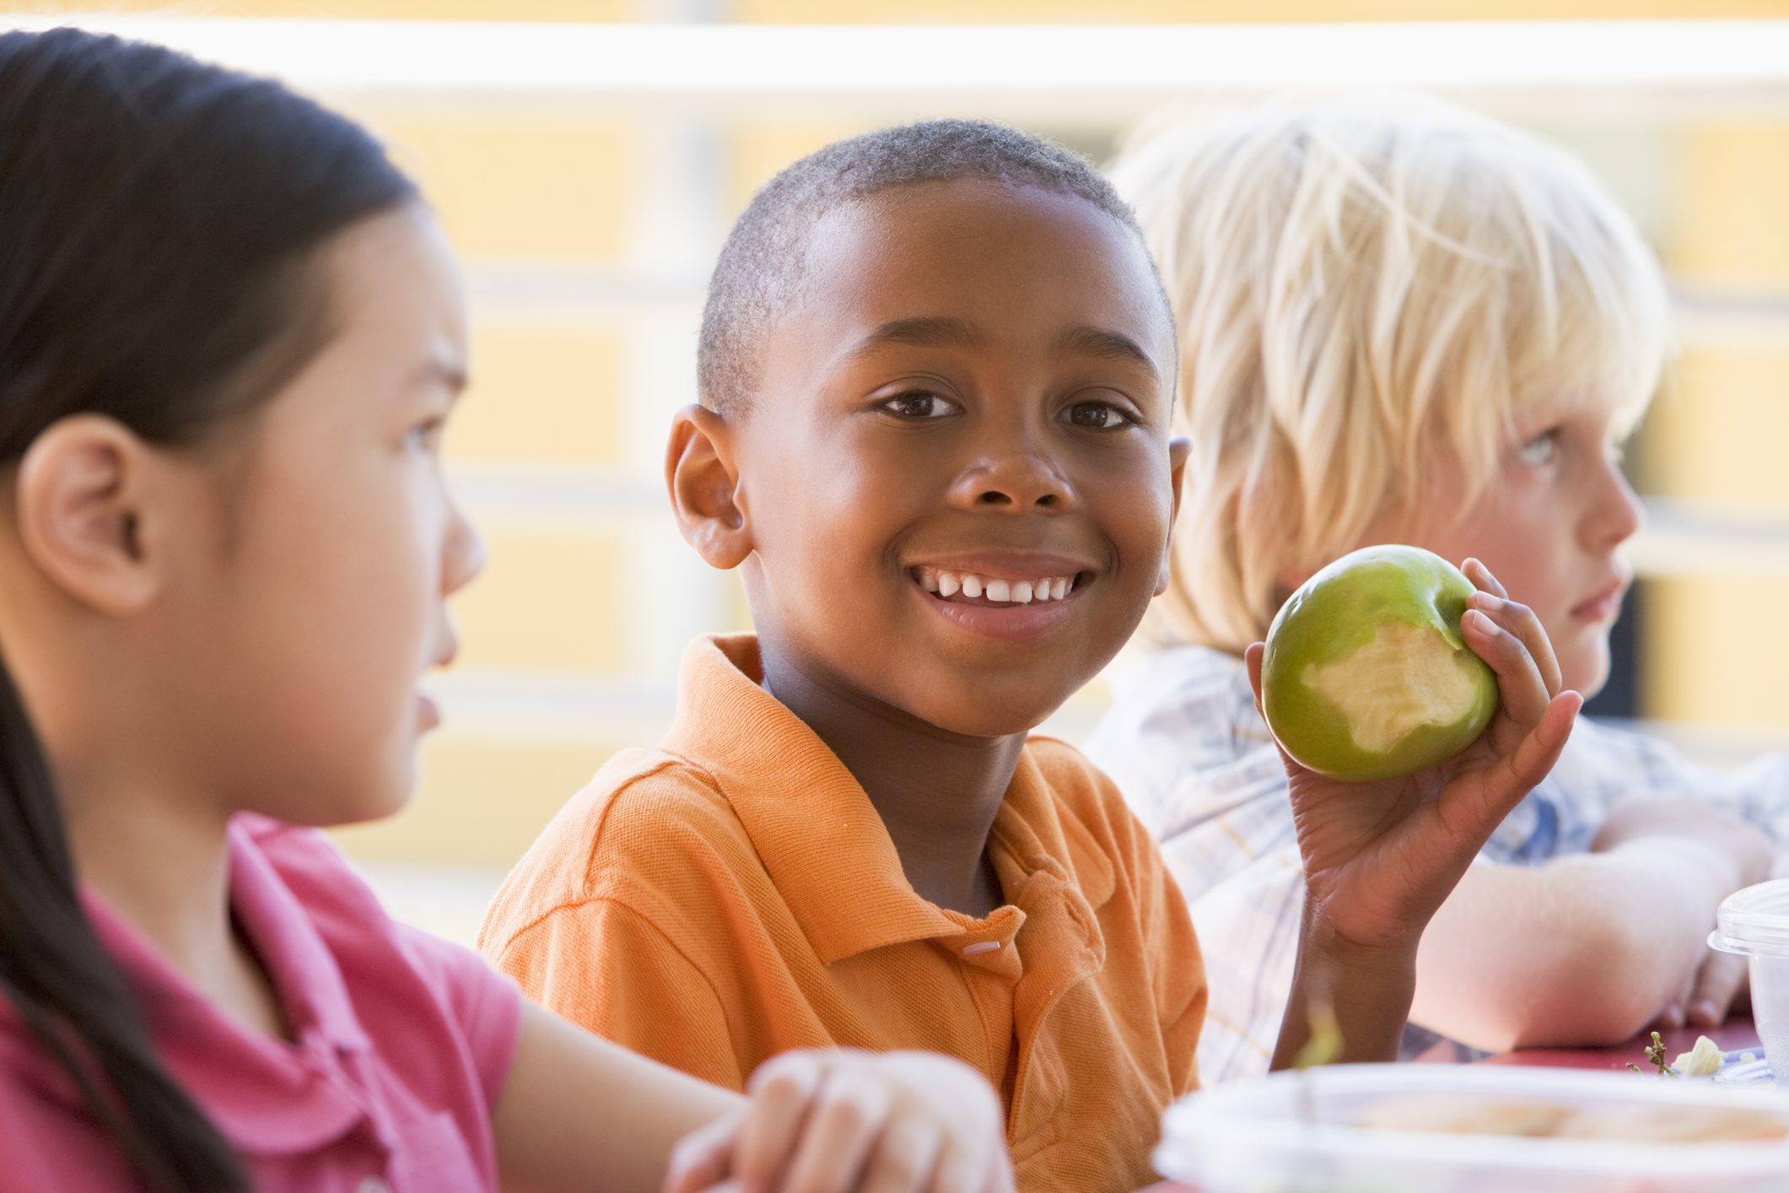
FOOD TASTING
Notes:
PA Note: Hide this slide if you are not doing a food tasting
Suggested food tasting for this lesson is Nearly a Five-Group Sundae – recipe found on page 4 in the workbook. If not doing a food tasting, review the recipe with the students and encourage them to make it at home when they take their book home at the end of the series of lessons.

Slide 20


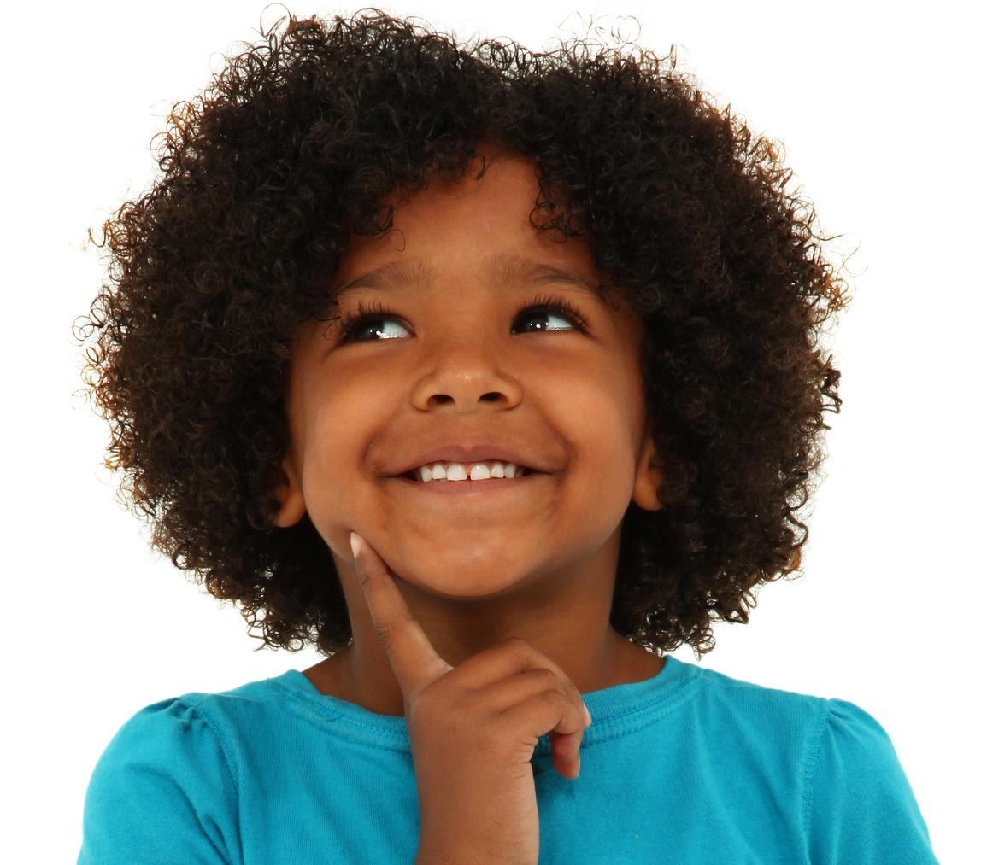
Notes:
Say: Today we had FUN with food, activity, and germs.
Ask: Who can tell me what you learned today? (Eat a variety of foods, wash your hands to prevent spread of germs, and move for at least 60 minutes every day.)

Slide 21
Notes:
Say: Turn to page 5 in your workbook and complete the sentences. While you’re working on those, I’ll come around a give you the Fitness Fun token for your book.
Say: Next time we’re together we’re going to learn some fun facts about the grain group. I have a little challenge for you this week. I want to ask everyone to try a new food at lunch at least one day during the next week and to remind each other to wash your hands with soap and water for 20 seconds. Your teacher will be watching and listening to see who meets this challenge.

