Slide 1
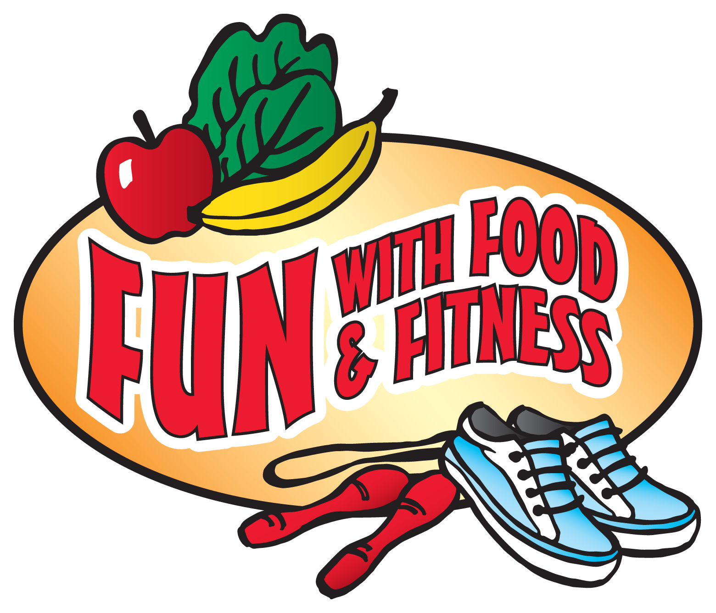



Notes:
SCRIPT:
Say: Good morning/afternoon boys and girls. If you can remember from my last visit, my name is ________________ and I am from EFNEP. Remember we’ve been learning about how you can be healthy and have FUN with Food and Fitness. Let’s keep learning and having FUN!

Slide 2
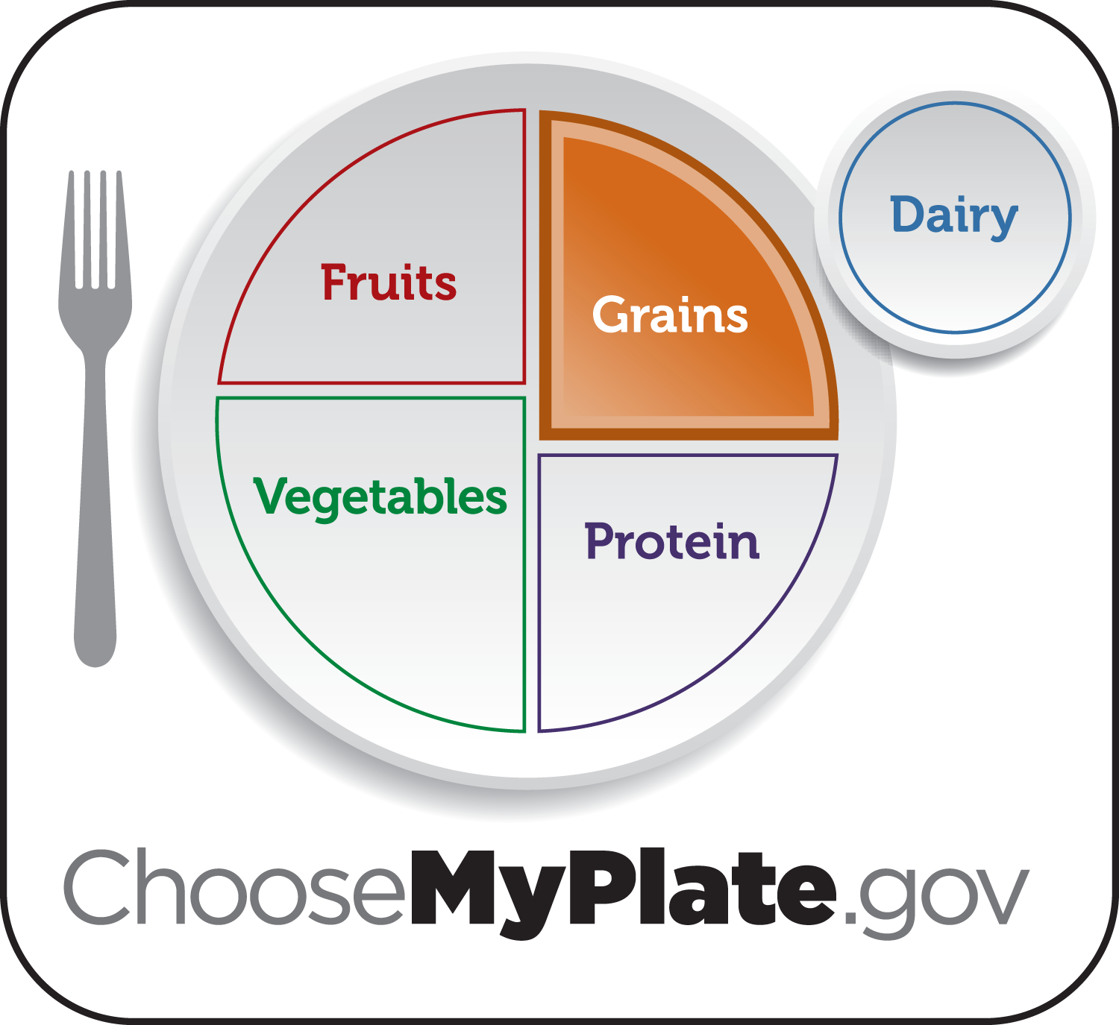
Notes:
Ask: Can anyone remind me what kinds of FUN we had last week and what the lesson was about? Here’s a clue (point to screen).
(allow time for children to raise hands)
Say: Great, that’s right! We learned about grains, the orange food group plus we had FUN being physically active and learning about germs.
Ask: Who can give me some examples of grains?
breads, pasta, rice, popcorn, oatmeal, etc.
Ask: Can anyone remind me what grains do for our bodies?
gives us energy to go – for playing, working, growing, learning and having FUN.
Ask: With a raise of hands, who tried a new grain this past week?
(allow students to raise hands and give praise; That’s great!)
Ask: Does anyone remember what lesson we’ll be learning today while having FUN?
I’ll give you some clues; this food group has foods that are crunchy, colorful, and taste wonderful.
Say: Today we are moving onto the green food group (point to MyPlate)
(next slide to answer question)

Slide 3
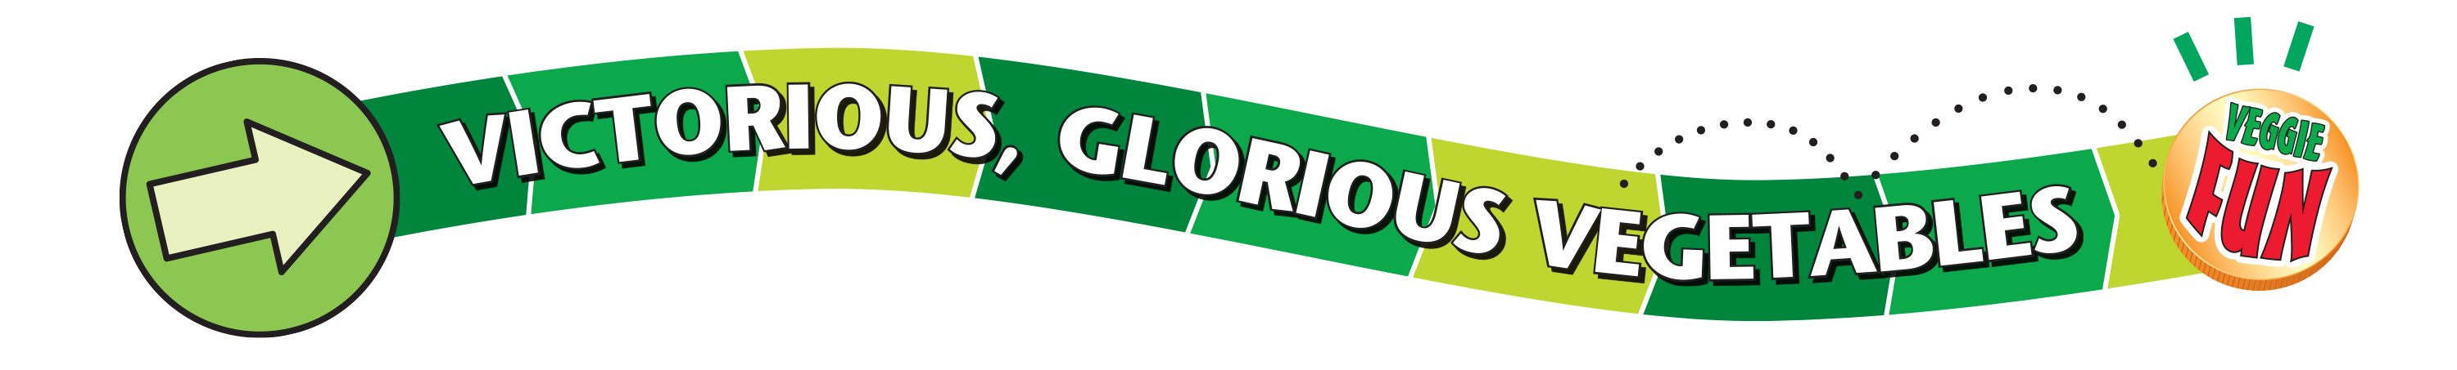
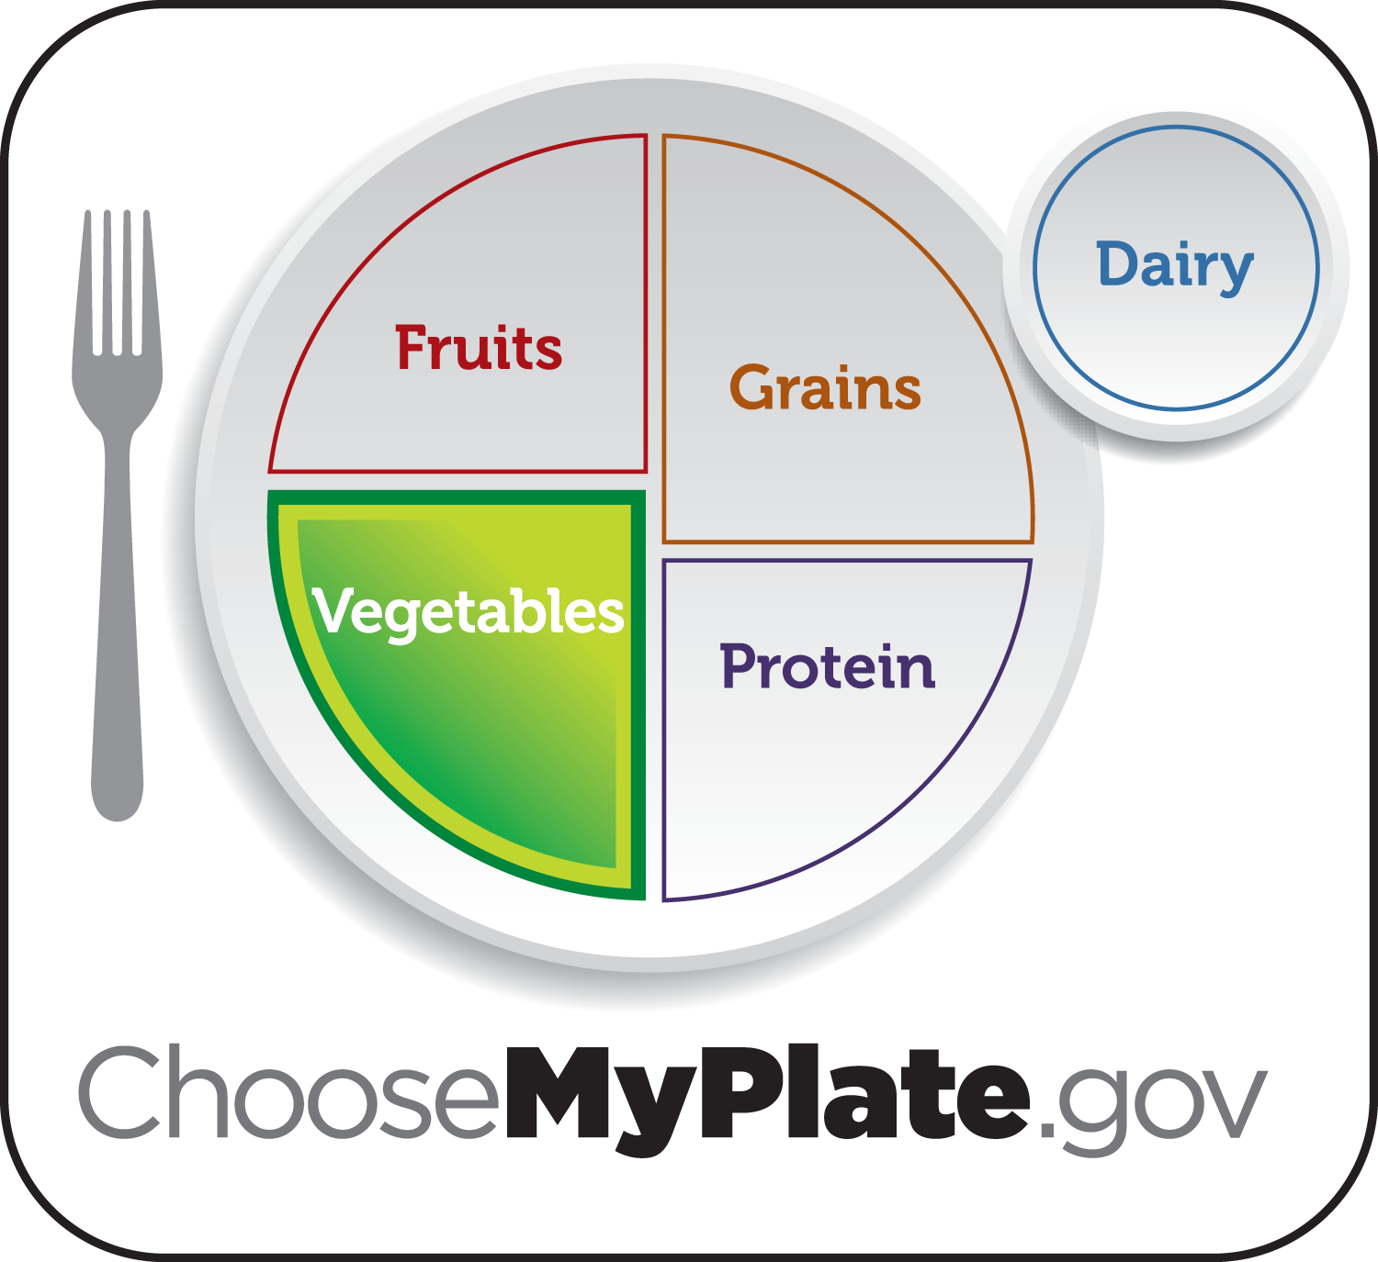
Notes:
Say: Victorious, Glorious Vegetables!
Ask: Who can share with the class their favorite vegetables?
(use foods models to prompt students)
(When one student answers…)
Ask: With raise of hands, who else in the class likes to eat _____?
Ask: I wonder what your teacher’s favorite vegetable is? Mr/Ms ______ can you share your favorite vegetable?
Say: Besides the fact that vegetables taste great, did you know they are good for us? They help us have healthy skin and shiny hair, help our cuts and bruises heal, help fight germs, and help us see in the dark!
We want to vary our veggies and try lots of different kinds.

Slide 4
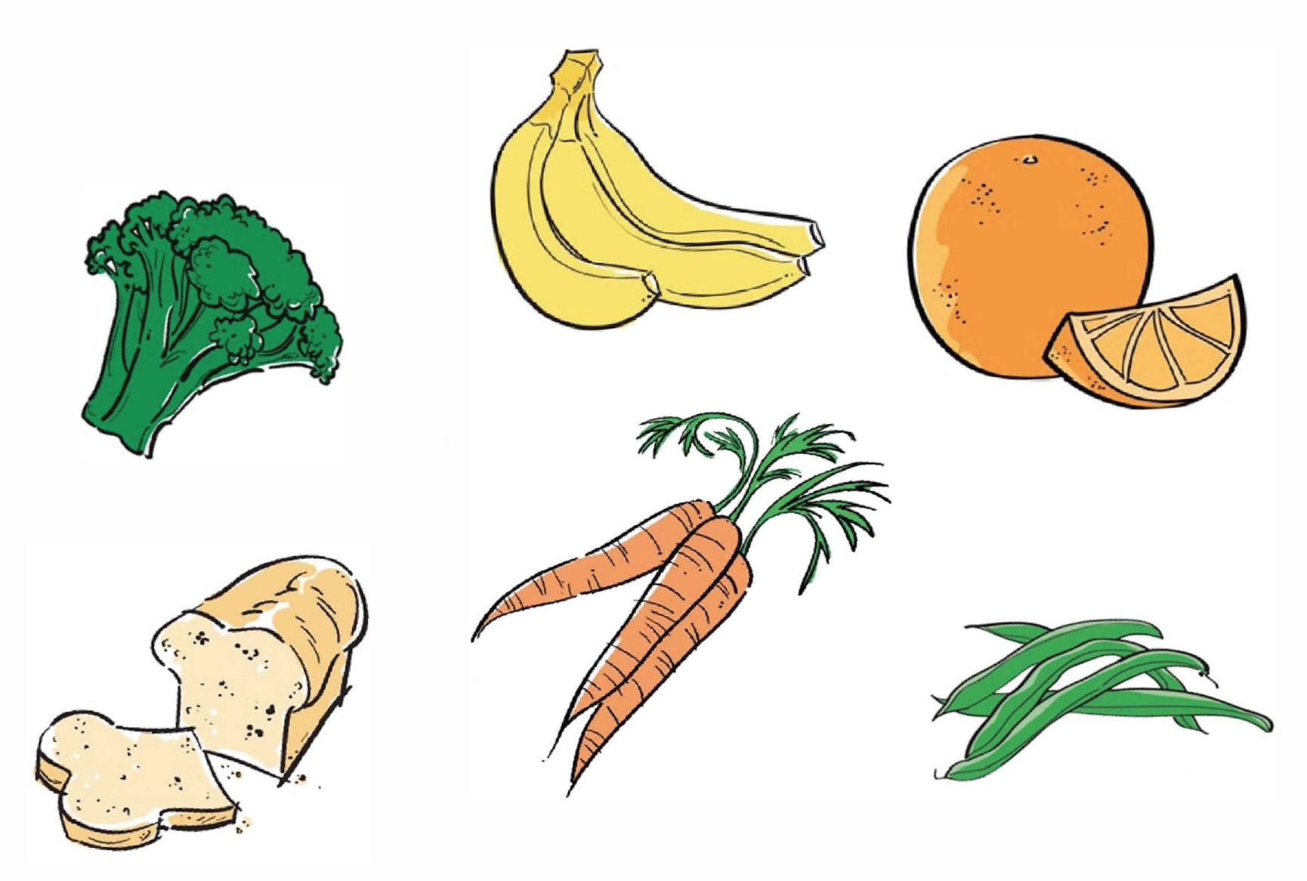
Notes:
Ask: Please open your workbooks and turn to page 10, and we’ll complete the “Victorious, Glorious Vegetables” activity together. Circle the all the vegetables.
(Go over each picture and ask different kids whether or not each food is a vegetable.)
Ask: Can you name other vegetables?
Cauliflower, celery, squash, cucumbers, peppers, eggplant, turnips, kale, etc.
(Use food models if possible.)

Slide 5
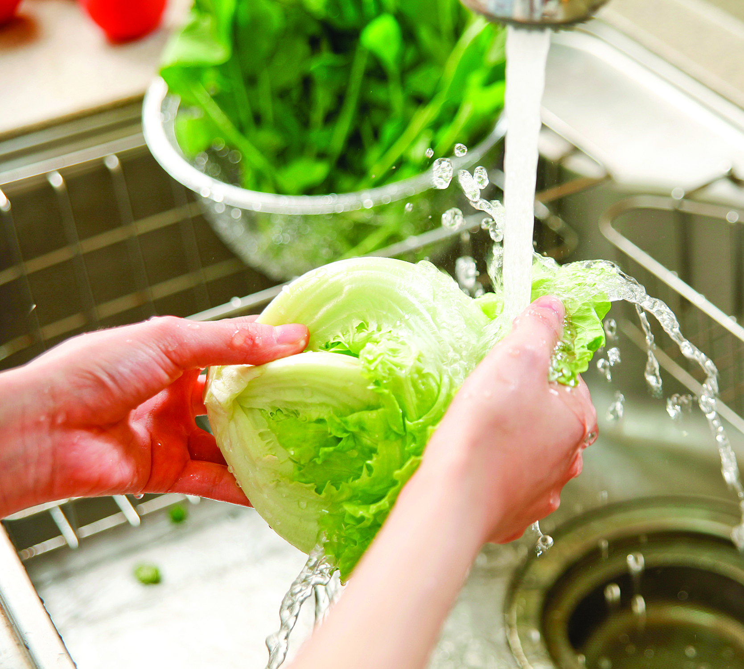
Wash fresh vegetables under cold, running water to let the dirt and germs wash away.
Notes:
Food Safety – Washing Vegetables Activity (5mins)
(using food models, pretend to wash vegetables)
Ask questions, prompting with answers as needed:
Ask: When we eat fresh vegetables, what do we need to do first? Wash them.
Ask: Why do we need to wash them? They have dirt and germs on them. Germs can make us sick which is NO FUN.
Say: We need to make sure food is clean before we eat it. Wash fresh vegetables under cold, running water to let the dirt and germs wash away.
Say: We will talk more about washing fruits and vegetables in our next lesson on fruits.
Ask: Let’s take a moment to think about what we would do when we’re at home and want a snack before going outside to have FUN being physically active. There are some grapes in the refrigerator that look crisp and yummy. What should you do before you eat them?
Wash them!

Slide 6
Notes:
Ask: Let’s look back in our workbook, page 11. Together let’s complete the “Choose the Healthy Vegetable Snacks” activity. Which vegetable combinations are going to be healthier for us, which are going to keep our bodies going so we can continue to have FUN each day. Circle the healthier snacks.
(Go over pictures in pairs: carrots vs. onion rings, french fries vs. broccoli with dip, celery with peanut butter vs. candy bar. Ask different kids whether or not each food is a healthy vegetable snack.)
(If time permits you can explain more what the fried/fatty foods aren’t great options.)

Slide 7
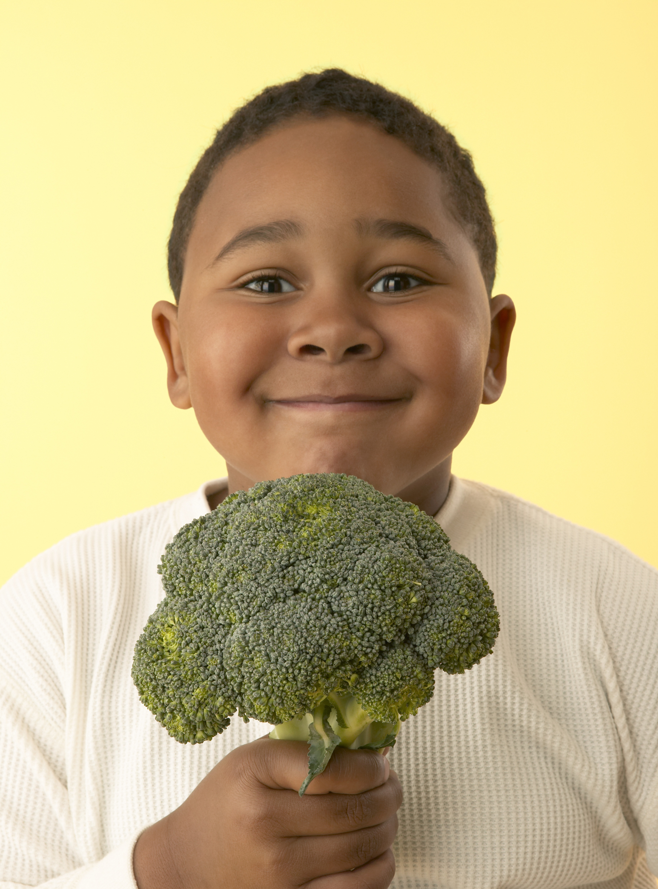

Please…
Notes:
Say: Now we are going to do an activity that reminds us of how to politely ask for foods.
Asking for Food activity (5-10mins)
Ask questions, prompting with answers as needed:
Ask: Who buys you food? Who prepares your food? parents, grandparents, brothers, sisters, etc.
What if you wanted to try a new vegetable or what if there is another healthy food that you would like to eat? How would you ask? Would you say please? Yes.
What else would be a good idea? Ask nicely; as at a good time.
Say: Let’s practice. (Read through the following scenarios. You should read the “When” and let students answer “how” they would ask.)
When: When you are at the grocery store with a parent or caretaker and you want bananas or another healthy food.
How: “May we please get some bananas (or another healthy food)?”
When: Just before a parent or caretaker goes to the grocery store and you want fresh fruit.
How: “ ___, I would like some fresh fruit. Would you please add bananas (or another food) to the list”
When: When a babysitter, older sibling, or caretaker is preparing an after-school snack and you want carrot sticks (or another healthy food).
How: “____, may I please have some carrot sticks (or another healthy snack) for (or with) my snack?”
When: When at a friend’s house after school and you want fresh fruit or vegetable.
How: Friend asks, “Are you hungry for a snack? What sounds good?” You reply, “How about fresh fruit or a vegetable?”
That was FUN practicing how to ask for healthy foods!

Slide 8
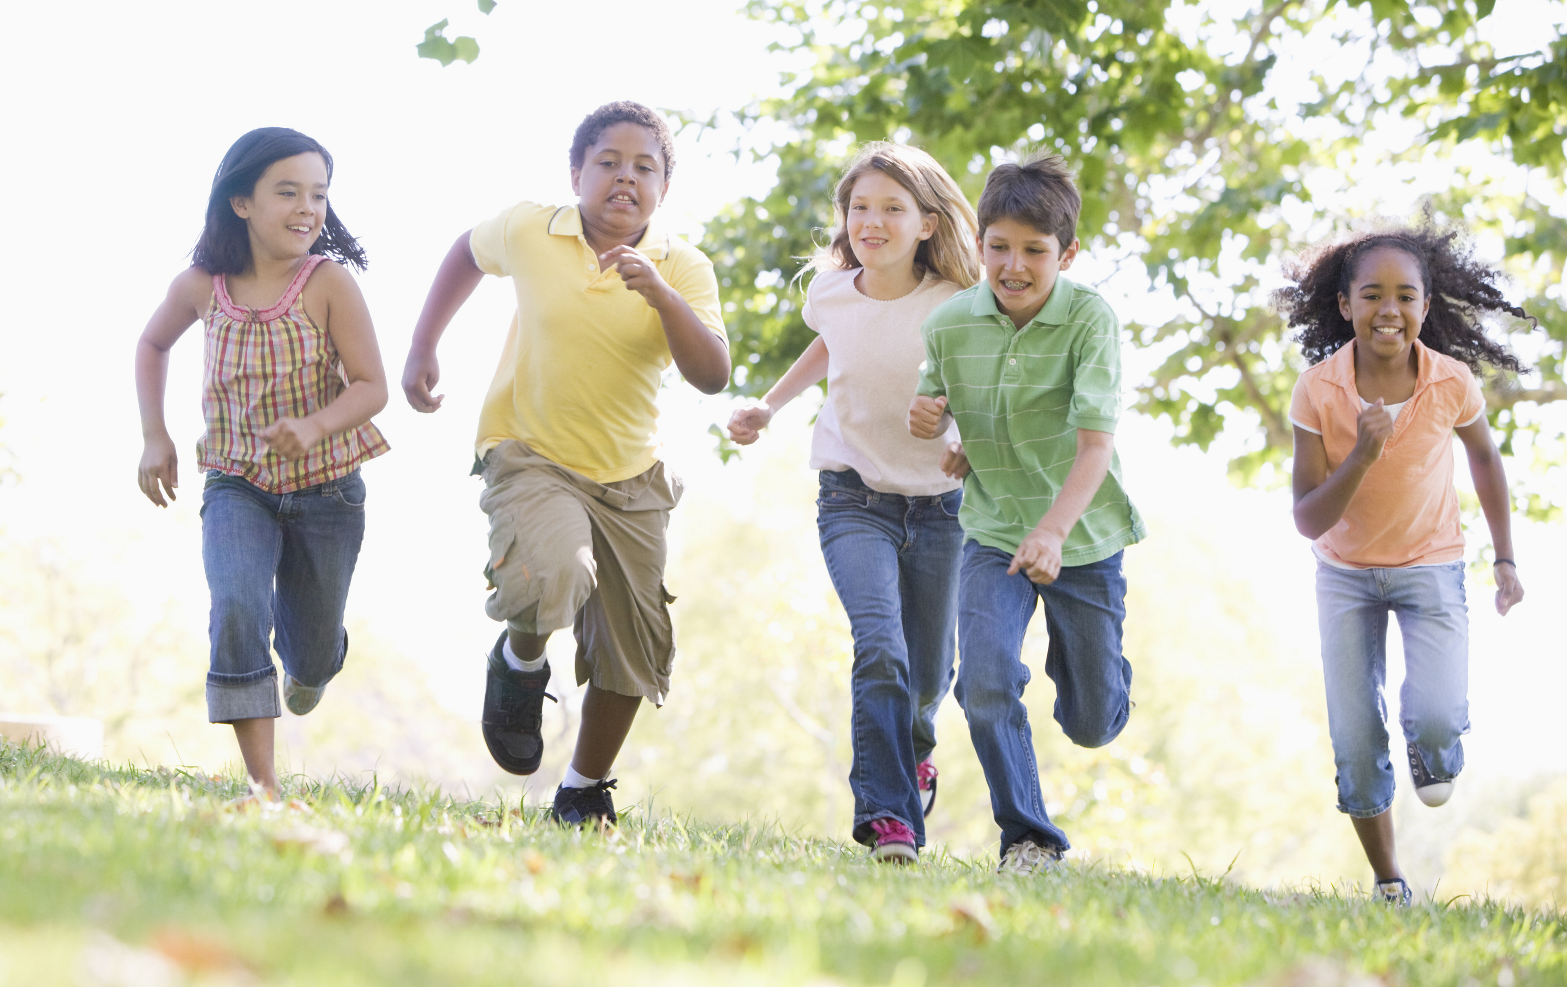
LET’S GET ACTIVE!
Notes:
Say: Let’s have some FUN being active together! Everybody stand up…we’re going to move our bodies for a few minutes.
Lead the kids through “The Talking Rutabaga Says…” (below) or “Superpower Vegetables” song from the Jump and Jill CD (in kit)
The Taking Rutabaga Says… (10-15mins)
Say: We all need food to be healthy, and we need to move our bodies, too. We should stretch our muscles and, most days, do activities that make our hearts beat faster.
Say: Let’s try this FUN activity; we are going to play a game called The talking rutabaga says…
Ask: Before we play, can anyone tell me what a rutabaga is? (allow time for student to answer, and hold up turnip food model if have)
A rutabaga is a root vegetable that grows underground, similar to the turnip or carrot. Rutabagas are typically white and purple in color. Rutabagas can be baked, boiled, mashed, roasted or eaten raw.
Say:
Now how to play the game. I will tell you to do an exercise. Do the exercise only if I say “the talking rutabaga says” to do it. If you do the exercise and I did not say “the talking rutabaga says,” you must sit down. (you may act out the exercises)
Let’s practice.
The talking rutabaga says… run in place.
Hop on one foot. (anyone doing it must sit down because I didn’t say “The talking rutabaga says...” hop on one foot.)
Let’s Play! (exercise ideas below)
Jump up and down
Eat a carrot for a snack
Play basketball
Drink some milk
Swim
Dance
Whisk an egg
Dig up a potato
Shake all over
March in place
Clap your hands behind your back
(End with “The talking rutabaga says… rest and relax.”)

Slide 9
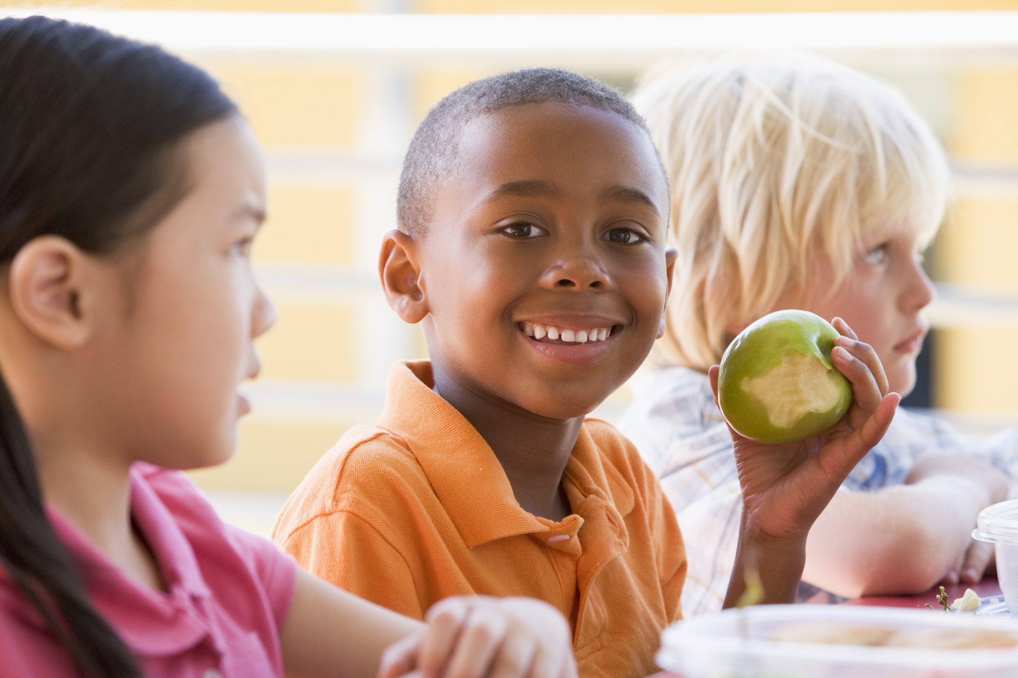
FOOD TASTING
Notes:
PA Note: Hide this slide if you are not doing a food tasting
Suggested food tasting for this lesson is Bunny Dip– recipe found on page 12. If not doing a food tasting, review the recipe with the students and encourage them to make it at home when they take their book home at the end of the series of lessons.

Slide 10
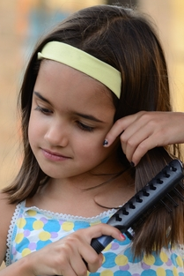
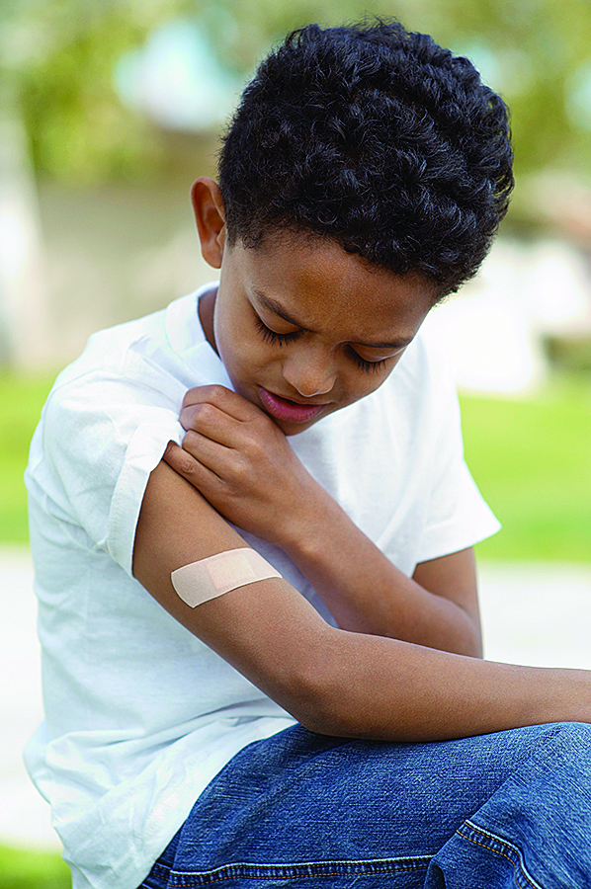
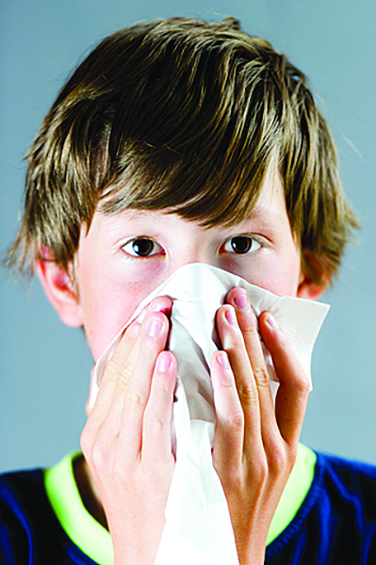

Vegetables help us…
…have healthy
skin and
shiny hair.
...heal cuts
and bruises.
...fight germs.
...have eyes that can see
in the dark.
Notes:
Ask: Before we end our lesson on Vegetables, who can tell me why vegetables are good for us?
Important to our health. They help us have healthy skin and shiny hair, help our cuts and bruises heal, help fight germs, and help us see in the dark!
Say: We want to make sure we eat a lot of different vegetables. Call out a new vegetable that you will try.
Carrots, cauliflower, celery, squash, cucumbers, peppers, eggplant, turnips, kale, onions, etc.
Ask: Who can tell me some different colors of vegetables?
Red, Yellow/Orange, Green, Purple, White, etc.
Say: Have FUN by choosing vegetables that are many different colors to eat each and every day.

Slide 11
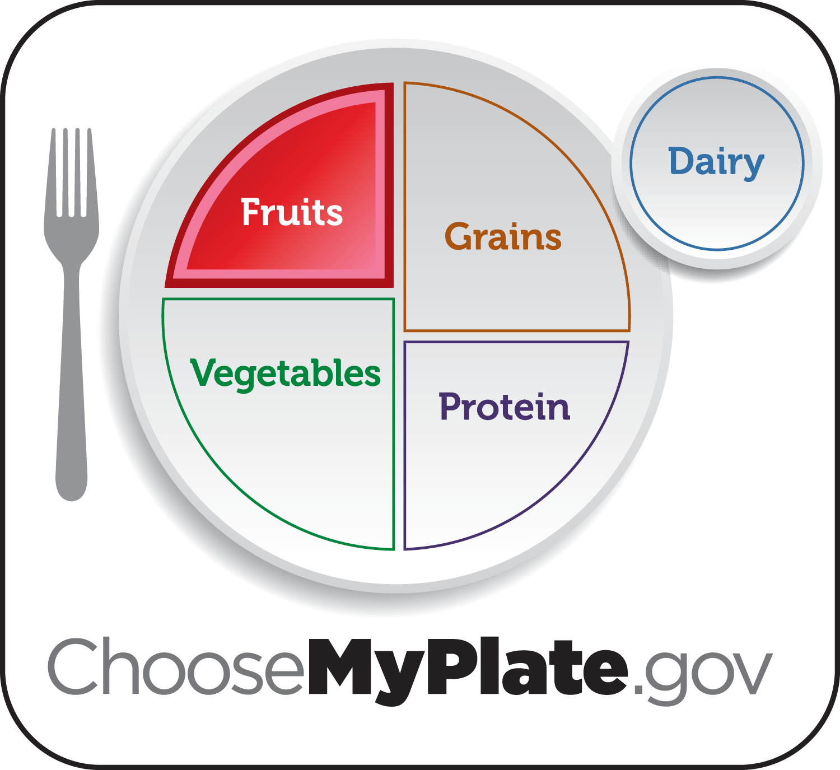
Notes:
Say: Next time we’re together we’re going to learn some fun facts about the fruit group.

Slide 12
Notes:
Say: Turn to page 13 in your workbook and complete the sentences. While you’re working on those, I’ll come around a give you the Veggie Fun token for your book.
Say: I have a little challenge for you this week. I want to ask everyone to try a new vegetable food at lunch at least one day during the next week and to remind each other to wash your vegetables before eating them. Your teacher will be watching and listening to see who meets this challenge.

