Slide 1
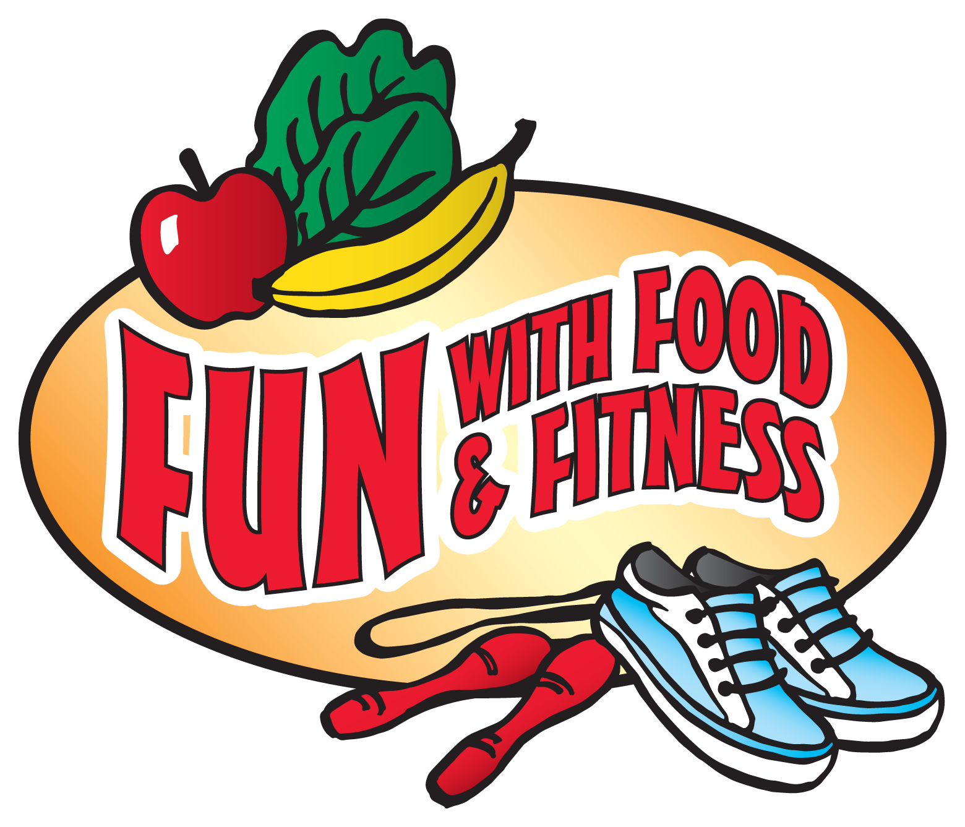



Notes:
SCRIPT:
Say: Good morning/afternoon boys and girls. How is everyone?
Ask: Can anyone remind us what we have learned about in FUN with Food and Fitness over the past few weeks?
Healthy eating, importance of physical activity, food safety, food groups, etc.
Say: After today’s lesson, we only have 2 more classes of FUN to complete the program then you’ll get to take your workbooks home.

Slide 2
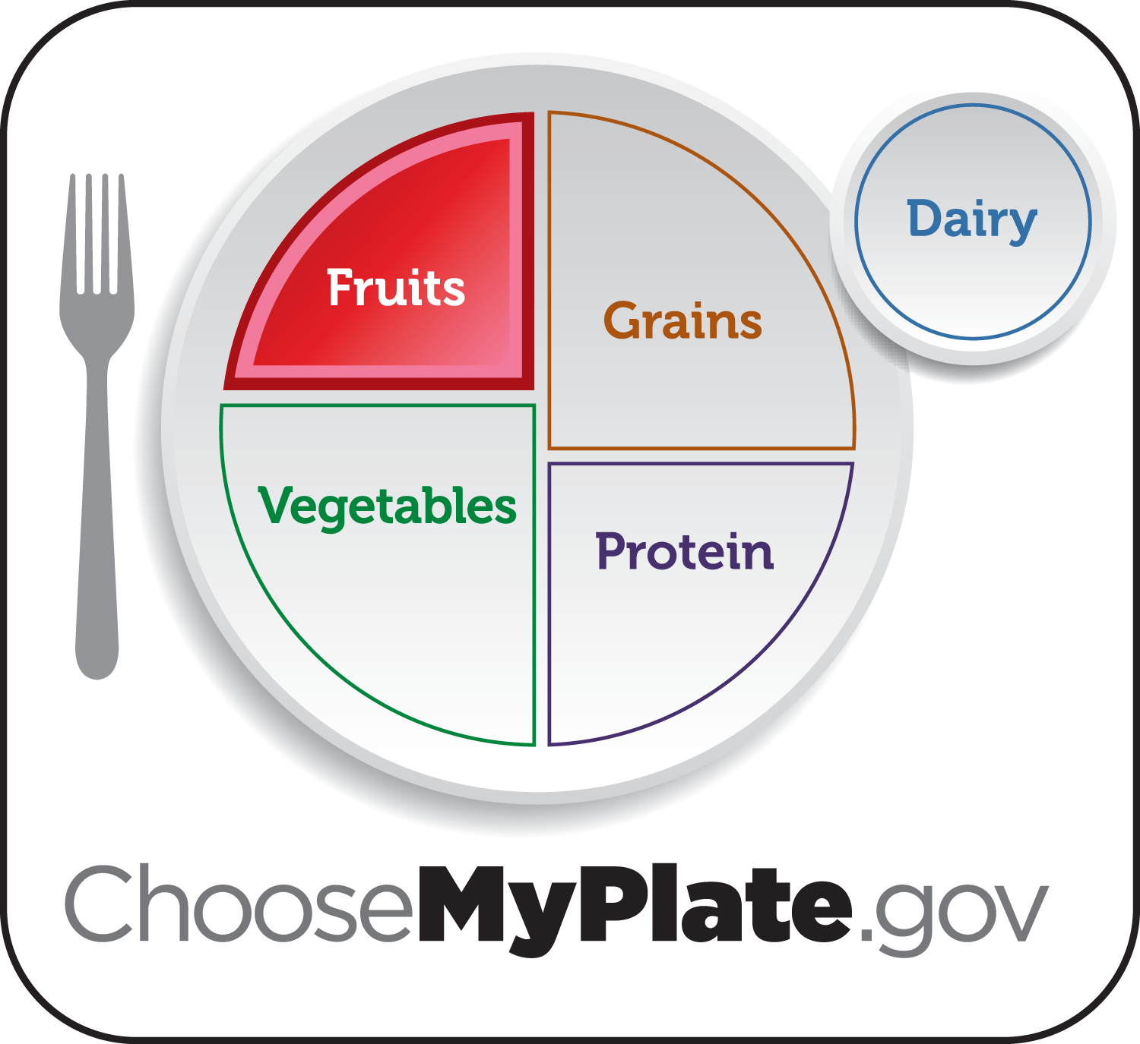
Notes:
Say: Let’s see what you remember from last week’s FUN with Fruits.
Ask: Who can tell the class one way fruits are good for us, a favorite fruit and/or if they tried a new fruit. (call on volunteers)
Fruits, like vegetables, are loaded with vitamins and minerals that help us have healthy skin and shiny hair, help our cuts and bruises heal, help fight germs, and help us see in the dark!
Favorite fruits: strawberry, pear, plum, blueberry, blackberry, nectarine, tangerine, kiwi, cherry, peach, etc.
Say: You all did a good job remembering why fruits are good for us and I’m excited to see you trying new fruits!
Ask: Does anyone remember what FUN Food Group we’ll be learning today?
I’ll give you a clue, it is in the shape of a circle on the MyPlate.
Dairy! (next slide)

Slide 3

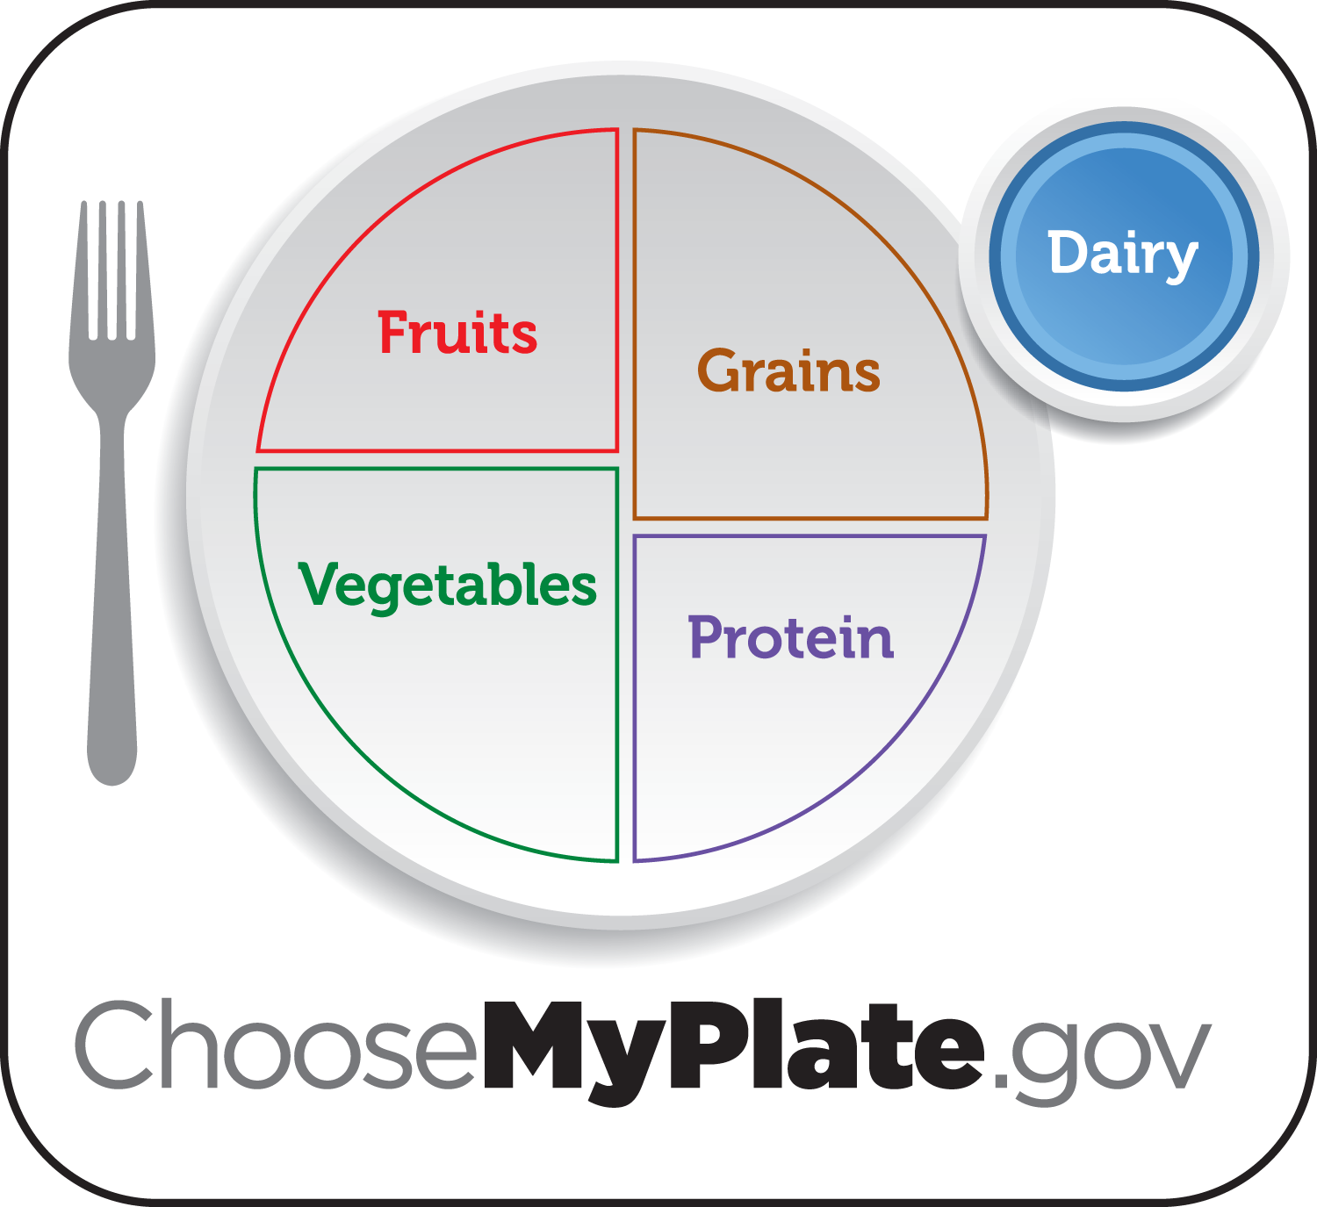
Notes:
Say: Today we are learning about the dairy food group that has yummy foods that come from cows. (point to MyPlate dairy group)
Ask: What color is the Dairy Group?
Blue!
Ask: Great job! Who would like to tell me a food you like from this group? (Prompt students with specifics as needed, such as what flavor yogurt, or foods that come from milk.)
yogurt, cheese, milk, etc.
(If someone mentioned ice cream, tell them they are right but also remind them that because of added sugars and fats ice cream is a special treat.)
Ask: Does anyone know how dairy foods help our bodies?
It helps us grow, stay healthy, and build strong bones and teeth.
Say: Feel the bones in your arms and ribs. Do you think that is as long as your bones will get?
No.
Ask: Do any of you have all of your permanent teeth?
No.
Say: Milk and foods made from milk will help you grow strong teeth and longer, stronger bones. And milk will help you grow taller during your growing years.

Slide 4
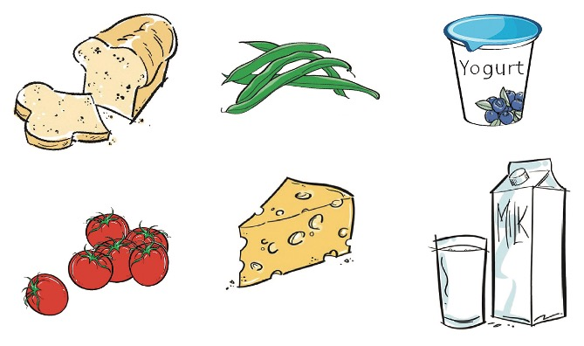
Notes:
Ask: Please open your workbooks and turn to page 20, and we’ll complete the “Delicious Dairy” activity together. Circle the all the dairy foods.
(Go over each picture and ask different kids whether or not each food is considered dairy.)
Ask: I wonder what Mr/Ms ______ favorite diary food is?

Slide 5
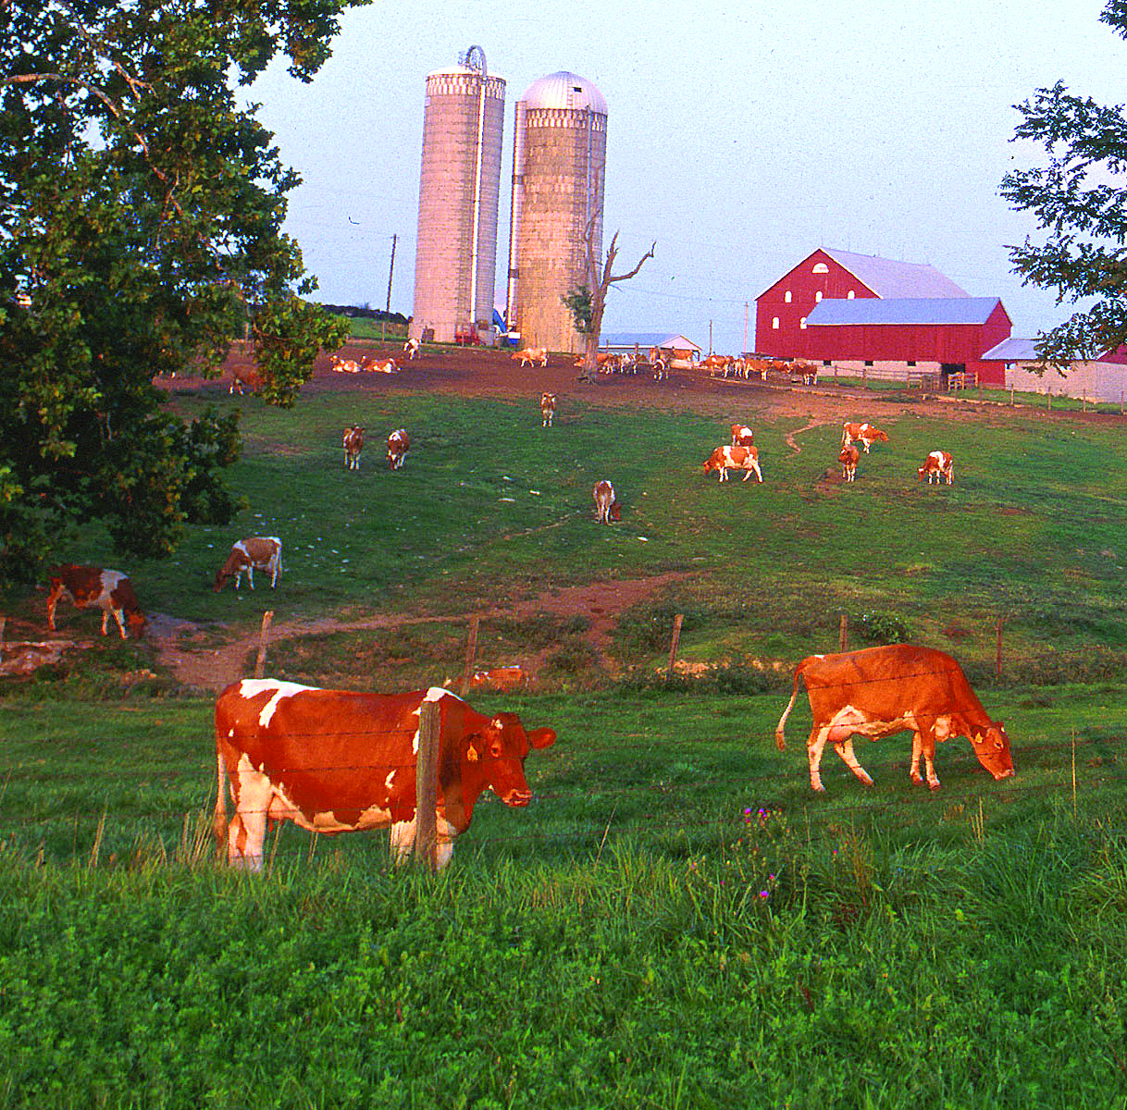
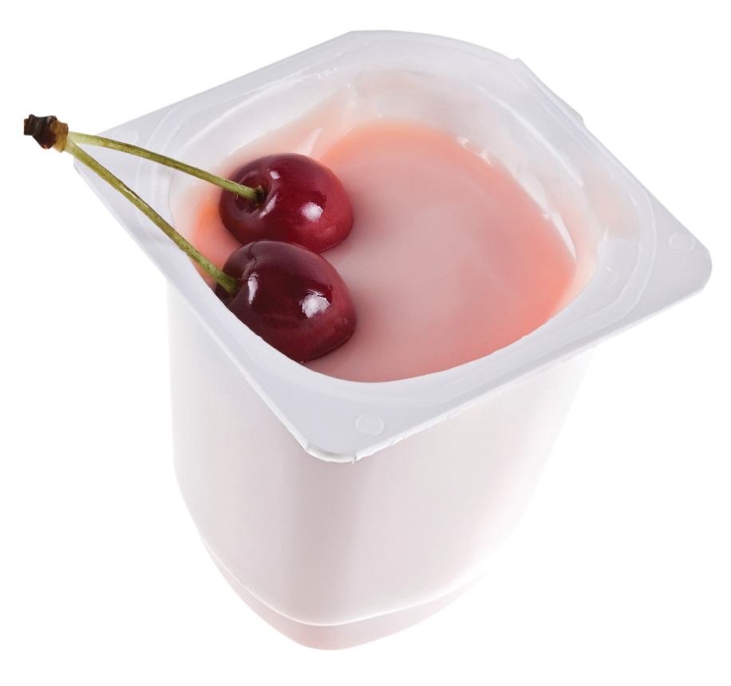
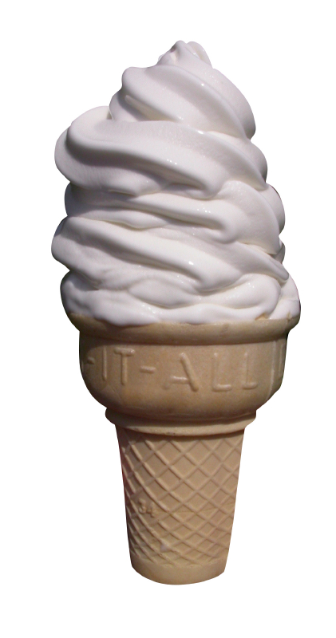
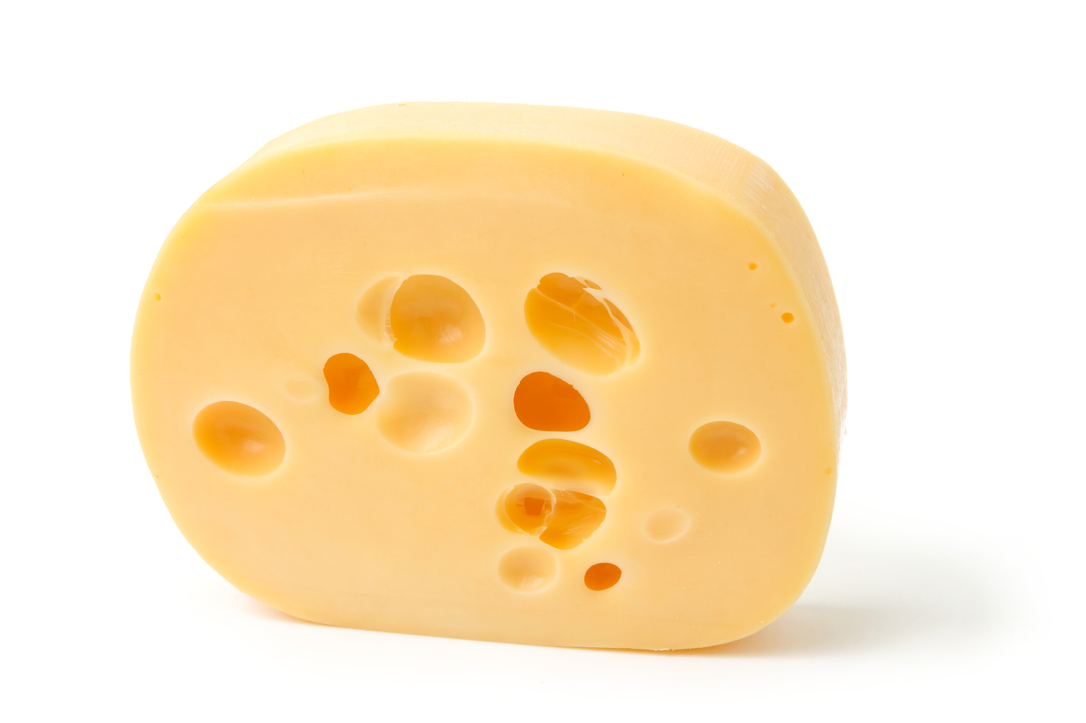
Notes:
Say: Let’s take a closer look at how milk is made on page 21.
Cows live on farms. Every day they eat lots of hay and drink lots of water. Their bodies turn what they eat into milk. Cows are milked at least twice a day, and the milk is stored in a big tank that keeps it cold. Milk is used to make yogurt, ice cream and cheese!
Say: Now turn to the next page, page 22, and complete the bottom checklist. Which types of cheese do you like? Place a check in the box beside each cheese that you like.
(Say each cheese: American, Cheddar, Swiss, Pepper Jack, and String)
Say: On page 23, let’s complete both these activities. Calcium is found in dairy foods and helps us build strong teeth and bones.
(Walk students through the fill-in-the-blank sentence)
Remember to drink more milk for CALCIUM which gives us strong BONES and TEETH.
Say: Dairy is not only good for humans, but mice enjoy cheese as well. Help this mouse (on the bottom of the sheet) through the maze to find the cheese.

Slide 6

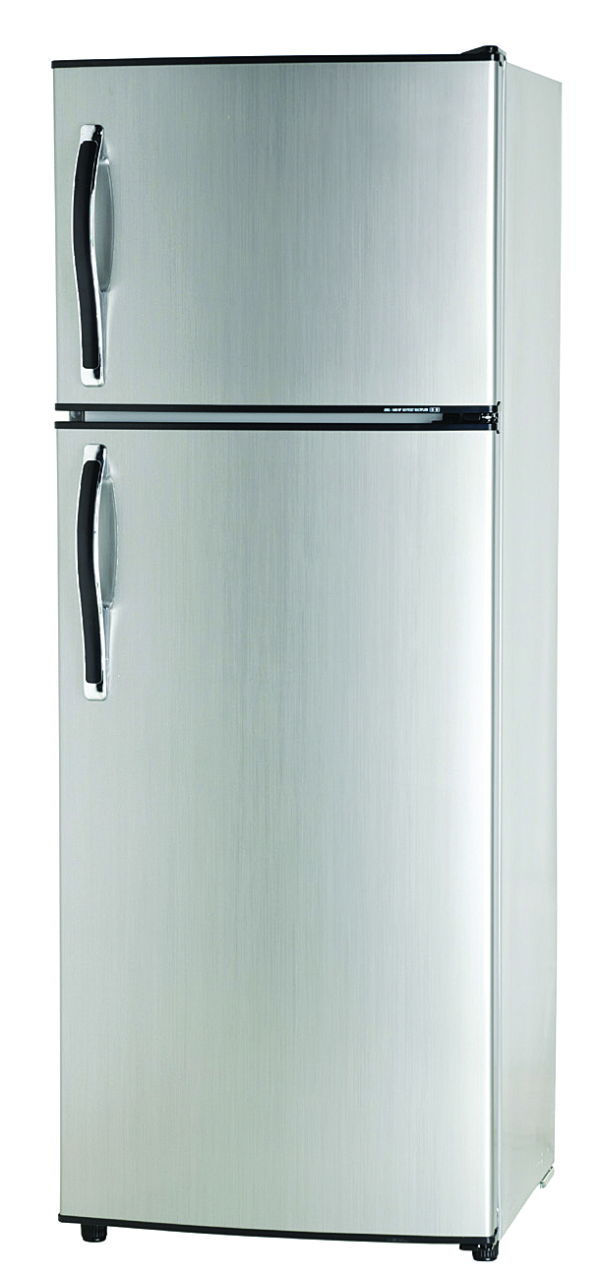
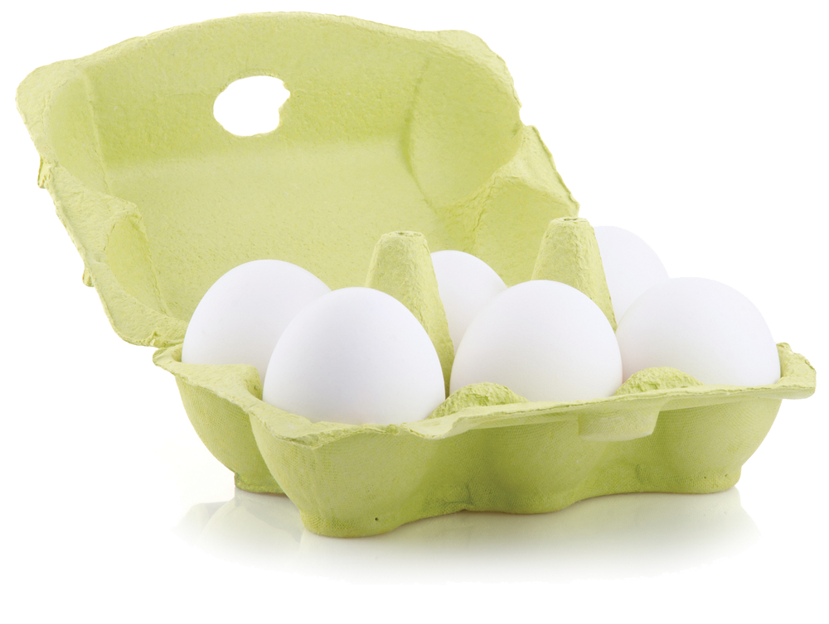
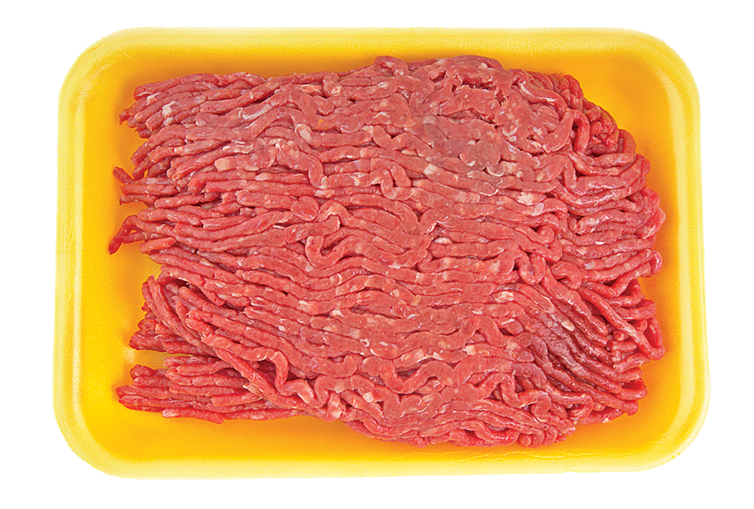
Notes:
Say: Now we are going to have FUN with Food Safety!
Lead students through a food safety activity.
“Storing Food” (15-20mins)
Nasco’s Nutrition Cards required
Ask questions, prompting with answers as needed.
Say: We are going to talk about how to store foods at the right temperature.
Ask: Does anyone know why it is important to keep cold foods cold? So germs won’t grow and make us sick when we eat the food, and we know that being sick is NO FUN.
Ask: Does anyone know what kind of foods have to be kept cold?
Milk, eggs, and meats.
Say: Some other foods need to be kept cold too. If food is cold when we buy it, it needs to stay cold.
Ask: Who can tell me a cold food that we may buy at the store? Yogurt, etc
Say: Some foods are stored in the refrigerator, and some foods are stored in the freezer.
Ask: Who can name a food that must be kept in the refrigerator? Milk, etc
Ask: Who can tell me a food we keep in the freezer? Ice cream, frozen veggies, etc.
Say: Some foods are on the shelf at room temperature in the grocery store but need to be kept cold after opening, like ketchup.
Ask: Can you name another food that we buy at room temperature, but needs to be in the refrigerator after opening? Mayonnaise, mustard, pickles, etc.
Ask: What do you think you need to do with the carton of milk after you pour a glass?
Put it back in the refrigerator.
Say: Great job! Now let’s practice.
(Pass out food cards to students)
Ask: Place the food card in the appropriate place – refrigerator, freezer or cabinet.
(Select an area/desk that represents refrigerator, freezer or cabinet)
Say: We had a lot of FUN putting our food in the right place for storage!

Slide 7
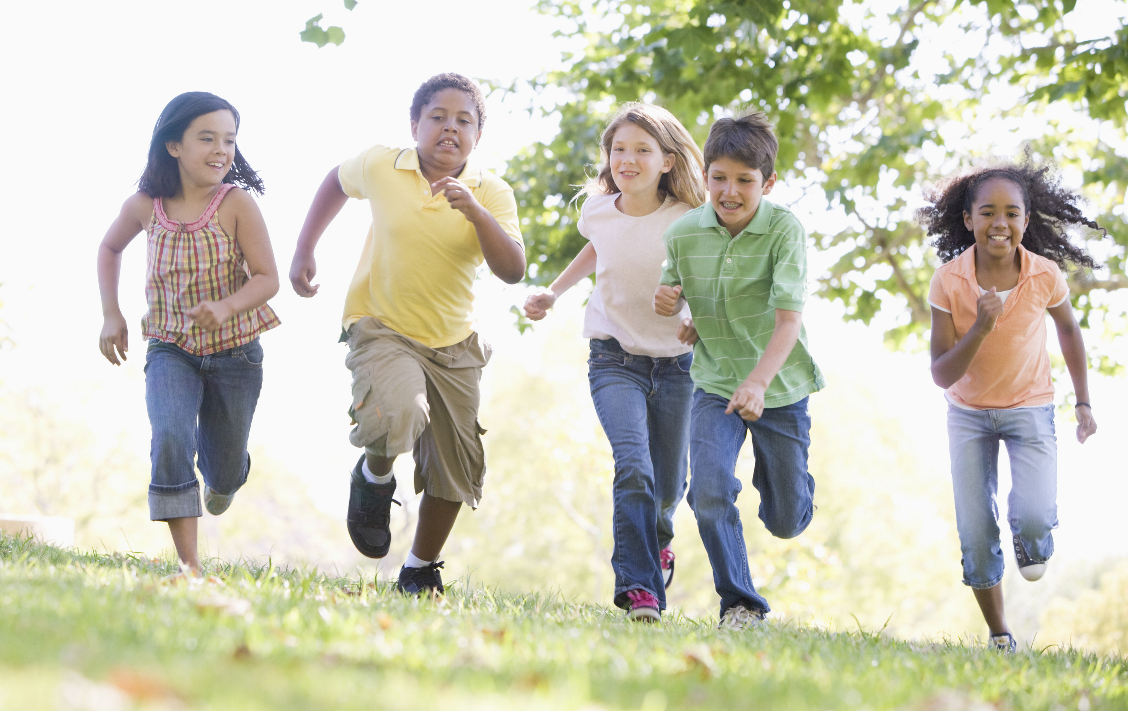
LET’S GET ACTIVE!
Notes:
Say: Let’s have some FUN being active together! Everybody stand up…we’re going to move our bodies for a few minutes.
Lead students through physical activities; “Milk Moves” (below) or “Instant Replay” (below)
“Milk moves” (5-10mins)
Say: So far we have talked about two different kinds of FUN activities, 1. muscle strengthening that stretches our muscles and 2. aerobic that makes our hearts beat faster.
Say: Today we are doing another kind of activity, the kind that we do when standing on our feet. This kind of activity may also stretch our muscles or make our hearts beat faster, but because we are standing on our feet, this kind of activity helps make our bones strong.
Ask: for a volunteer to be leader.
Say: The leader will do an activity that is done standing up like walk in place, run in place, jump, hop, skip. When the leader says “milk moves,” the rest of the class joins in the same activity.
Ask: Everyone stand and let’s begin.
(Let the students take turns being the leader.)
“Instant Replay” (15-20mins)
Say: We all need food to be healthy, and we need to move our bodies, too. We can have FUN moving our bodies each day. We should do muscle strengthening activities like stretching our muscles and, most days, do aerobic activities that make our hearts beat faster. Let’s play a replay game.
Instructions:
Pair students into groups of two and three. (If desired, students can count off by saying: milk, cheese, yogurt, or other Dairy Group food names.)
Each group should make up an exercise (jump, hop, skip, dance, walk in place, etc.) that will be demonstrated to the whole class. Keep in mind the physical space that is available. When asked, each group will come to the front of the class to demonstrate their activity.
After each team demonstrates their exercise, team members shout “INSTANT REPLAY!” Everyone else will then perform the exercise beside their desk.
Continue the activity until all teams have demonstrated at the front of the class.

Slide 8
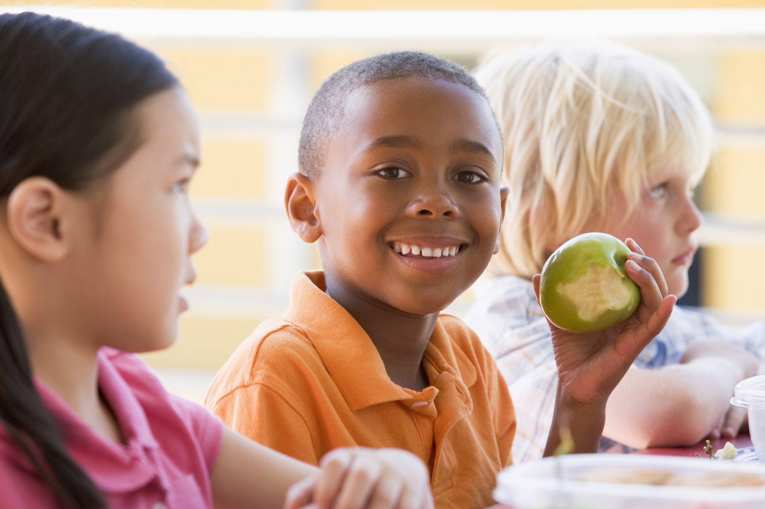
FOOD TASTING
Notes:
PA Note: Hide this slide if you are not doing a food tasting
Suggested food tasting for this lesson is Fruit Smoothies with yogurt– recipe found on page 24. If not doing a food tasting, review the recipe with the students and encourage them to make it at home when they take their book home at the end of the series of lessons.

Slide 9

Notes:
Ask: Who can remind me what dairy can do for our bodies?
It helps us grow, stay healthy, and build strong bones and teeth.

Slide 10
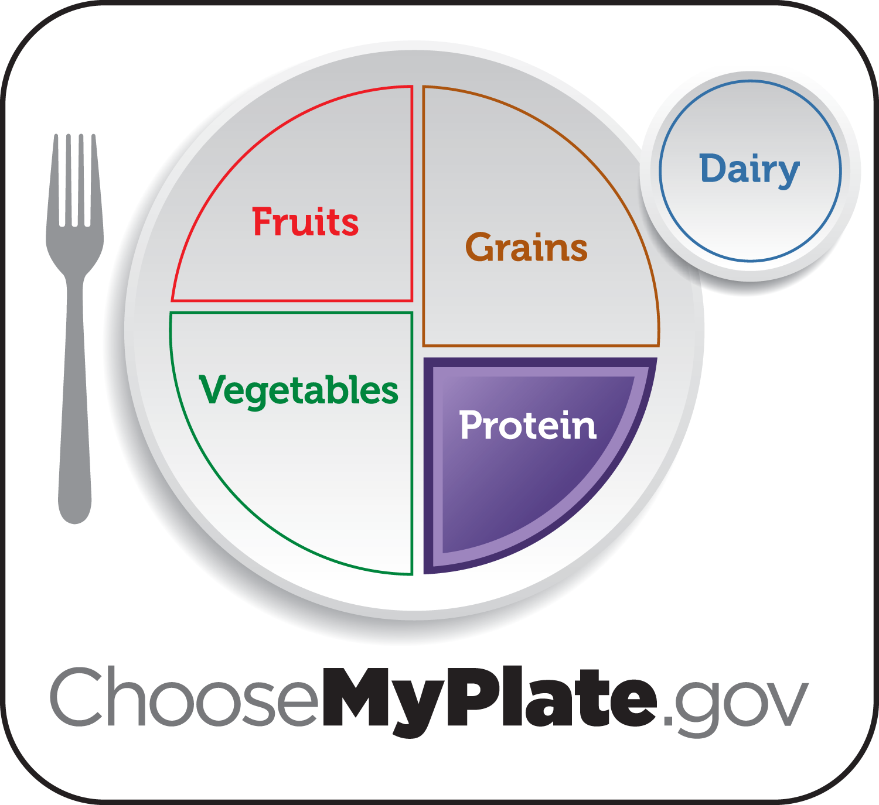
Notes:
Say: Next time we’re together we’re going to learn some fun facts about the protein group.

Slide 11
Notes:
Say: Turn to page 25 in your workbook and complete the sentences. While you’re working on those, I’ll come around a give you the Dairy Fun token for your book.
Say: I have a little challenge for you this week. I want to ask everyone to have a dairy food at breakfast, lunch and dinner each day during the next week and remember to be physically active for at least 60 minutes a day. Your teacher will be watching and listening to see who meets this challenge.

