Slide 1




Notes:
SCRIPT:
Say: Good morning/afternoon boys and girls. How is everyone?
Ask: Can anyone remind us what we have been learning for the past few weeks?
Healthy eating, importance of physical activity, and food safety.
Say: After today’s lesson, we only have 1 more FUN with Food and Fitness class; then you’ll get to take your workbooks home.

Slide 2

Notes:
Say: Let’s review last week’s FUN with Dairy.
Ask: Did anyone try a new Dairy food?
Yogurt, a different cheese, 1 or 2% milk instead of whole, etc.
Ask: Did anyone have Dairy with all three meals everyday? Most days? 2-3 days? 1 day?
Say: Good job everyone. Keep getting dairy in your diet.
Ask: Who can share with the class why Dairy is important for our bodies?
It helps us grow, stay healthy, and build strong bones and teeth.
Ask: Let’s look carefully at MyPlate now. Is there a group that we haven’t had FUN learning about yet? What color is it?
Protein, purple.

Slide 3


Notes:
Say: Today we are learning about the Protein, the purple food group. (point to MyPlate)
Ask: Who would like to tell me a food you like from this group? (Prompt students with specifics as needed, such as: How do you like to eat ham? On sandwiches? When do you like to eat eggs? For breakfast?)
Meat, poultry, fish, beans, seeds, eggs
Beef, chicken, turkey, salmon, black beans, nuts, peanut butter, tofu
Ask: Does anyone know what Protein Foods do for our bodies?
They help us build strong muscles and help our bodies heal, such as when we get a cut and need to build new skin.
Ask: I wonder if Mr/Ms. ________ would share what protein food they had yesterday?

Slide 4
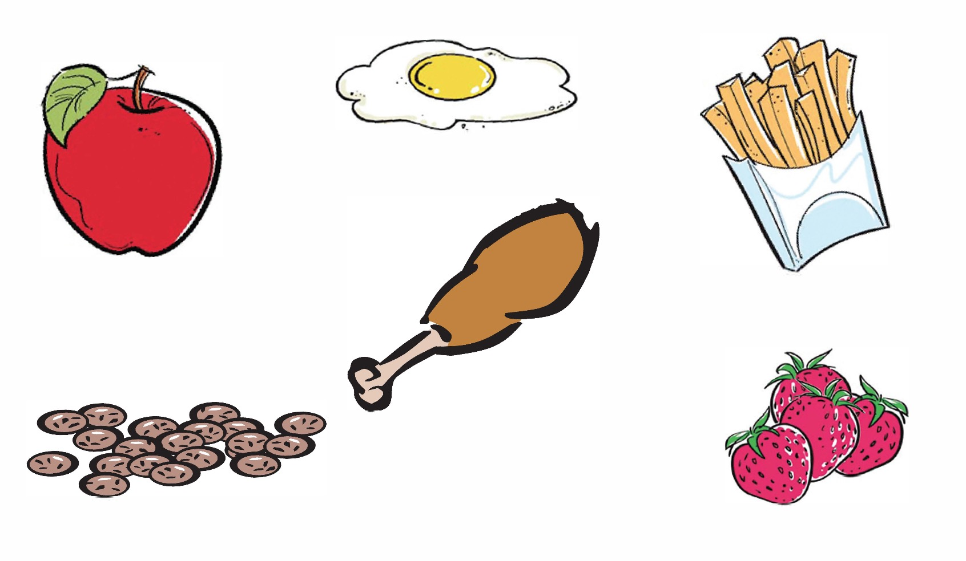
Notes:
Ask: Please open your workbooks and turn to page 26, and we’ll complete the “Phenomenal Protein Foods” activity together. Circle the all the Protein foods.
(Go over each picture and ask different kids whether or not each food is considered protein)

Slide 5
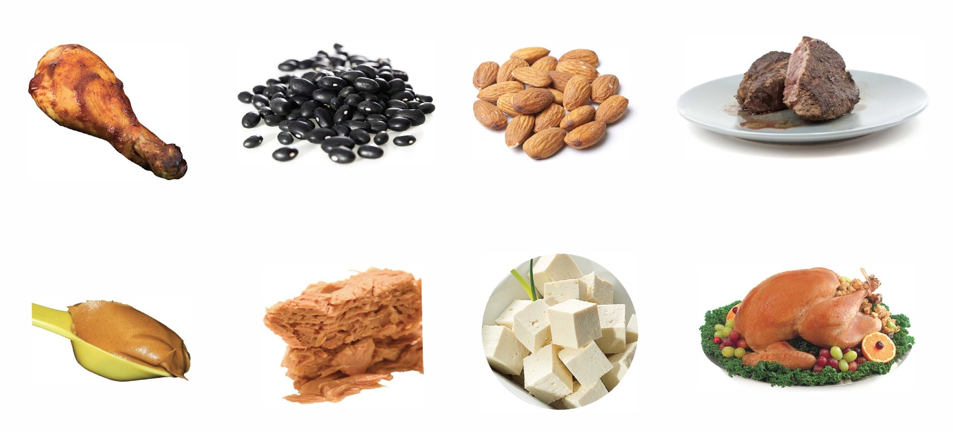
Notes:
Say: Here’s a FUN fact, protein comes from both animals and plants.
Ask: As mentioned previously, the chicken and fish are examples of ______protein source?
Animal
Ask: Beans and seeds are examples of _____ protein source?
Plant
Say. Great! Now let’s do an activity that will help us remember the differences.

Slide 6


Protein food from a plant
Protein food from an animal
Notes:
Say: On page 27, together we’ll complete the Plant or Animal activity.
Say: Does the Protein food come from a plant or an animal. Draw a line from each food to the plant leaf or animal paw print.
(Go over each picture and ask different kids which source is the protein food.)

Slide 7
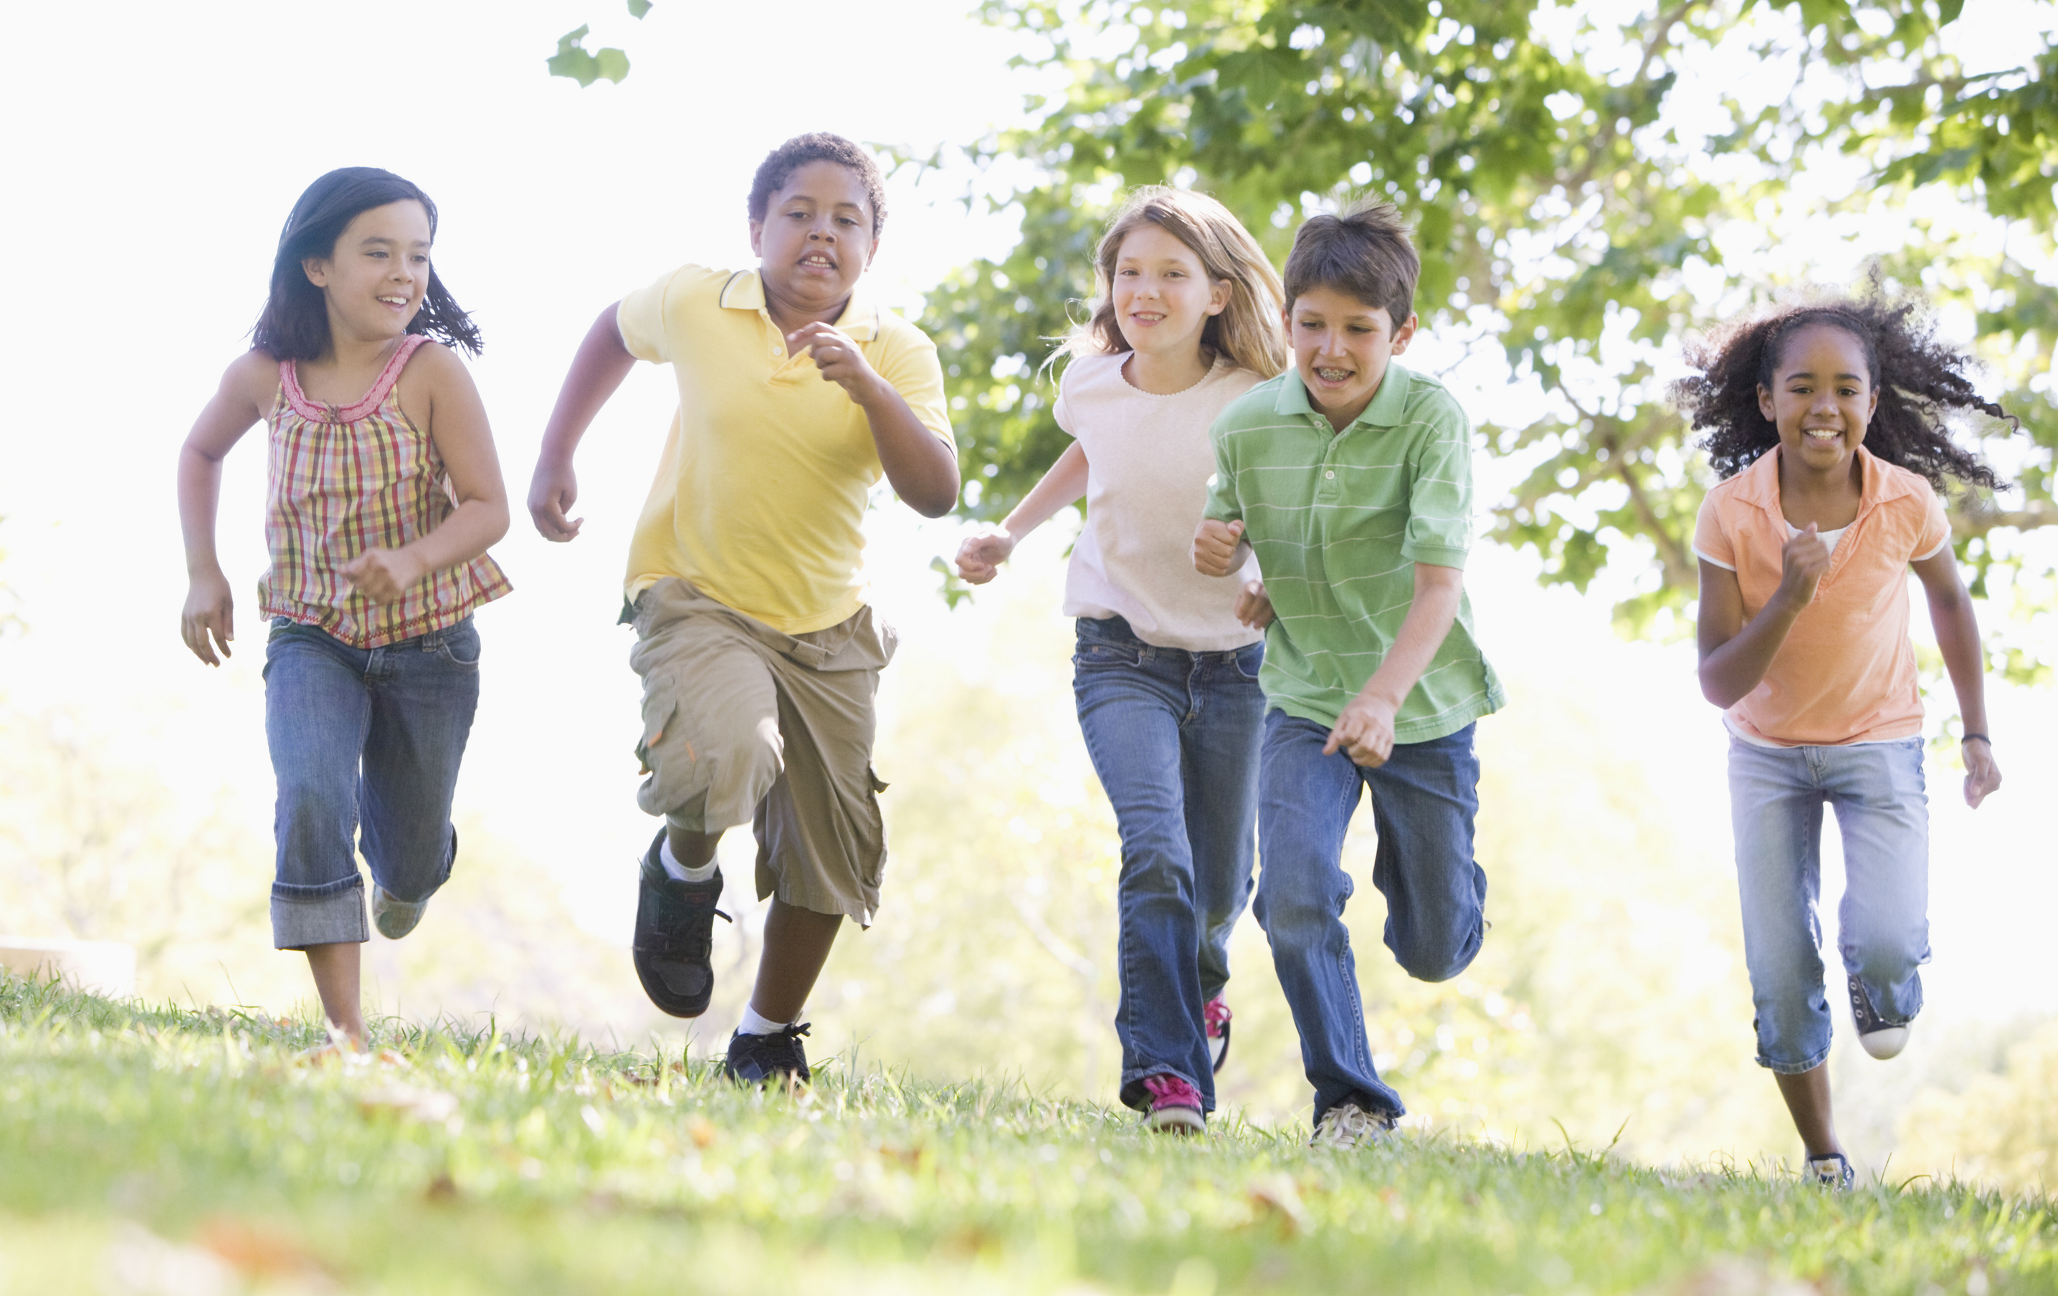
LET’S GET ACTIVE!
Notes:
Say: Let’s have some FUN being active together! Everybody stand up…we’re going to move our bodies for a few minutes.
Lead students through physical activities; “Protein Foods Group Relay” (below) or “Salmon Jump” (below)
“Protein Foods Group Relay” (15-20mins)
(Nasco’s Nutrition Cards required - you will use only the cards with protein foods)
Say: Let’s play a FUN relay game to learn more about foods in the Protein Foods Group that come from animals or plants.
(Designate two desks/areas at one end of the classroom: One for Plant Sources and one for Animal Sources.)
Say: Now we are going to divide into two groups (count off by saying plant or animal).
Say: Carefully, we are going to line up both groups at one end of the room.
(Divide protein cards evenly among both groups and pass out cards to the beginning of the line; 23 maximum protein cards.)
Say: Here is how the game will work. When I tell you go, the first person from each line will walk to the opposite side of the room and put the protein food card picture on the desk they think is the correct group; animal or plant protein. Then walk back to the line, tag the next person, who continues the relay until everyone gets a turn.
(Vary the relay by having students walk backward or hop on one foot, go sideways, etc.)
When both lines have finished, as as class go through each protein pile and have students tell you whether or not the food is in the correct group. Give positive reinforcement for all answers, such as “good job” or “good try.”
“Salmon Jump” (2-5mins)
Say: FUN fact, did you know that every year, salmon must travel upstream? It is very hard work. They take huge flying leaps out of the water as they travel upstream against the fast, strong current of the river! They have to use their muscles to do so.
Ask: Pretend you are in a river, swimming upstream. Stand by your desk, wriggle and do the Salmon jump.
Ask: Do you feel your muscles working? When we use our muscles, we make them stronger!
(Remind students that swimming is a fun activity we can do to move our body and keep it healthy.)

Slide 8
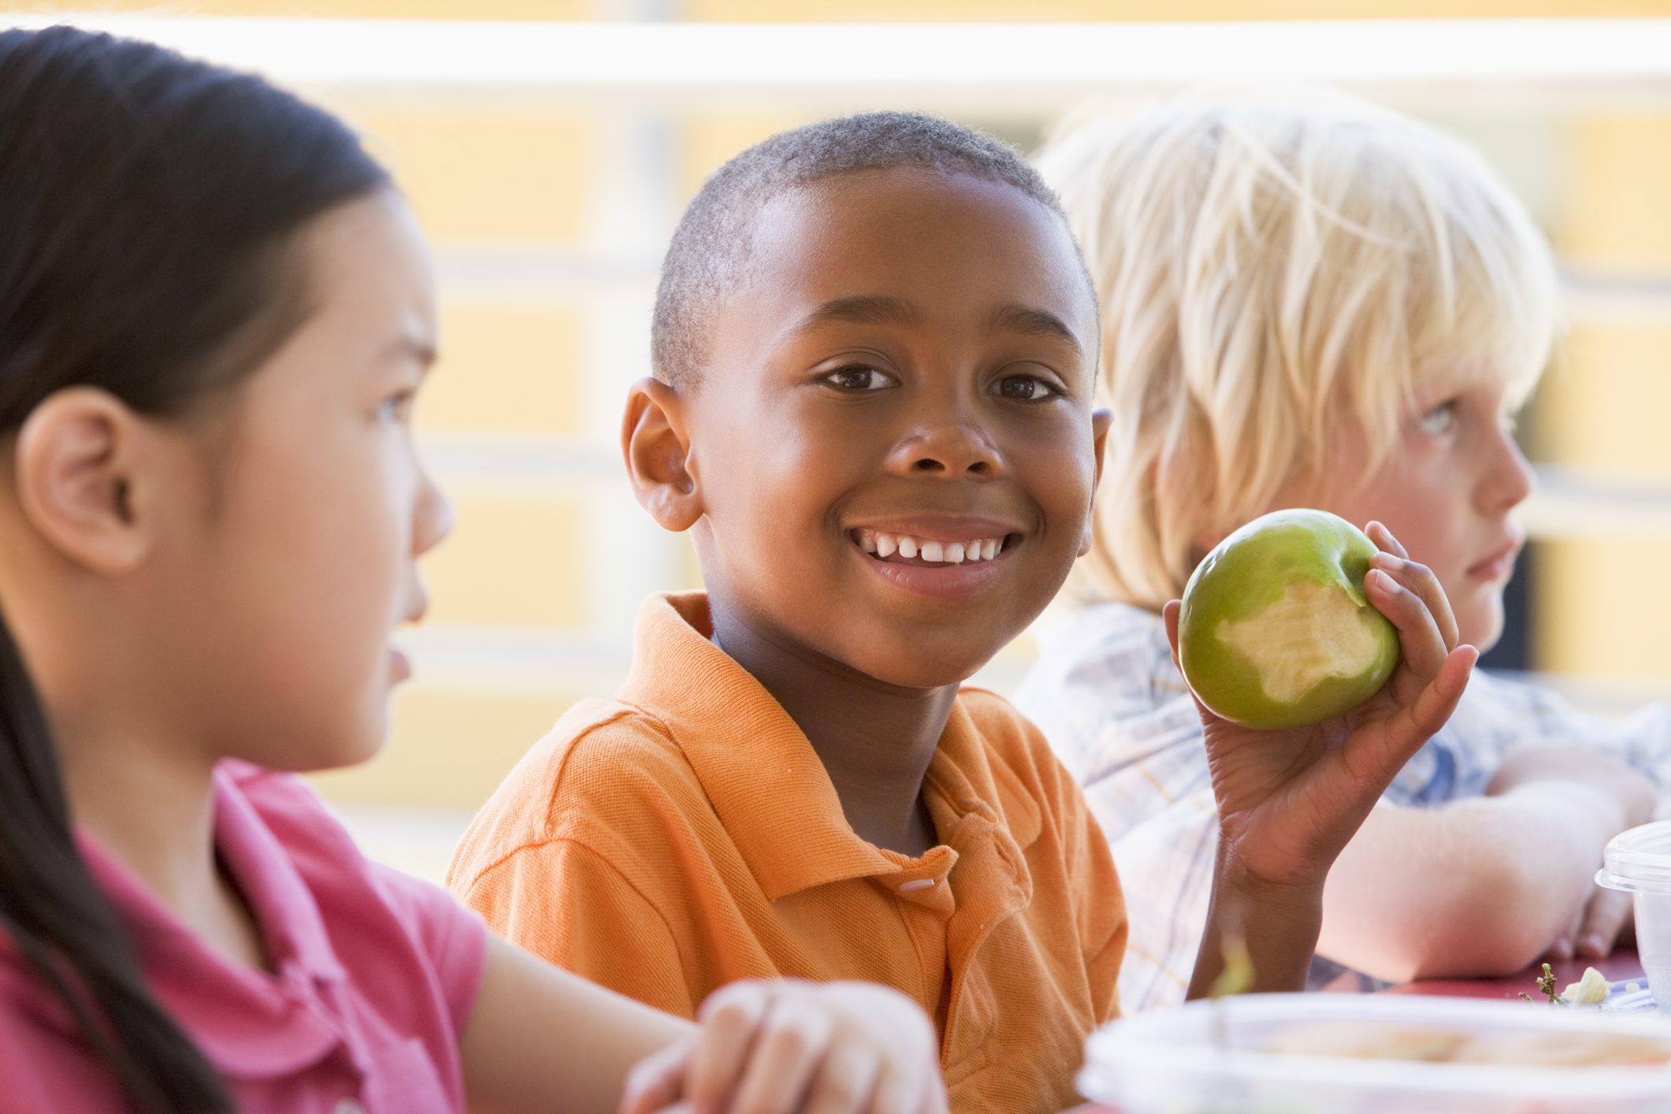
FOOD TASTING
Notes:
PA Note: Hide this slide if you are not doing a food tasting
Suggested food tasting for this lesson is Chicken Pitas– recipe found on page 28. If not doing a food tasting, review the recipe with the students and encourage them to make it at home when they take their book home at the end of the series of lessons.

Slide 9

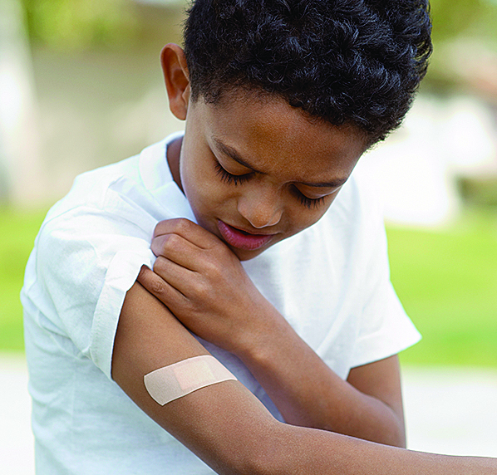
Protein foods help us…
Build strong muscles
Heal our bodies when we get a cut and need to build new skin
Notes:
Ask: Before we end our lesson today, who can remind me what protein foods do for our bodies?
They help us build strong muscles and help our bodies heal, such as when we get a cut and need to build new skin.
Say: Have FUN by choosing a mixture of animal and plant protein foods to eat each and every day.

Slide 10

Notes:
Say: Remember, next week will be our last opportunity to have FUN together. We will be reviewing all the food groups, so try to remember all the things we have learned about.
Say: Also, after next time you’ll get to take home your workbooks and share with your families all the FUN with Food and Fitness we’ve been learning.

Slide 11
Notes:
Say: Turn to page 29 n your workbook and complete the sentences. While you’re working on those, I’ll come around a give you the Protein Fun token for your book.
Say: I have a little challenge for you this week. I want to ask everyone to try a new plant or animal protein food at lunch at least one day during the next week and remember to be physically active at least 60 minutes each day. Your teacher will be watching and listening to see who meets this challenge.

