Slide 1



Adapted with permission from Show Me Nutrition,
University of Missouri Extension.

Slide 2


Slide 3
The Little Rainbow of Blueberry Hollow

Slide 4
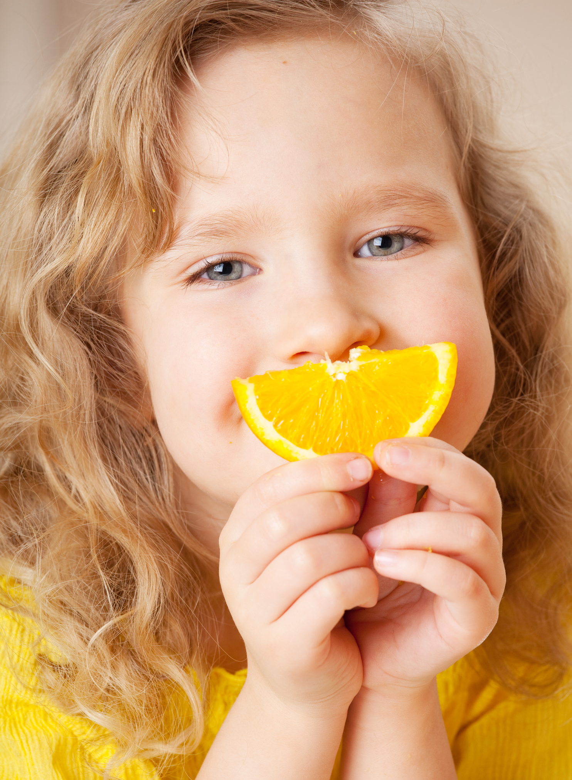
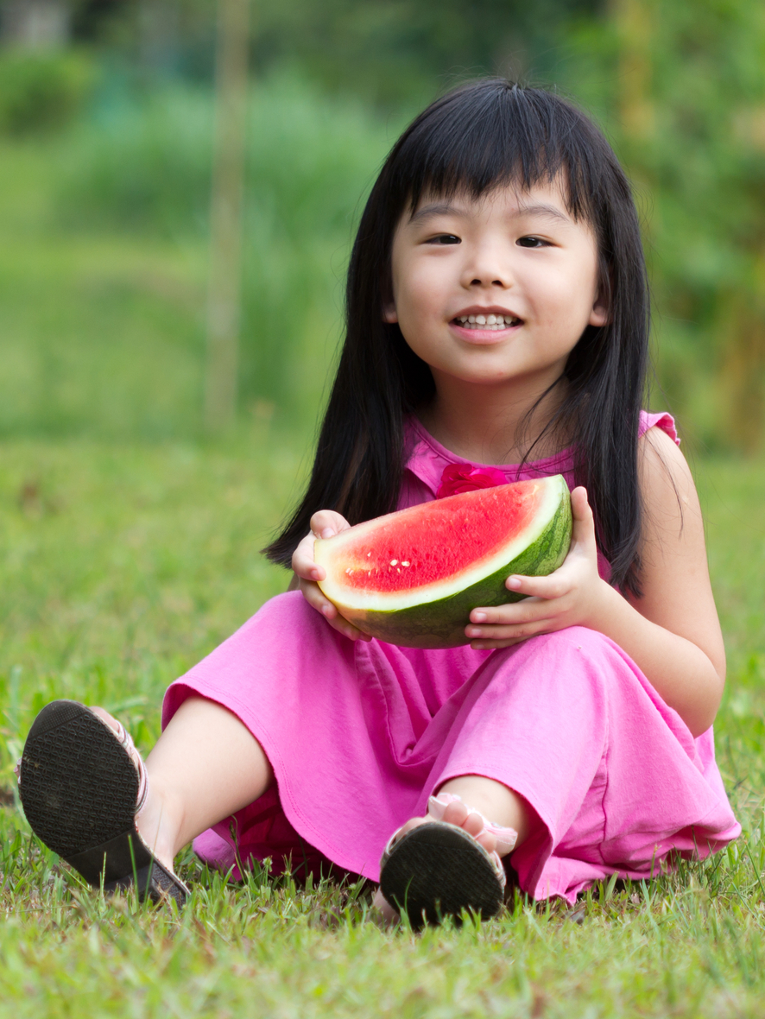
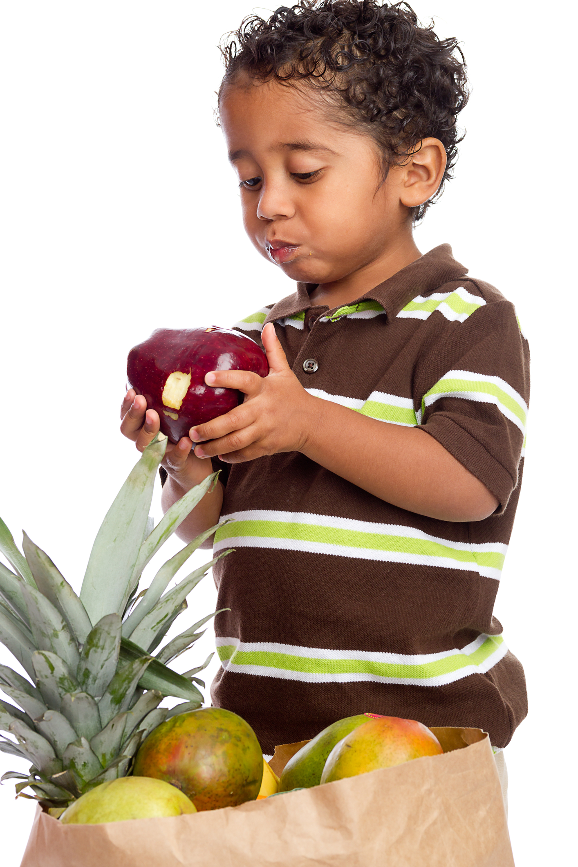
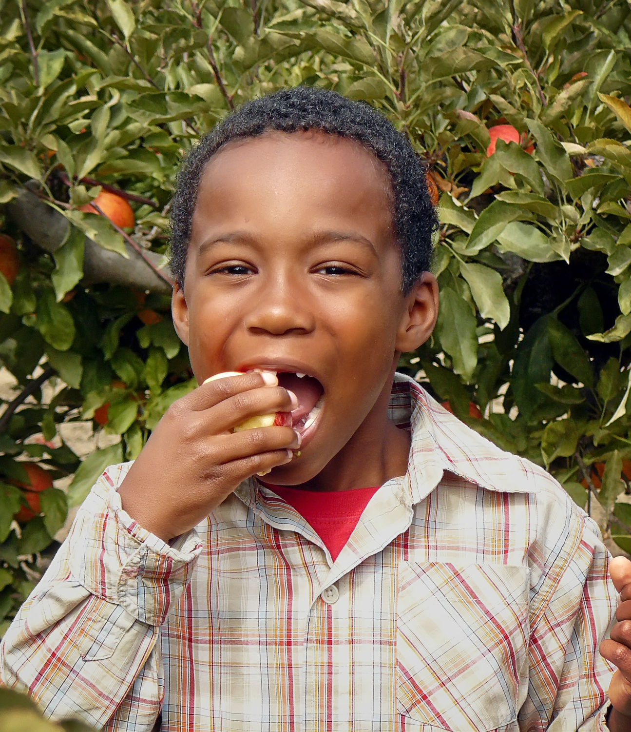

Slide 7
Did you ever see a kiwi, a kiwi, a kiwi?
Did you ever see a kiwi—it’s small and it’s brown.
It’s brown on the outside and green on the inside.
Did you ever see a kiwi—it’s small and it’s brown.
Did you ever taste a kiwi, a kiwi, a kiwi?
Did you ever taste a kiwi—it’s small and it’s sweet.
It’s good and nutritious and really delicious.
Did you ever taste a kiwi—it’s small and it’s sweet.
Did you ever see a coconut, a coconut, a coconut?
Did you ever see a coconut—it’s big and it’s brown.
It’s brown on the outside and white on the inside.
Did you ever see a coconut—it’s big and it’s brown.
Did you ever taste a coconut, a coconut, a coconut?
Did you ever taste a coconut—it’s crunchy and it’s sweet.
It’s good and nutritious and really delicious,
Did you ever taste a coconut—it’s crunchy and it’s sweet.
Yes, coconuts and kiwis are such fun to eat!

Slide 8
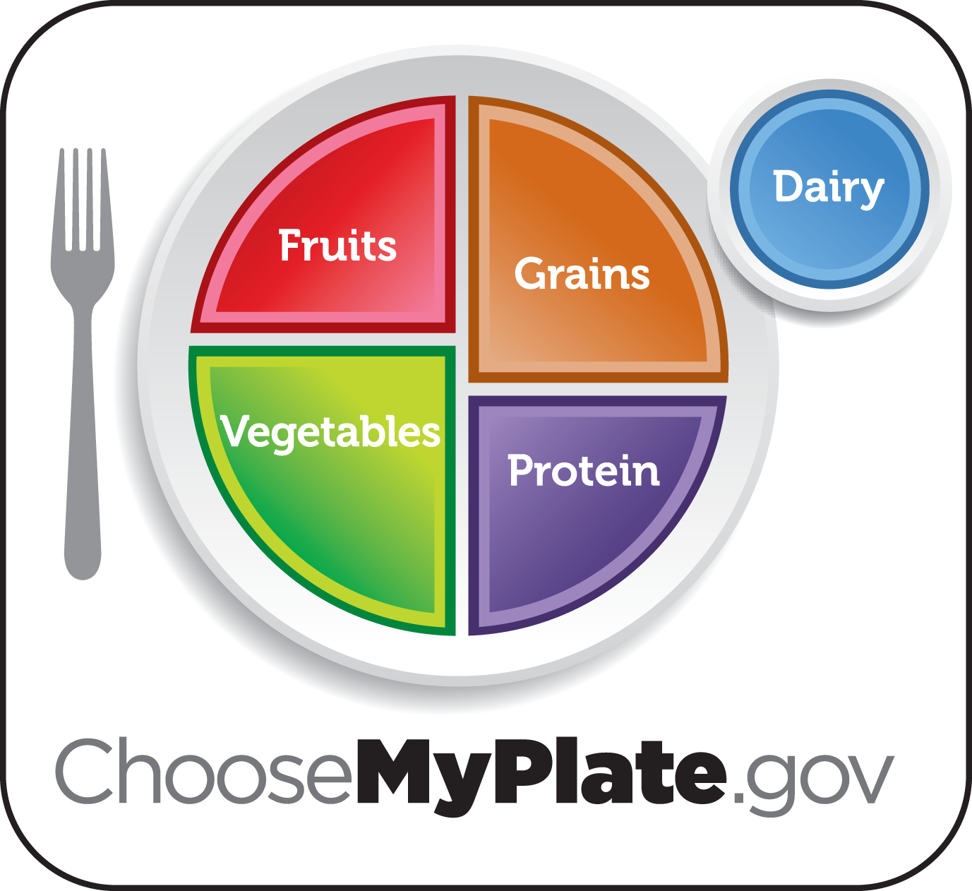

EAT SMART:
Choose a variety of foods each day.
Let’s try it!

Slide 9
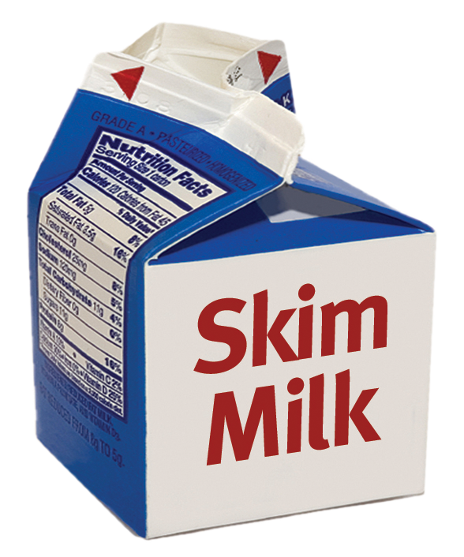
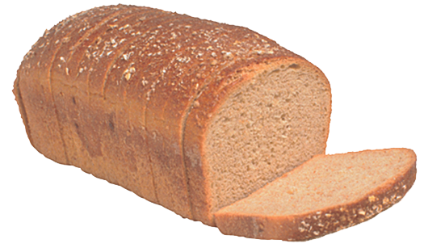
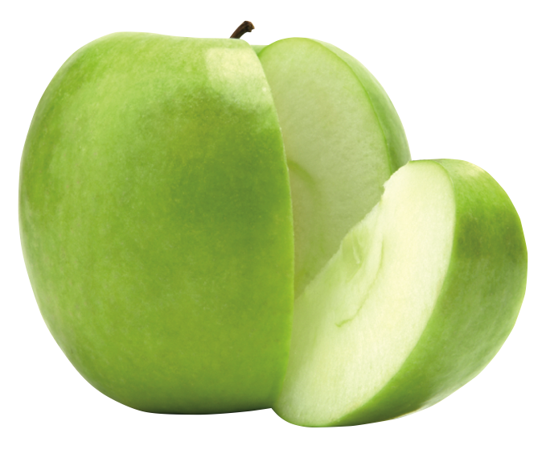
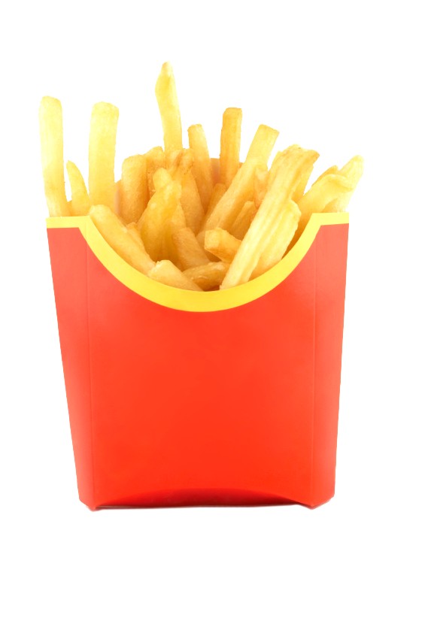
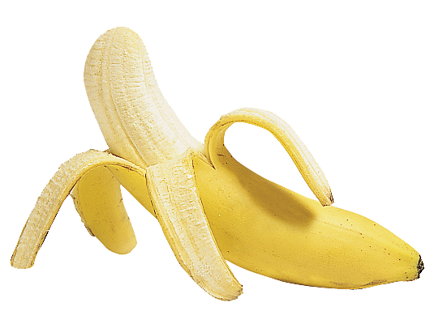
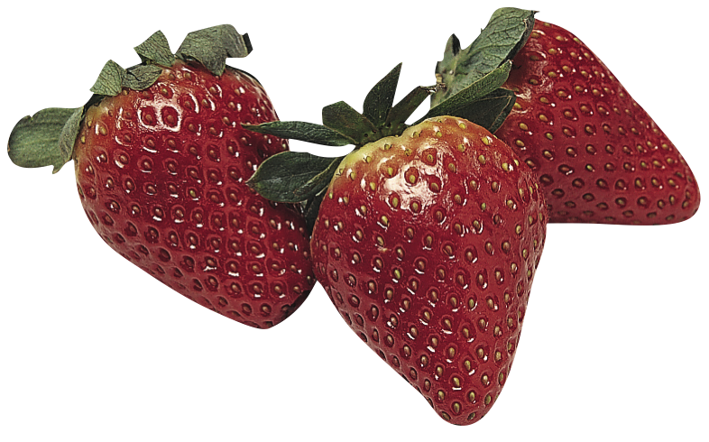

Slide 10
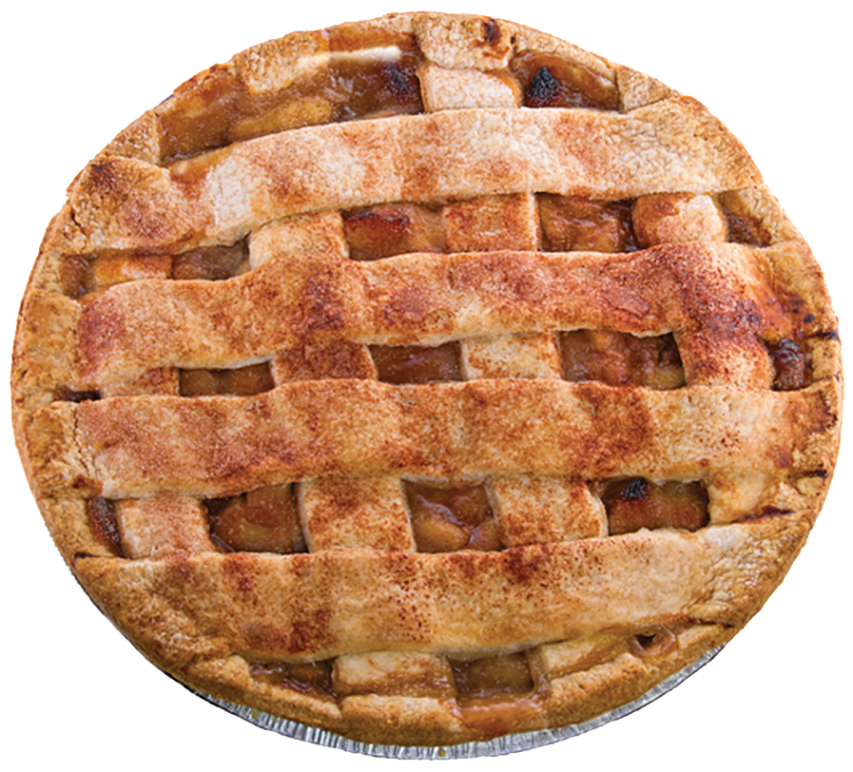
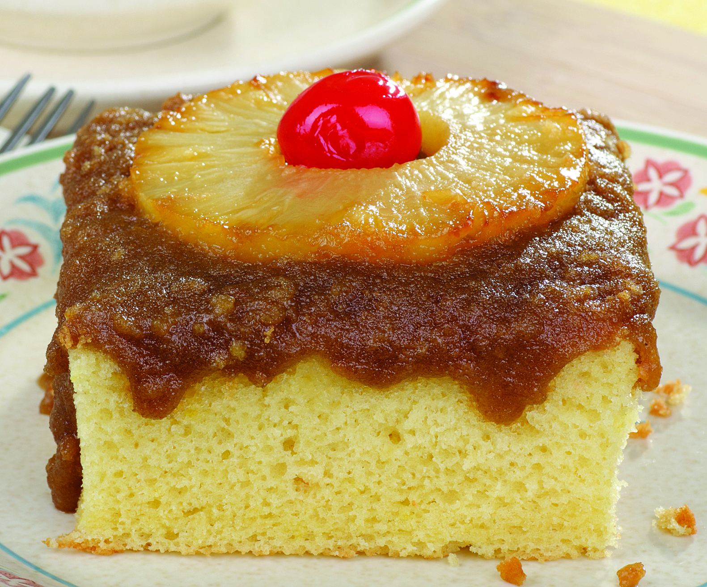
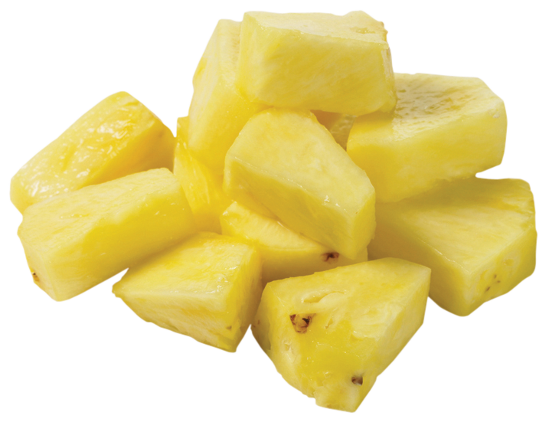
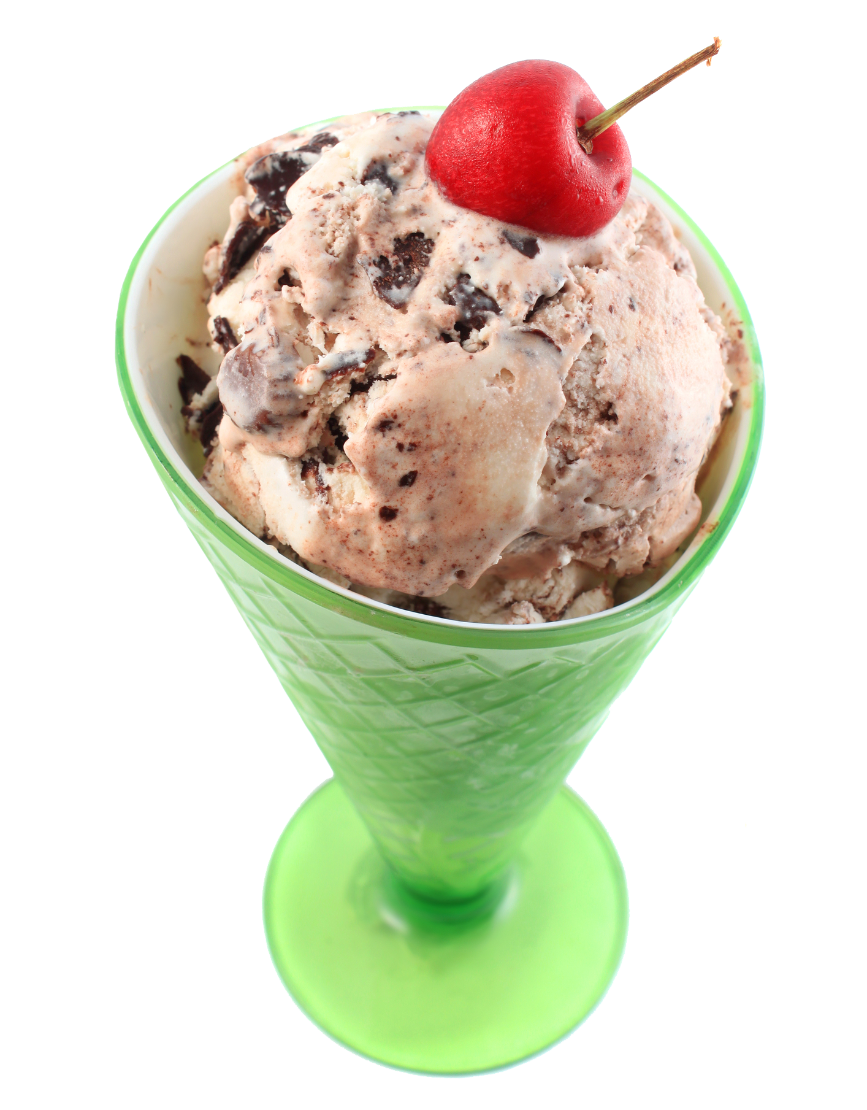
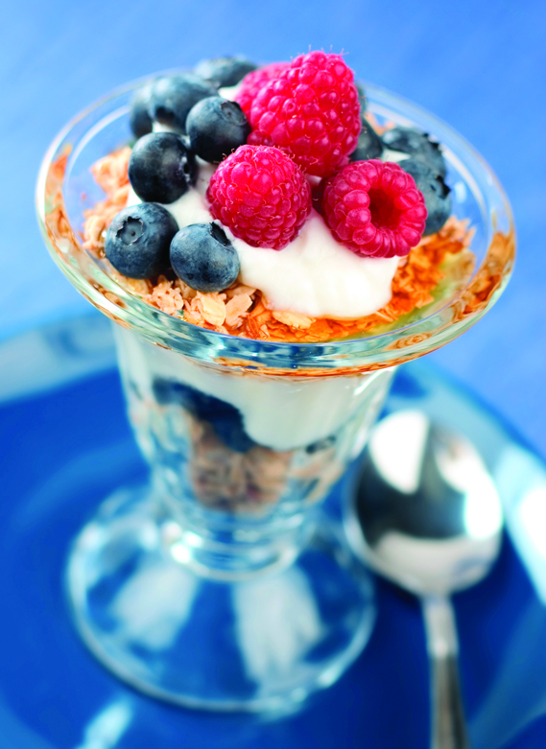
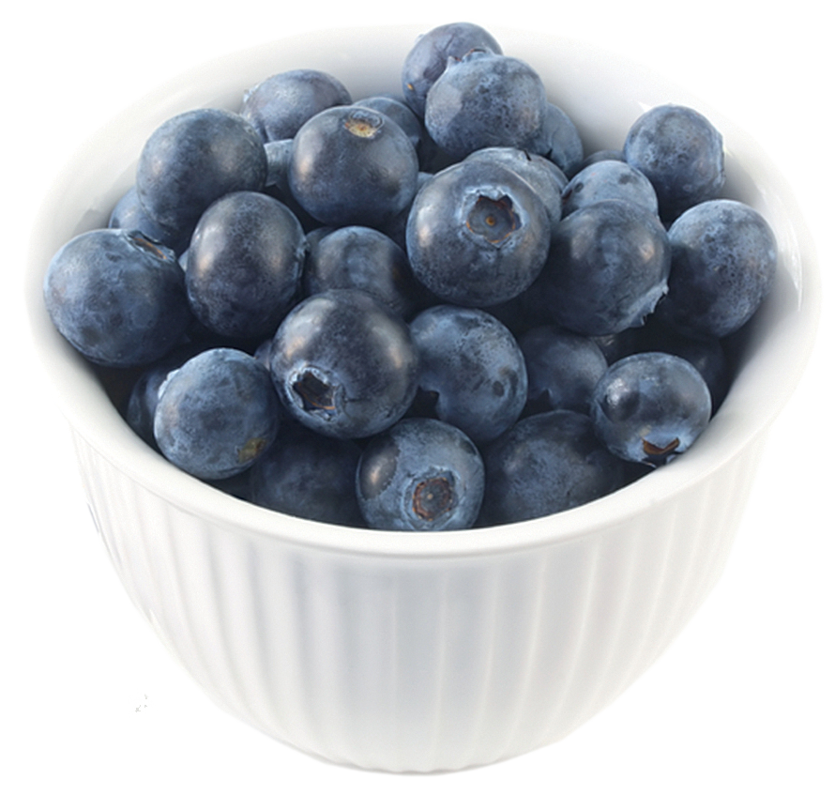
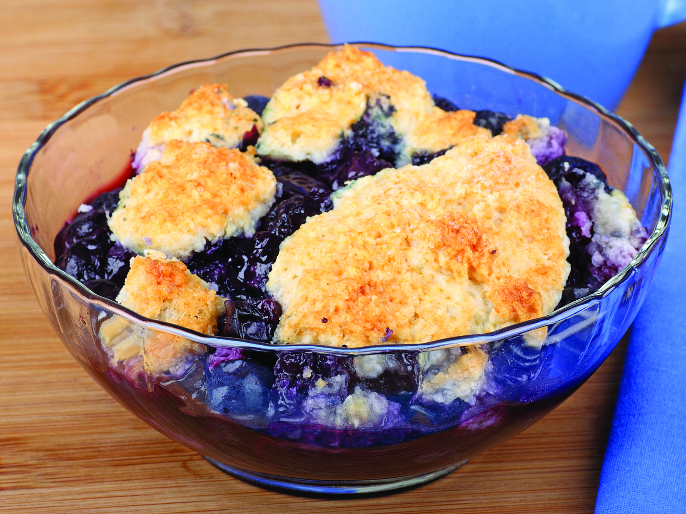

Slide 12

Eat a variety of fruits every day for good health.
Choose fruit instead of sugary snacks.

