Slide 1



Adapted with permission from Show Me Nutrition,
University of Missouri Extension.

Slide 2


Slide 3

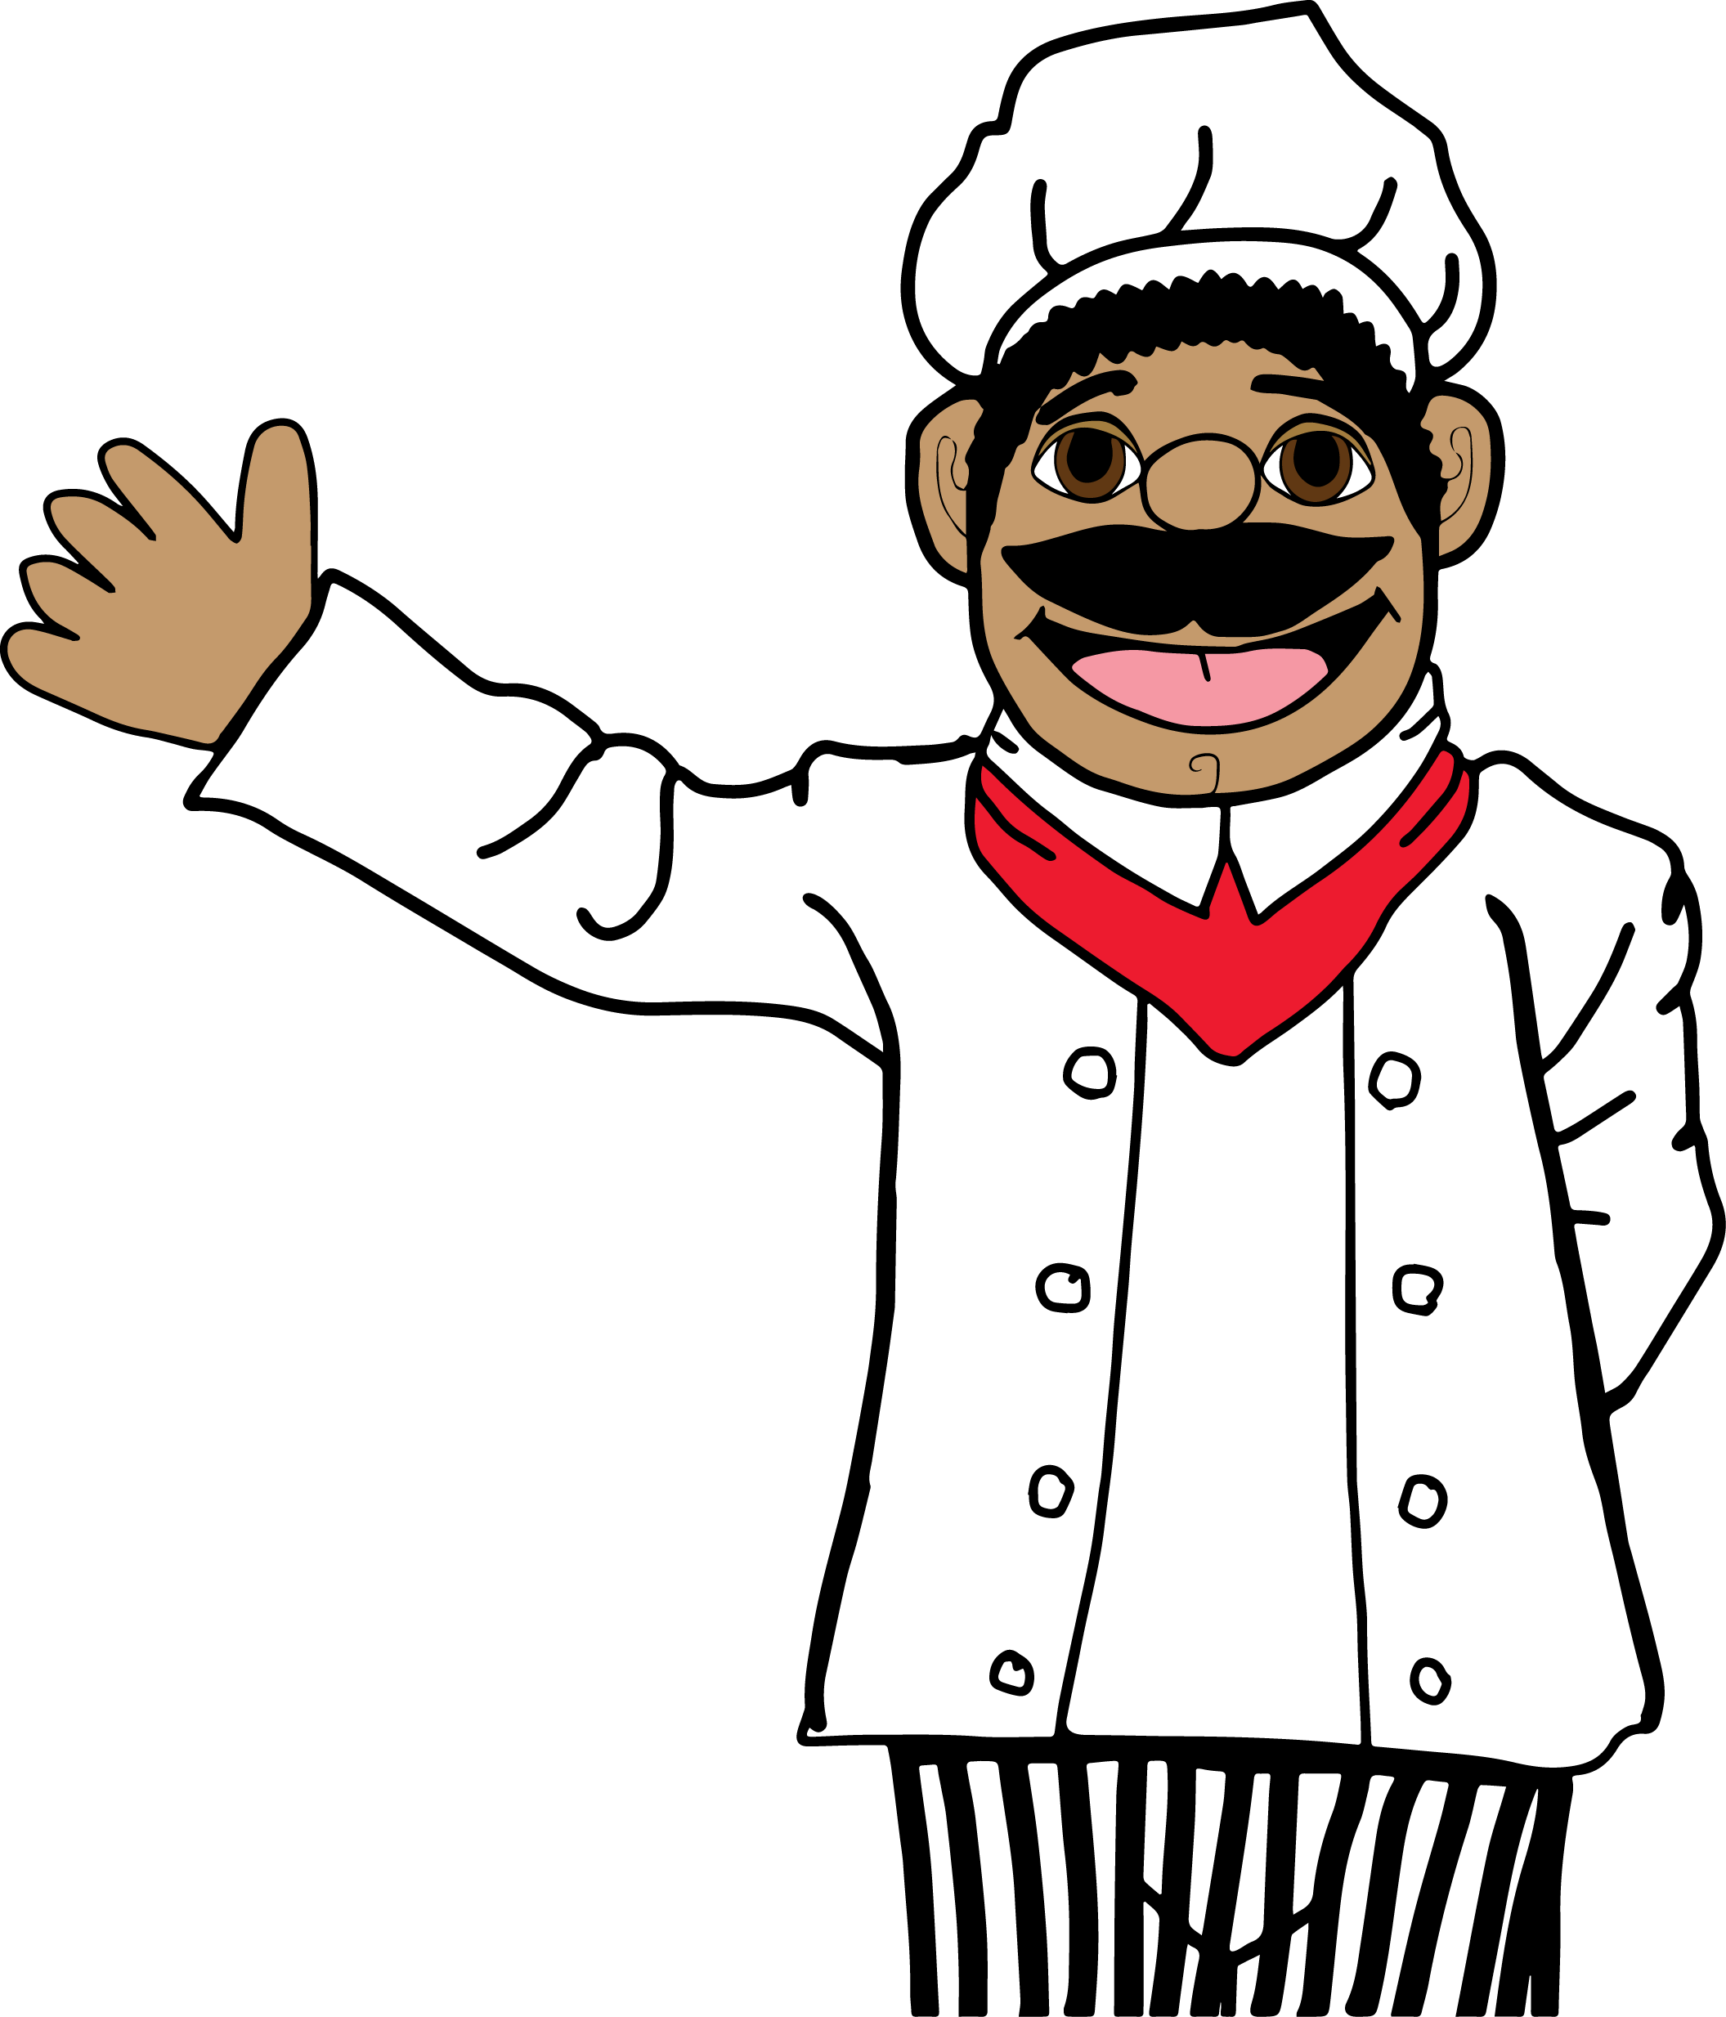
EAT SMART:
Choose a variety of foods each day.
Let’s try it!

Slide 4
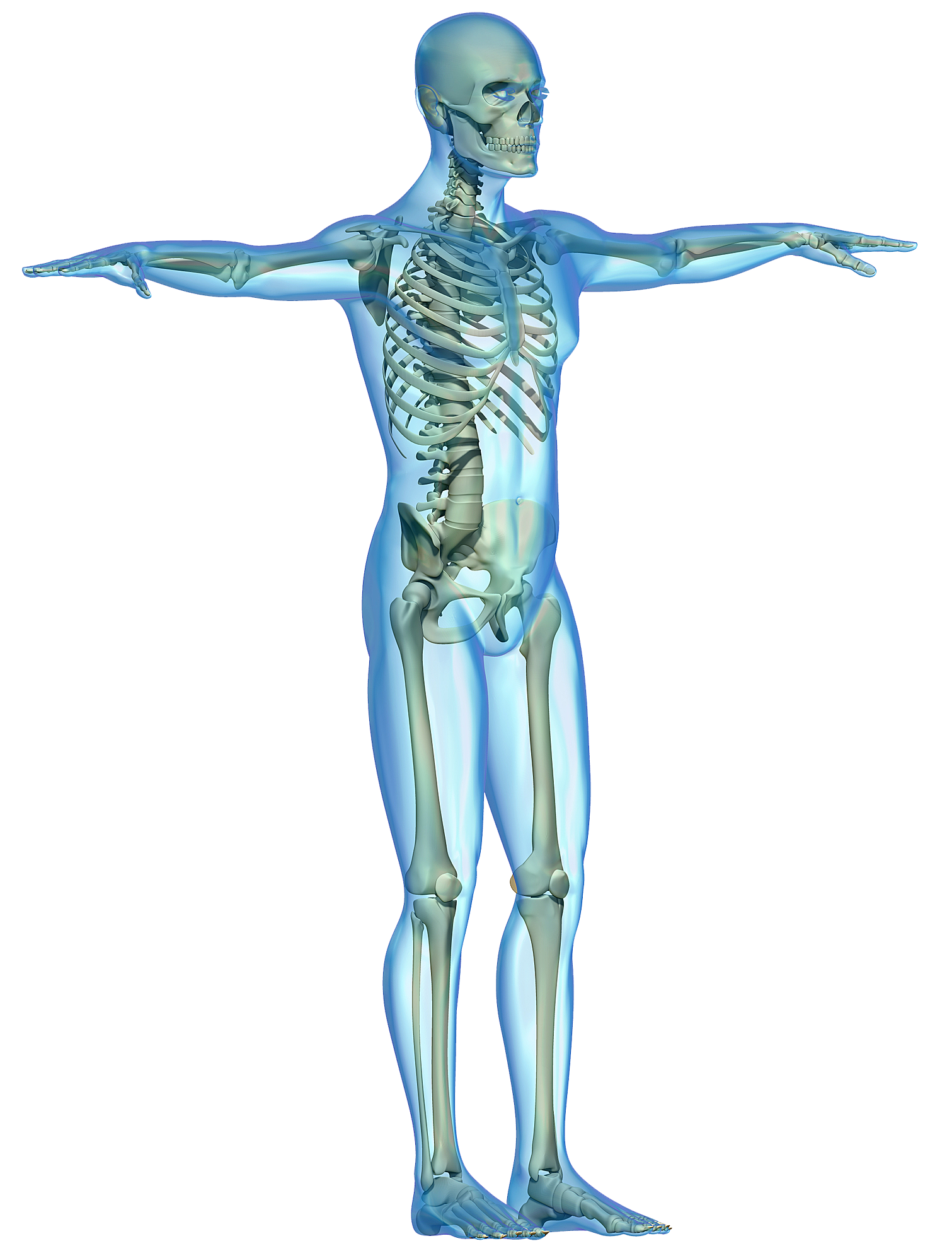

Slide 5
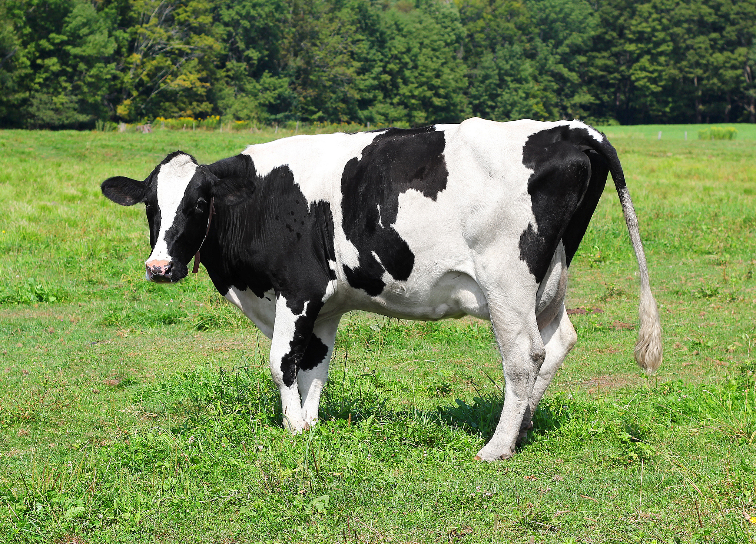

Slide 7
Astronaut training song
(Sing to the tune of “London Bridge Is Falling Down”)
Astronauts are strong and fit, strong and fit, strong and fit.
Astronauts are strong and fit—we do exercise.
Astronauts stretch way up high, stretch way up high, stretch way up high.
Astronauts stretch way up high—we keep strong and fit.
Astronauts reach way down low, way down low, way down low.
Astronauts reach way down low—we keep strong and fit.
Astronauts circle their arms, circle their arms, circle their arms.
Astronauts circle their arms—we keep strong and fit.
Astronauts twist and turn, twist and turn, twist and turn.
Astronauts twist and turn—we keep strong and fit.

Slide 8
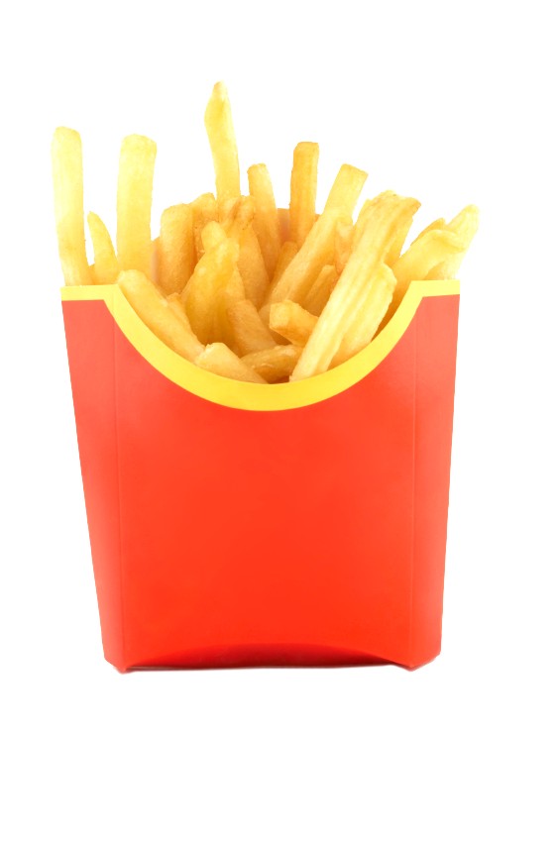
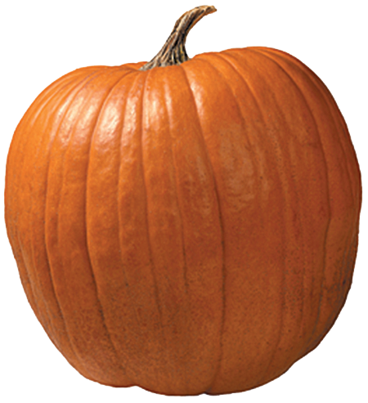
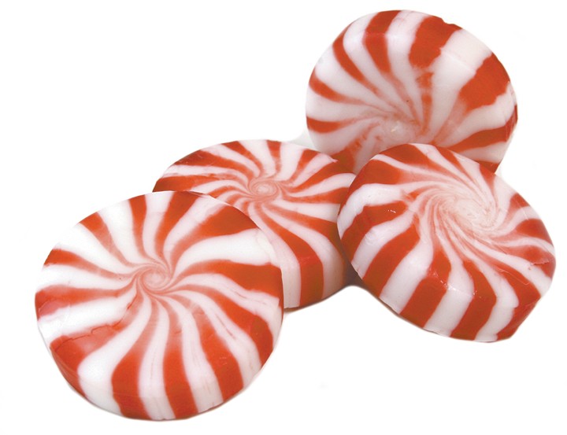
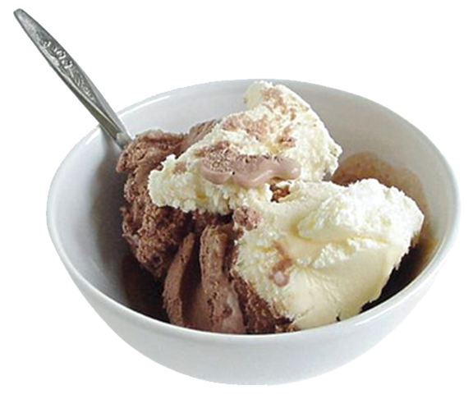
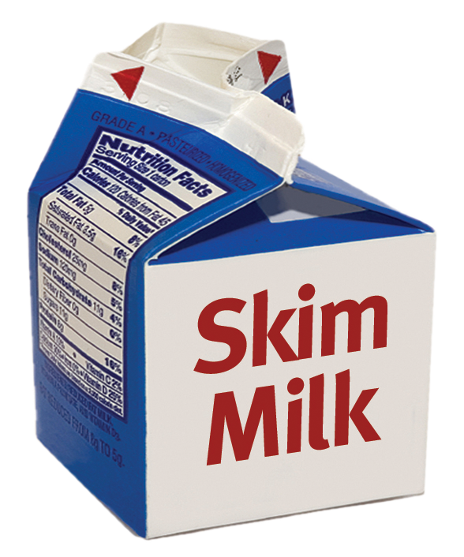
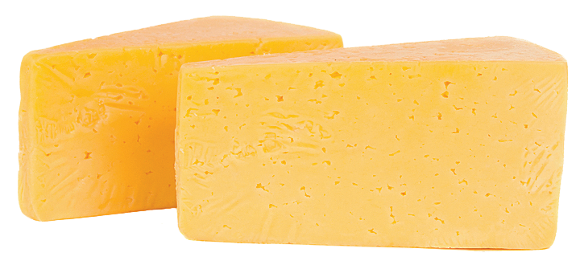

Slide 9
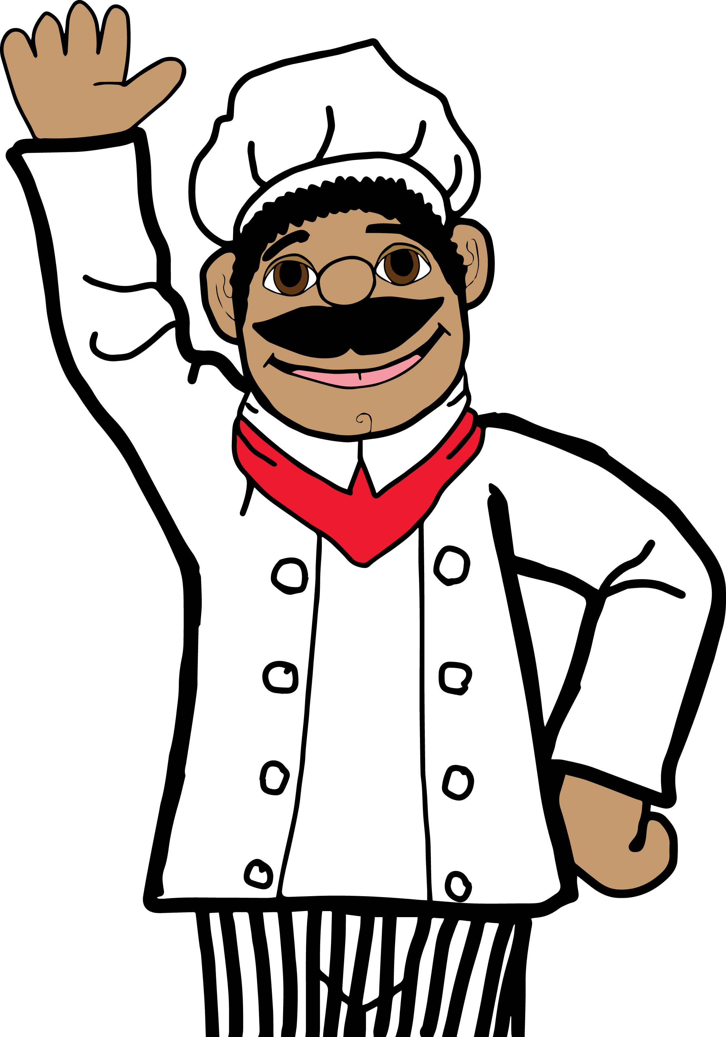
Drink milk
Choose dairy foods for meals and snacks.

