Slide 1



Adapted with permission from Show Me Nutrition,
University of Missouri Extension.

Slide 2


Slide 3






Doughnut
Whole wheat bread
Whole grain tortilla
Cake
Brown rice
Large biscuit

Slide 4


Slide 5






Baked potato
French fries
Grilled zucchini
Fried zucchini
Vegetable soup
Creamy potato soup

Slide 6


Slide 7
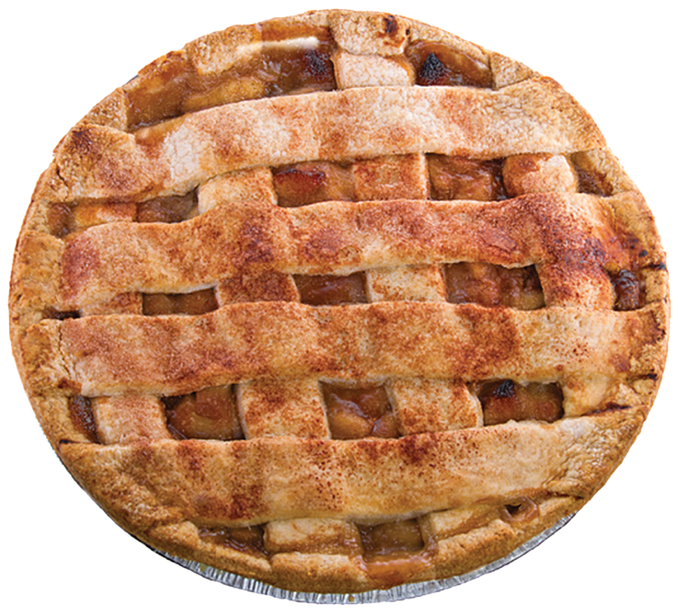



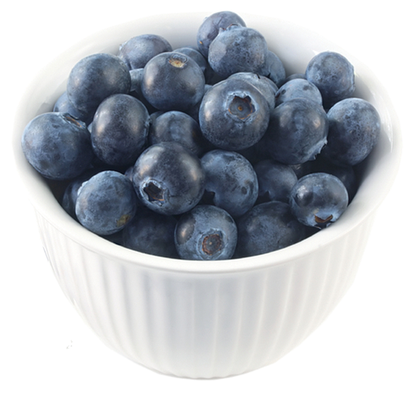

Apple
Apple pie
Pineapple
Pineapple cake
Blueberries
Blueberry cobbler

Slide 8


Slide 9




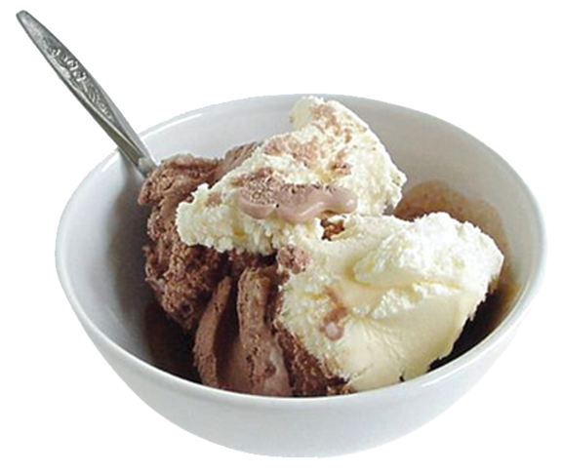

Low-fat milk
Whole milk
Milkshake
Low-fat cheese
Low-fat yogurt
Ice cream

Slide 10


Slide 11
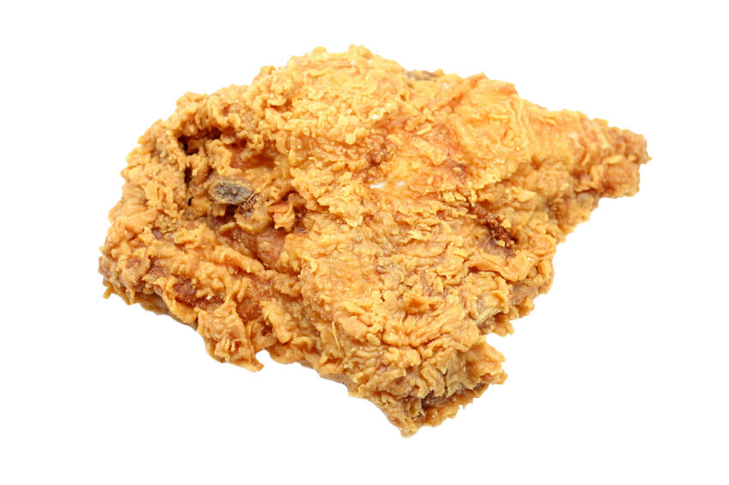
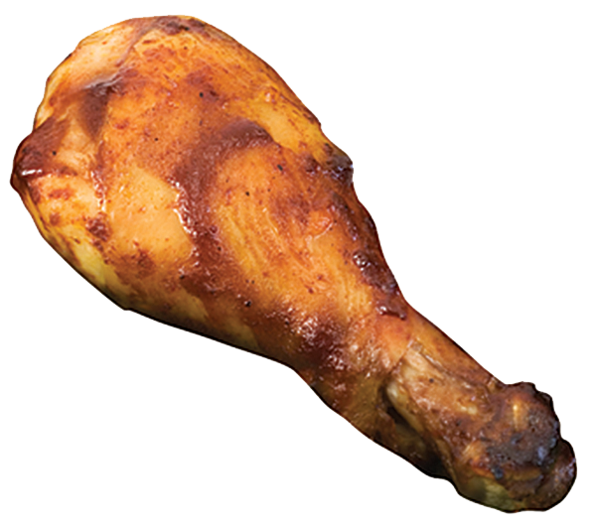




Grilled chicken
Fried chicken
Pork chop
Broiled fish
Fish sticks
Hot dog

Slide 12





Slide 13


EAT SMART:
Choose a variety of foods each day.
Let’s try it!

Slide 20

Choose a variety
of healthy foods.
Be active every day.

