Slide 1



Adapted with permission from Show Me Nutrition,
University of Missouri Extension.

Slide 2




Slide 4
Brush, brush, brush your teeth,
Brush them night and day.
Keep them clean and shiny white,
Send tooth decay away!

Slide 5


Slide 6
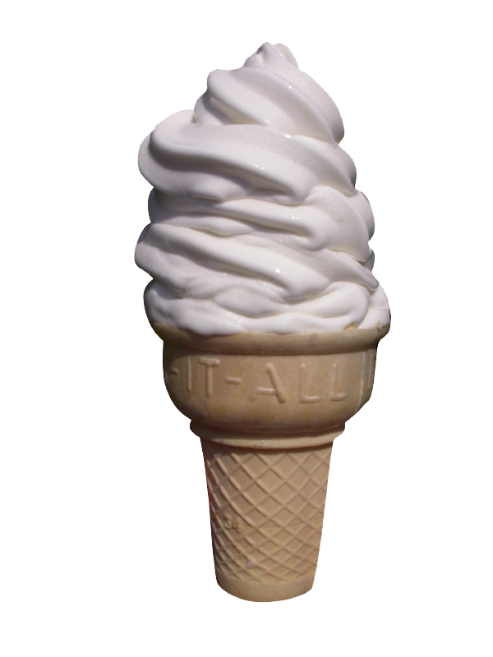
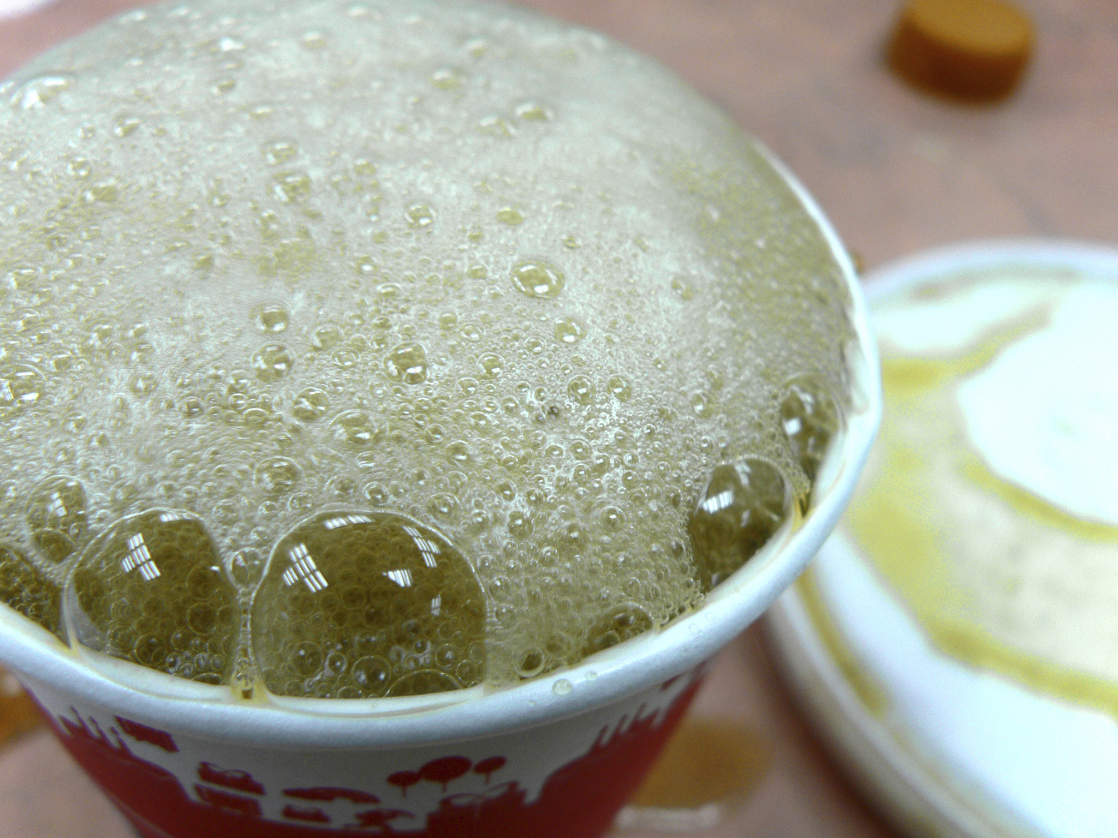

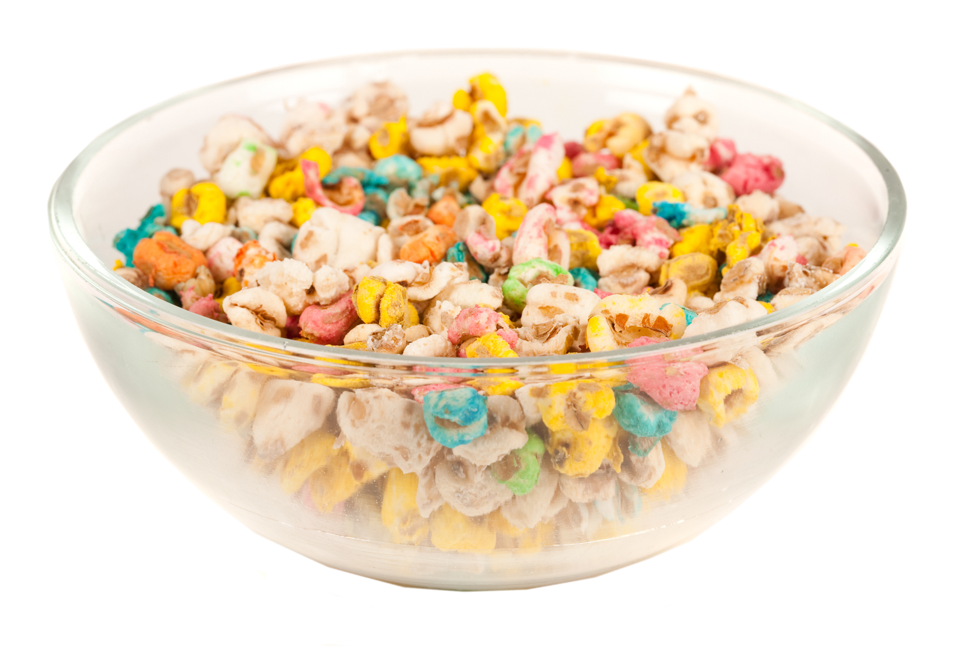

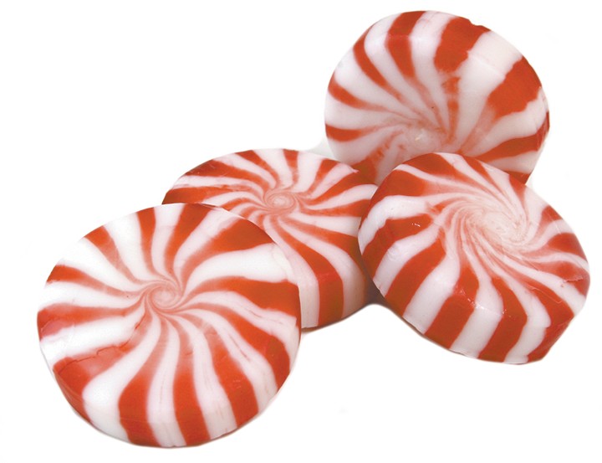

Slide 7

EAT SMART:
Choose a variety of foods each day.
Let’s try it!

